Slide 1
WIND ENRGY STATUS : PAKISTAN
ASIAN CLEAN ENERGY FORUM 2011
2ND ADB Quantum Leap in Wind Conference
GOVERNMENT OF PAKISTAN
June 20 , 2011
Notes:
1

Slide 2
ENERGY SCENARIO: PAKISTAN
Electrical Energy Sector Overview:
Total Installed Electricity Generation 19,420 MW
Capacity
  Thermal (fossil-fuels): 12,487 MW (64% share)
  Hydel: 6,480 MW (33% share)
  Nuclear: 462 MW (2% share)

Slide 3
ENERGY SCENARIO: PAKISTAN

Slide 4
Energy Sector Overview
Population: 176.34 million
Electrification Rate: 62.4%
Population Connected to Gird: 102.6 million

Slide 5
Energy Sector Overview
Energy Stakeholders:
Ministry of Water and Power
Ministry of Petroleum and Natural Resources
Water and Power Development Authority (WAPDA)
National Electric Power Regulatory Authority (NEPRA)
National Transmission and Despatch Company (NTDC)
Private Power and Infrastructure Board (PPIB)
Alternate Energy Development Board (AEDB)
Pakistan Atomic Energy Commission (PAEC)
Oil and Gas Regulatory Authority (OGRA)
Oil and Gas Development Company Limited (OGDCL)
Oil Marketing Companies (OMCs)
Provincial organizations

Slide 6
Renewable Energy
Yearly increase in Energy Demand 7-10%
Current Total Installed Capacity 19,420 MW
Projected Demand by 2030 162,590 MW
Share of Renewables by 2030 9700 MW *(i.e. at least 5% share)
* Source: Mid Term Development Framework, Planning Commission, Govt. of Pakistan

Slide 7
*RE POLICY: Unique Features
Wind Risk - responsibility of GoP
Guaranteed Electricity Purchase
Grid provision is the responsibility of the purchaser
Attractive Tariff (17%-18% ROE)
Counter Guarantee by multilaterals for first few projects
Special Incentives by the State bank for up to 10 MW plants
No Import Duties on Equipment
Zero Sales Tax
Net Metering
Banking of Electricity
Wheeling Provisions
Grid Spill Over Concept introduced
Carbon Credits
*Revised Policy expected to be submitted to CCI for approval.

Slide 8
Electricity Tariff For Wind as Determined by NEPRA
Sr. No. | Name of IPP | Project Capacity (MW) | Tariff (US $ Cents per kWh)
1 | Dawood Power Ltd. | 49.5 | 11.87
2 | Zorlu Enerji Pakistan Ltd. | 49.5 | 12.1057
3 | Arabian Sea Wind Energy Pvt. Ltd. | 49.5 | 11.9201
4 | FFC Energy Limited | 49.5 | 16.109

Slide 9
Total Installed Capacity
Currently first phase of 06 MW has been installed by an IPP.
Projects in Pipeline:
IPPs expected to achieve Financial Close for 50 MW each this year;
  FFC Energy Ltd.
  Zorlu Enerji
  CWE
  Tenaga Genarasi
  Fauji Foundation (100 MW)
  Lucky Energy
  Gul Ahmed Power
  Metro Power
Year | Financial Close | COD
2011 | 400 MW | 6 MW
2012 | 150 MW | 100 MW
2013 | 300 MW | 400MW

Slide 10
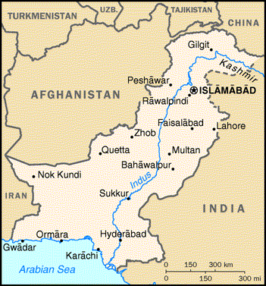
Wind Resource Potential
70,000 – 80,000MW harnessable potential
50,000 MW in Gharo-Keti Bandar and Jhampir corridors.
  Average Wind Speed 7 + meters / sec
  At 60 m height
Sites in Baluchistan, Punjab and Northern Areas being identified
Gharo Wind Corridor
Notes:
Pakistan has a 1,046 Km coastline in the South
Average wind speed more than 7 m/s in Gharo Wind Corridor
Estimated wind potential more than 50,000 MW
Other sites in Balochistan and Northern Areas being identified

Slide 11
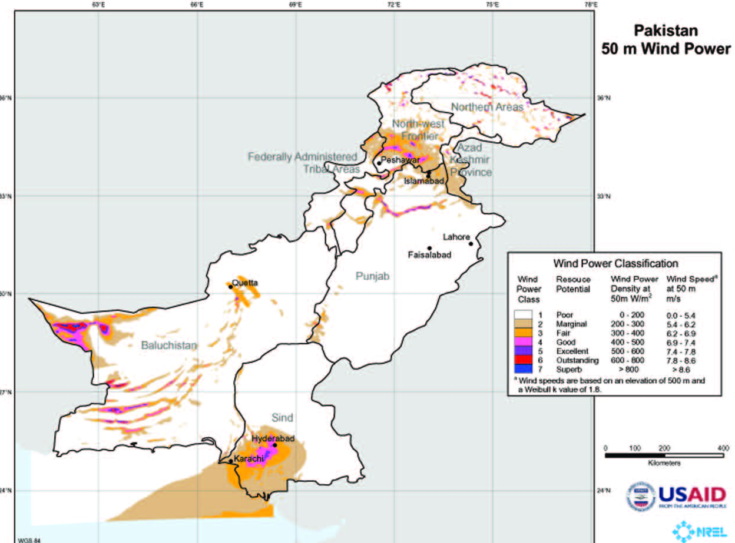
Pakistan Wind Map
Developed by National Renewable Energy Laboratory, USA
30,000MW
30,000MW
30,000MW
180,000MW
3,000MW
40,000MW
50,000MW

Slide 12
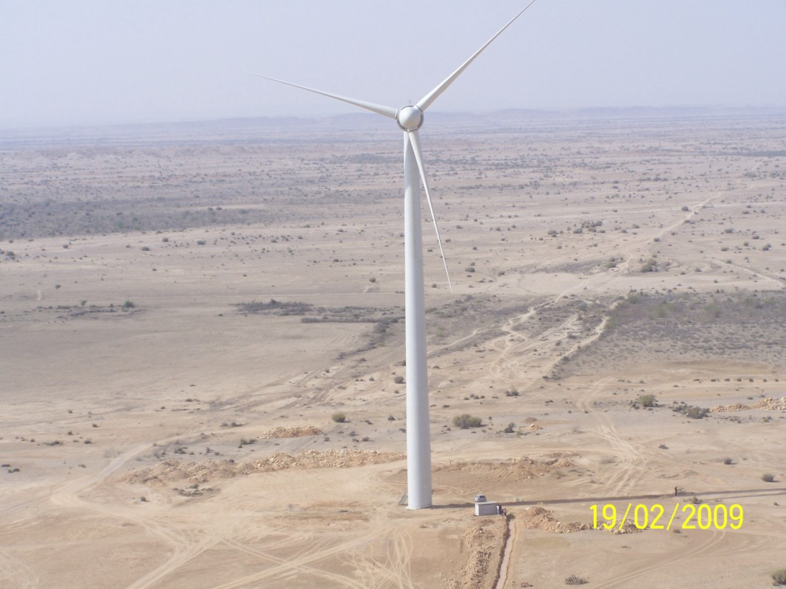
First Wind TurbineIinstalled by M/s Zorlu Enerji at Jhampir, Thatta

Slide 13
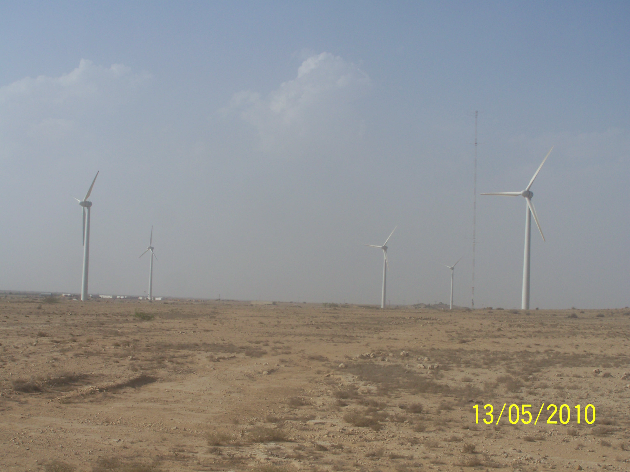
06 MW Wind Power Project (Phase-1) by M/s Zorlu Enerji at Jhampir, Thatta

Slide 14
Next Steps
Detailed Resource Mapping
  In order to develop potential areas, detailed wind resource assessment is required.
  Wind measuring masts being installed in potential areas. More wind measuring masts need to be installed all over Pakistan in order to establish detailed wind resource of Pakistan.
LAND (Availability & Security)
  Several project proposals can be encouraged by availability of land.

Slide 15
Next Steps
Tariff by NEPRA
  Cumbersome cost-plus tariff determination process – Requires firm turbine and EPC contracts as well as Lenders’ term sheet prior to submissions.
  Sometimes extends beyond validity of the Equipment, EPC and lender contract validities.
  Feed-in-Tariffs /Upfront tariffs being recommended in the draft RE policy to reduce project development time by up to 10 months, and attract more foreign investors.

Slide 16
Thank YOU

