Slide 1
Wind Development in China
Hu Runqing
Energy Research Institute, NDRC, China

Slide 2
Energy sector overview
Population: 1370 M
Electrification rate: 99.6%
Population unconnected to grid: 5 Million
Deficit in energy in 2008:
    Total energy available for consumption 2.87 B tce
        Primary energy output: 2.60 B tce
        Imports: 370 M tce
        Exports: 99 M tce
    Total energy consumption 2.91 B tce

Slide 3
Energy consumption
Quick economic increase brings quick increase of energy consumption
  More than expected
Demand for RE also increases
RE must be faster than expected

Slide 4
Power generation
 | capacity |  | generation
 | GW | % | TWh | %
total | 962 |  | 4228
hydro | 213 | 22% | 686 | 16%
coal | 707 | 73% | 3415 | 81%
nuclear | 11 | 1% | 77 | 2%
wind | 31 | 3% | 50 | 1%
others | 0.26 | 0% | 0.3 | 0%

Slide 5
Energy consumption
Total energy consumption
  2009: 3.06 B tce, increase rate 5.2%
  2010: 3.25 B tce, increase rate 5.9%
Composition in 2009
  Coal: 70.4%
  Crude oil: 17.9%
  Natural gas: 4.3%
  Hydro-power, nuclear power, wind power: 7.8%

Slide 6
RE target
Renewable energy target: 15% in 2020
Barrier: energy consumption increase very quickly, renewable energy target had to change

Slide 7
RE development situation 2010
Total RE: 286 M tce, 8.8% of energy consumption
  Hydro power: 213 GW, 78% of RE
  Wind capacity: 31 GW, 5% of RE
  PV: 800 MW
  Solar water heater: 170 M m² , 19.55 M tce, 6.8% of RE
  Biomass: 22.66 M tce, 9% of RE
Comparing:
  2009: 258 M tce, 8.34%;
  2008: 250 M tce, 8.8%
RE developed very quickly, but proportion didn’t increase

Slide 8
Renewable energy policy
Wind:
  Onshore: fix price according to wind resource
  Offshore: concession projects bidding
  VAT: 50% off
PV:
  Subsidy for woof system
  Bidding price for large scale PV concession projects
SWH: commercialized already
  Subsidy for rural customers
  Mandatory installation by local governments
Biomass:
  Fix price for biomass generation, but not for co-firing
  Subsidy for pullet

Slide 9
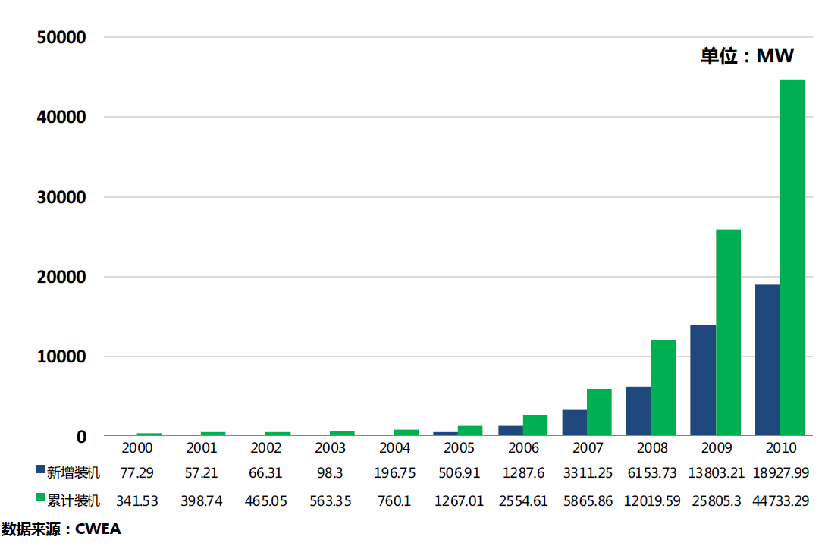
Wind developed very quickly
New installation doubled in last 5 years
Total capacity more than 44GW
图5 2000-2010年中国历年风电装机容量

Slide 10
Manufacture developed very quickly
Top 10 manufactures cover more than 85% of total market
40 assembling companies
Capacity
  Sinovel, Golden Wind, Dongqi are more than 2000MW respectively
  Union Power and Mingyang are more than 1000MW
Output
  Golden wind, Sinovel and Dongqi are more than 10 GW
Foreign companies’ share decreased
Top 10 manufactures for new installation
 | Company | Capacity MW | Market share
1 | 华锐 | 4386 | 23.2%
2 | 金风 | 3735 | 19.7%
3 | 东汽 | 2623.5 | 13.9%
4 | 联合动力 | 1643 | 8.7%
5 | 明阳 | 1050 | 5.5%
6 | Vestas | 892.1 | 4.7%
7 | 上海电气 | 597.85 | 3.2%
8 | Gamesa | 595.55 | 3.1%
9 | 湘电风能 | 507 | 2.7%
10 | 华创风能 | 486 | 2.6%
 | 其它 | 2411.99 | 12.7%
 | 总计 | 18927.99 | 100%

Slide 11
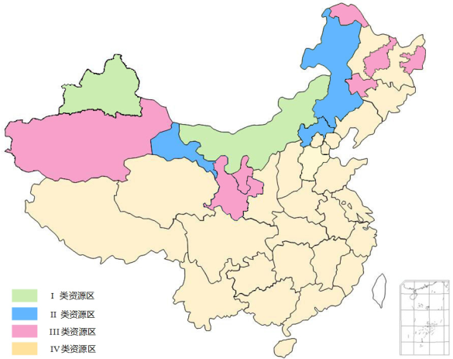
Wind price and distribution
0.54 RMB/kWh
0.58 RMB/kWh
0.51RMB/kWh
0.61RMB/kWh

Slide 12
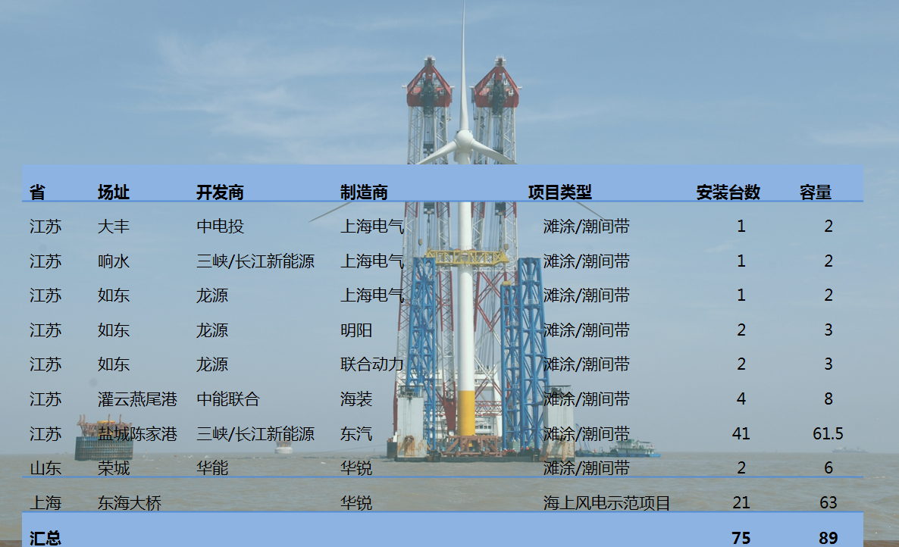
1 GW offshore wind concession projects have been confirmed

Slide 13
Wind target
Wind Target in 2007
  2010: 5 GW 2010 real: 45GW
  2020: 30GW
Wind target discussed now
  2015: 100 GW
  2020: 150-200GW
  2030: 300 GW, 10% of total electricity

Slide 14
Electricity Cost:
Subsidies and Incentives
RE Subsidies
Fossil Fuel Subsidies
RE Source | Base Rate ($/kWh) | Subsidy
Wind | 0.51-0.61RMB/kWh 0.078-0.094 $/kWh
Solar |  | 50% for on-grid systems 70% for off-grid systems
Biomass generation | 0.75RMB/kWh 0.115 $/kWh
Others
Fossil Fuel | Base Rate ($/kWh) | Subsidy ($/kWh)
Coal | 0.23-0.44 RMB/kWh 0.035-0.067 $/kWh | no

Slide 15
Wind Resource Potential
Exploitable potential:
  >150W/m2 at 10 m height (5.4 m/s)
  >300W/m2 at 50 m height (6.7 m/s)
Following number are at 50 m height, announced by Wind and Solar Resource Center
Region | Total area (10⁴km²) | Wind resource coverage (10⁴km²) | Exploitable potentials (10⁸kW)
Onshore (50m height, 2009) | ≈960 | 146.4 | 23.8
Offshore (<Water depth 25) | 20.6 | 20.6 | 2.1

Slide 16
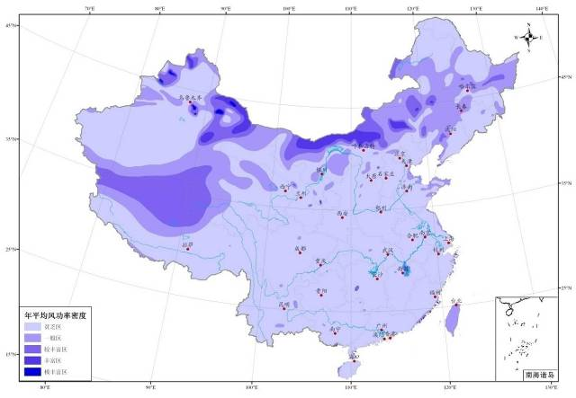
Wind map in 10 m height
Exploitable potentials 2.97 10⁸ kW
Wind resource coverage: 20*10⁴ km²

Slide 17
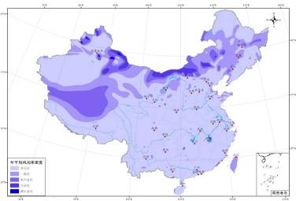
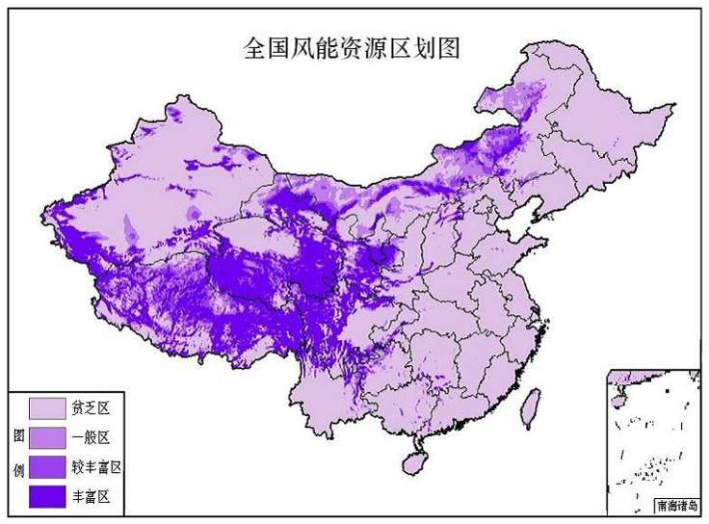
Wind map in 50 m height
Region I
<300W/m²
Region II
300W/m²-400W/m²
Region III
400W/m²-500W/m²
Region IV
≥500W/m²

Slide 18
Major barriers
Grid connection is biggest challenge
  Grid planning can’t match wind planning
  wind farm in 2010 didn’t connect to the grid on time
Order of wind market development is lack
  Without planning, or not according to planning
  Wind developer has serious competition
Over supply of wind turbine appears
  Domestic manufactures development very quickly
  International manufactures also enter China
  Wind turbine price is lower than 4000RMB/kW (615$/kW)
Quality of domestic wind turbine need to be proofed

Slide 19
Wind resource concentrated

Slide 20

Grid connection is largest challenge
东 北
吉林
蒙东
辽宁
哈密
蒙西
酒泉
河北
西 北
Load region
西 藏
江苏
南 方

Slide 21
Next step
Wind energy will keep high increase rate
Three changes need be done:
  Wind development speed
    → wind development quality
  Installed capacity
  → wind electricity generation
  Concentrated and scale-up wind farm
    → scale-up wind farm and distributed wind farm

Slide 22
Thanks！
Hu Runqing hurunqing@amr.gov.cn

