Slide 1
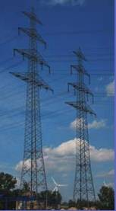
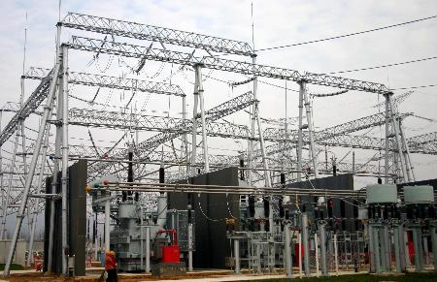
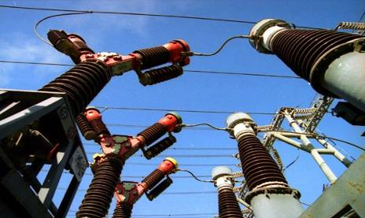
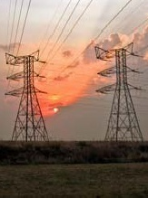
Introduction of National Wind and Solar Energy Storage and Transmission Demonstration Project
Yao Hongchun
China Electric Power Research Institute

Slide 2

1. Project Overview
2. Technical Scheme of the Project

Slide 3
Project Overview
Prominent problems in new energy generation in China
  We need to improve power generation characteristics as the new energy sources are currently random, volatile and intermittent.
  We need to improve grid source coordination as it’s now difficult to do effective forecast, dispatch and control.
  The resources have distinct geographical features with reverse distribution against the demand, which calls for effective allocation of the resources.

Slide 4
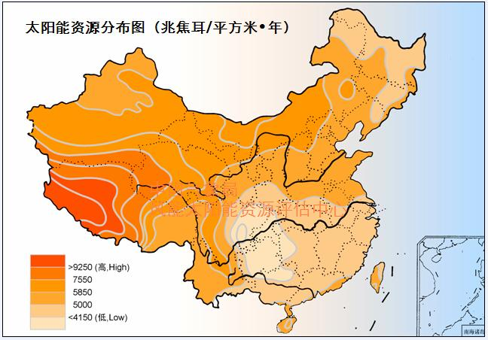
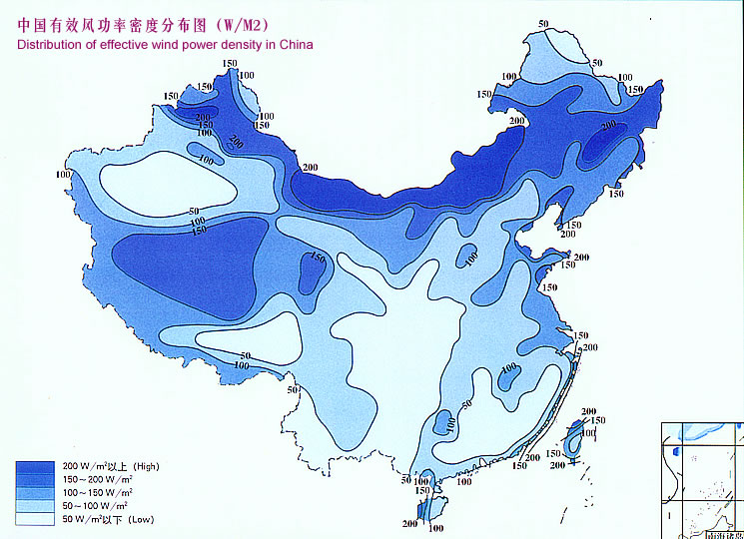
Project Overview
Overview of the Demonstration Project
National Wind and Solar Energy Storage and Transmission Demonstration Project is located in Bashang area within the territory of Zhangbei County and Shangyi County, Zhangjiakou, Hebei Province. It’s 20km from Zhangbei County, about 50km from Zhangjiakou and around 200km from Beijing.
Planned total capacity: 500MW for wind power generation,100MW for PV power generation，70～110MW for energy storage system. For Phase I, the proposed total capacity for wind power generation is 100MW, PV 40MW and 20MW for energy storage system.
Solar resources distribution diagram (MJ/m^{2 ●} year)
Zhangbei: 3000 annual illumination hours
Zhangbei: 70m high mean annual wind velocity 6.4-8m/s, 200-450W/m²

Slide 5
Project Overview
Wind-PV complementarities and energy storage analysis
An analysis on wind & PV resources in Zhangbei area tells us that when wind to PV ratio ranges 10:0~10:10, the combined output fluctuates between 30%－12%. Therefore, to improve the wind-PV complementary properties can help to overcome output fluctuation.
Research indicates that the smaller the wind to PV ratio is, the more significant the energy storage stabilization can be; when energy storage capacity is 20-40MW, the efficiency to stabilize fluctuation reaches the maximum; if energy storage capacity ranges 60-80MW, the stabilizing effect is optimum.

Slide 6
Project Overview
Technical path of the demonstration project
机组控制
场站控制
机组控制
场站控制
风电特性分析
机组控制
场站控制
风电特性分析
风电特性分析
机组控制
场站控制
机组控制
场站控制
机组控制
场站控制
机组控制
场站控制
机组控制
场站控制
风电特性分析
Wind & solar
power
generation control
technologies
风电特性分析
风电特性分析
风电特性分析
风电特性分析
Analysis of wind
power properties
改善
不确定性
改善
不确定性
改善
不确定性
改善
不确定性
改善
不确定性
改善
不确定性
改善
不确定性
改善
不确定性
Improving
uncertainties
光伏特性分析
Combined power generation intelligent monitoring
光伏特性分析
光伏特性分析
光伏特性分析
光伏特性分析
光伏特性分析
光伏特性分析
光伏特性分析
Analysis of
PV properties
Smooth output
Output tracking
Load shifting
Friendly interaction between source and grid
Mutual development
Energy storage
technology
integration
大容量
储能系统
大容量
储能系统
大容量
储能系统
大容量
储能系统
大容量
储能系统
大容量
储能系统
大容量
储能系统
大容量
储能系统
储能技术
系统集成
储能技术
系统集成
储能技术
系统集成
储能技术
系统集成
储能技术
系统集成
储能技术
系统集成
储能技术
系统集成
储能技术
系统集成
Large-capacity
energy storage
system
协调
配置
协调
配置
协调
配置
Coordinated
configuration
协调
配置
协调
配置
协调
配置
协调
配置
协调
配置
Participating in system
frequency regulation
Weather forecast &
forecast model
Combined
prediction system
Output
prediction
Adjustability improvement

Slide 7
1. Project overview
2. Technical Scheme of the Project

Slide 8
Technical Scheme
General structure of wind-PV storage and transmission system
Legend:
Energy-storage-based power generation
PV power generation
Wind-solar power generation
Control signal
220kV Intelligent substation
Unified solid intelligent grid
Wind power generation
Operation mode of 7 modes of configuration (incl. wind, solar, energy storage)
Power generation based on wind & solar energy and energy storage
Power generation based on wind energy and energy storage
Two-way conversion
Power generation based on solar energy and energy storage
Energy storage station
Note:
Combined power generation intelligent monitoring system can perform optimal control over energy storage devices, wind power units as well as PV array according to dispatch curves, wind and illumination, which can turn fluctuating wind and PV power into high-quality electric power.
100MW wind farm
40MW PV power station
20MW energy storage station
Combined power generation intelligent monitoring system

Slide 9
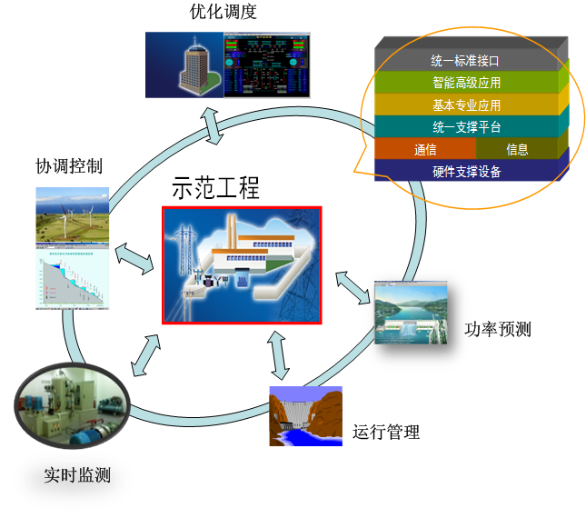
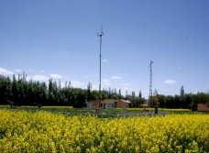

Technical Scheme:
Intelligent Monitoring System
Schemes for intelligent monitoring system for combined power generation
Optimized dispatch
Rested on control concepts of centralized decision-making and distributed execution, such integrated monitoring system functions to realize joint operation with coordinated multi-control targets (smooth output, tracking plan, AGC support, load shifting, etc.) under different modes of combination (i.e., wind, solar, storage, wind +solar, wind + storage, solar + storage, wind + solar +storage) and diverse time scales (steady, dynamic, transient). concepts
Uniform standard interface
Senior intelligent application
Basic professional application
Uniform support platform
Coordinated control
Communication
Information
Demonstration project
Hardware support equipment
Power forecast
Operation management
Real-time monitoring

Slide 10
Technical Scheme:
Intelligent Monitoring system
Functions of intelligent monitoring system for combined power generation
1
Data acquisition and combined monitoring for wind + solar+ storage combination
2
Power generation prediction for wind + solar+ storage combination
3
Combined control for wind + solar+ storage combination
4
5
Wind + solar+ storage data analysis and evaluation
Combined optimized scheduling for wind + solar+ storage combination
6
7
Realization of communication with grid scheduling system
Realization of communication with farm station

Slide 11
Technical Scheme of Project:
Wind Farm
Principle to Select Wind Power Generation Unit Types
Selection principles
Combining two different technical paths
Units that are grid connection friendly
Catering for intelligent monitoring system for combined power generation
Prioritizing both wind turbine safety and reliability
Leading wind turbine capacity development

Slide 12
Technical Scheme:
Wind Farm
Wind turbine configuration
Demonstration area (50MW) | Display area (50MW)
2.0MW wind turbine (24 sets) | 2.5MW wind turbine (15 sets) 1MW vertical-axle wind turbine (2 sets) 3.0MW wind turbine (2 sets) 5.0MW wind turbine (1 set)

Slide 13
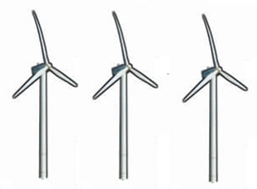



Technical Scheme:
Wind Farm
Diagrams of technical schemes in wind farm
Full mastery of
technologies
such as passive
Comprehensive control,
wind farm active
Control and LV ride
through
Independently
developing
communication
control devices of
wind farms
Independently
developing
intelligent
monitoring
system for
combined power
generation
Realizing
seamless
connection with
higher-level
scheduling

Slide 14
Technical Scheme:
PV Power Station
Configuration of major equipment in PV power station
PV modules
S.N. | Type of module | Capacity (kW) | Mode of installation
1 | Polycrystalline silicon PV module | 35000 | Fixed installation
 |  | 1500 | Inclined uniaxial tracking
 |  | 500 | Even uniaxial tracking
 |  | 50 | Biaxial tracking
2 | Sunpower PV module | 500 | Fixed installation
 |  | 500 | Inclined uniaxial tracking
3 | Monocrystalline silicon PV module | 1000 | Fixed installation
4 | Non-crystalline film PV module | 1000 | Fixed installation
For PV inverters, 630kW (16 sets) and 500kW (60 sets) are adopted.

Slide 15
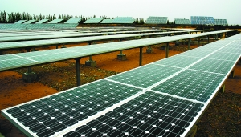
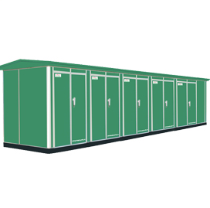
Technical Scheme:
PV Power Station
Diagrams for technical schemes for PV power station
Independently
developing
intelligent
monitoring
system for
combined power
generation
Displaying various
PV modules and
supports
Full command of
technologies
associated with
large-capacity
grid-connected inverters
Independently
developing
communication
control devices of
PV power stations
Realizing
seamless
connection with
higher-level
scheduling

Slide 16
Technical Scheme:
Energy Storage Power Station
Energy storage system improves access capacity related to wind-solar combined power generation from three aspects.
Smooth fluctuation of combined power generation, enhanced controllability and reduced reserve capacity.
Tracking planned generation output , improving predictability of combined power generation and decreasing output deviation
Participating in peak load shaving of the grid and enhancing dispatchability of the system
Simulated calculation reveals that the basic configuration power for energy storage is ~ 20MW and the capacity is about 90MWh.

Slide 17
Technical Scheme:
Energy Storage Power Station
Comparison of the overall performance of energy storage cells
 | Price | Reliability risk | Project realizable risk | Safety and environmental risks | Demon result | Technical flexibility | Configuration principle
Sodium- sulphur cell | High | High | Low | Medium | Good | Low | Appropriate proportion
Electrochemical flow cell | High | Low | High | High | So-so | High | Low proportion
Lithium-ion cell | Low | Medium | Medium | Low | So-so | High | High
Through comparative analysis on energy storage systems of the three types of cells in terms of technical risks, technical reasonability and technical flexibility, they have advantages of their own in properties. But in our project, we found that the energy storage system of the lithium-ion cell is the best regarding the overall performance, followed by that of the sodium-sulfur cell; that of the electrochemical flow cell is relatively poor.

Slide 18
Technical Scheme:
Energy Storage Power Station
Configuration schemes of energy storage systems
 | Output power | Energy storage capacity | Price (10,000 yuan) | Floor area (m²)
Energy storage of lithium-ion cell | 14MW | 64MWh | 24000 | 7000
Energy storage of sodium-sulpher cell | 4MW | 24MWh | 16000 | 1000
Energy storage of vanadium redox flow (VRB) cell | 2MW | 8MWh | 6000 | 2000
Total (rated output) | 20MW | 96MWh | 46000 | 10000
Total (practical output) | 28MW | 96MWh | - | -
Features:
We introduced technologically matured sodium-sulfur cell which helped to reduce technical risks;
We introduced three types of energy storage cells with diversified energy storage devices, which is conducive to comparative analysis on the performance of different energy storage technologies;
The power and capacity configurations can guarantee the application in Phase I project.

Slide 19


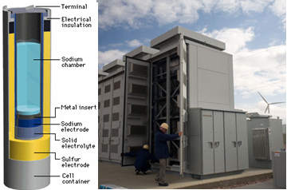
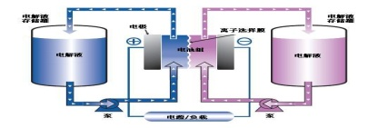
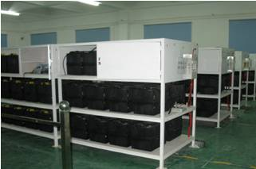
Technical Scheme:
Energy Storage Power Station
Structure diagrams of energy storage system
We aim to build world-class large-capacity energy storage systems, conduct in-depth study on multiple applications such as smooth output, track dispatch and scheduling curve, and peak load shaving and explore the values of energy storage systems in promoting large-scale new energy grid integration.
Independent development of
intelligent monitoring
system for combined power
generation
Realizing
seamless
connection with
higher-level
scheduling
Independent development of
energy storage
monitoring system
Sodium-sulphur energy
storage system
Flow energy
storage system
Lithium-ion energy
storage system

Slide 20
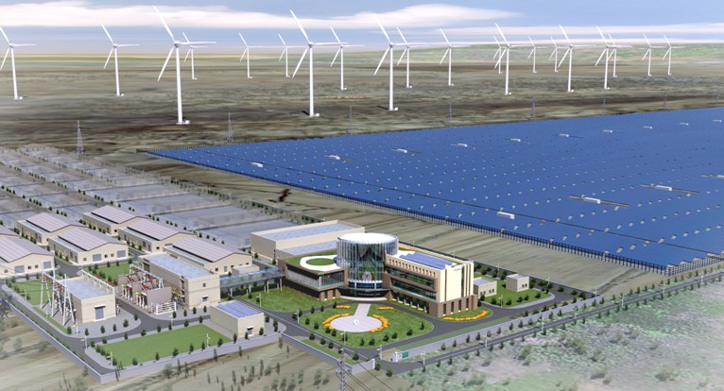
课题申请单位及主要参与单位研究基础
Thanks!
19

