Slide 1
Operation &Control Technologies for New Energy Power Generation and Grid Integration
China Electric Power Research Institute
Sep. 21, 2013

Slide 2



Contents
1
Overview of New Energy Power Generation Development
2
Challenges to Grid Operation by New Energy Integration
3
Adaptive Requirement of the Grid to New Energy Integration
4
Key Operation & Control Technologies for New Energy Grid Integration
5
Conclusion and Outlook

Slide 3

1. Overview of New Energy Power Generation Development
Overview of Wind Power Development
In 2012, newly-increased global installed capacity of wind power was approximately 44GW, with a year-on-year increase of less than 20%, further experiencing a slow-down in growth. It’s basically in a development stage with relatively flat growth. By the end of 2012, the total global installed capacity of wind power reached 282GW.
单位：GW
Unit: GW
Global newly- increased installed capacity
Global accumulated installed capacity
Notes:
3

Slide 4
1. Overview of New Energy Power Generation Development
Overview of Wind Power Development
China’s national installed capacity of wind power increased from 2540MW to 78.26GW in the past seven years between 2006 and 2012, which is far higher than global average growth.
In 2012, on-grid wind energy across the country amounted to 100.8 billion kWh，accounting for about 2% of national power generation.
单位：GW
Unit: GW
China newly-increased installed capacity
China accumulated installed capacity
Notes:
4

Slide 5
1. Overview of New Energy Power Generation Development
Overview of PV Power Development
In 2012, global newly-increased PV installed capacity hit a new historical high once again，up to 34GW. Since then, accumulated global PV installed capacity totaled 102GW by the end of 2012.
Unit: GW
单位：GW
Global newly-increased installed capacity
Global accumulated installed capacity
Annual growth rate
Notes:
5

Slide 6
1. Overview of New Energy Power Generation Development
Overview of PV Power Development
The year 2011 can be said as the first year for PV application in China. Encouraged by a great deal of policy, accumulated projects that are under construction or to be commenced have exceeded 9GW by the end of 2011; the formally completed projects prior to December 30, 2011 have come up to 2.7GW. PV market has been officially launched in China. By the end of 2012, China’s accumulated installed capacity has reached 8.16GW.
单位：MW
Unit: MW
China newly-increased installed capacity
China accumulated installed capacity
Notes:
6

Slide 7
Contents
1
Introduction to New Energy Power Generation Development
2
Challenges to Grid Operation by New Energy Integration
3
Adaptive Requirement of the Grid to New Energy Integration
4
Key Operation & Control Technologies for New Energy Grid Integration
5
Summary and Outlook

Slide 8
2. Challenges to Grid Operation by New Energy Integration
Peak
&
frequency
regulation
Reactive power
balance and
voltage level
Impacts of new energy on grid
Accomodation
ability
Stability
Notes:
陈宁给图
8

Slide 9
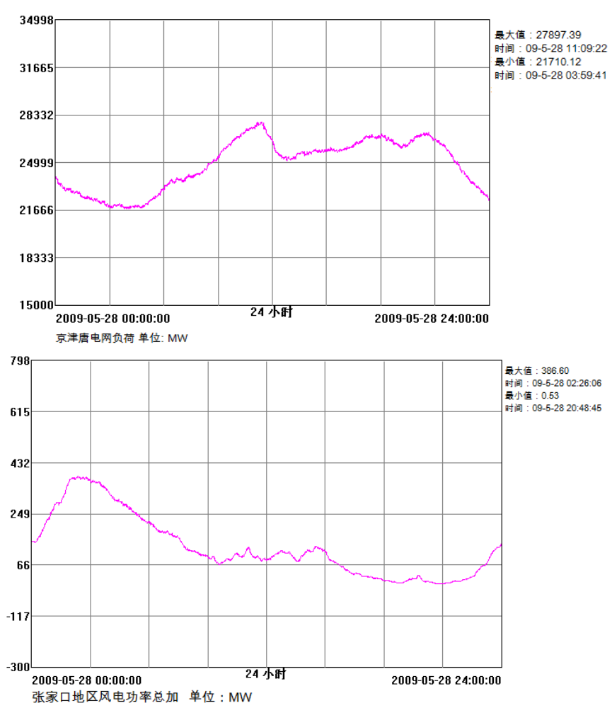
2. Challenges to Grid Operation by New Energy Integration
Greater difficulty in system dispatch and peak regulation
Distinct anti-regulation properties of wind power output, which renders difficulty in system peak regulation.
Maximum: 27897.39
Time: 09-5-28 11:09:22
Minimum: 21710.12
Time: 09-5-28 03:59:41
24 hours
Load of Beijing-Tianjin-Tangshan Power Grid (MW)
Maximum: 386.60
Time: 09-5-28 02:26:06
Minimum:0.53
Time: 09-5-28 20:48:45
Wind power output and grid load present higher anti-regulation properties.
24 hours
Sum of wind power in Zhangjiakou Wind Power (MW)
Notes:
陈宁给数据或图
9

Slide 10
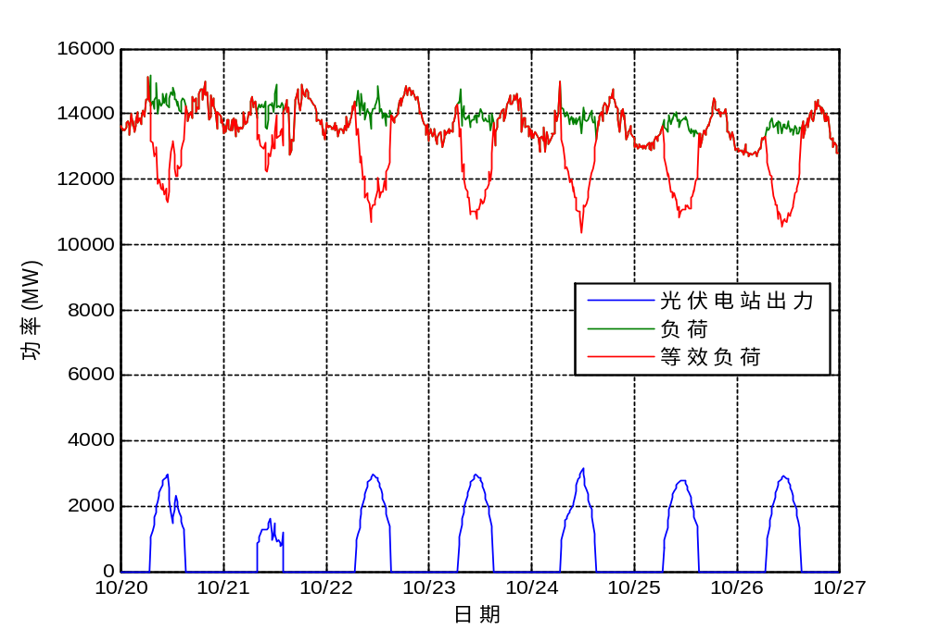
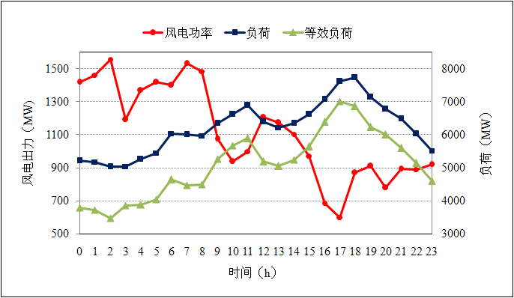
2. Challenges to Grid Operation by New Energy Integration
Greater difficulty in system dispatch and peak regulation
Wind power
Load
Equivalent load
Wind power output (MW)
Load (MW)
Power (MW)
PV output
Load
Equivalent load
Time (h)
Date
Integration of wind and PV power results in greater fluctuation of equivalent load, and thus bigger difficulty for grid dispatching.
Notes:
陈宁给图
10

Slide 11
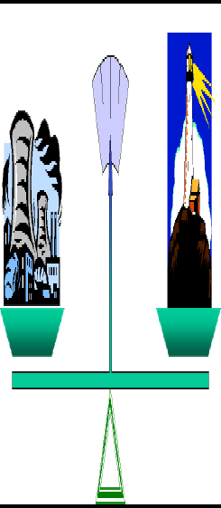
2. Challenges to Grid Operation by New Energy Integration
Greater difficulty in system dispatch and peak regulation
50.0Hz
49.8
50.2
Power generation
Power utilization
Regulatable power
generation output
Controllable
prime motor power
Conventional
Energy source
Grid
Power load
New energy power generation
Power load changes randomly
with higher
load prediction accuracy
Viable and non-controllable power for new energy power generation, with low prediction accuracy
Notes:
11

Slide 12
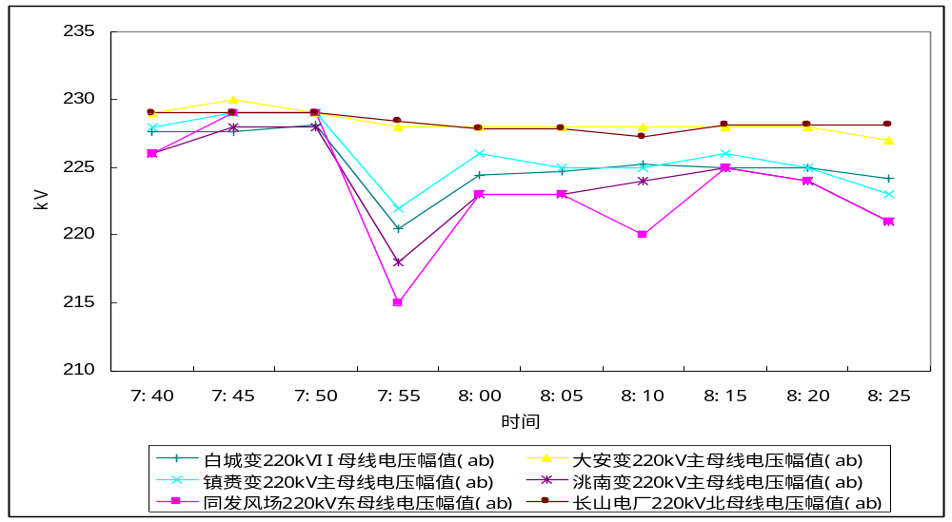
2. Challenges to Grid Operation by New Energy Integration
Greater difficulty in grid voltage control
In China, the areas where wind farms and PV power plants are grid integrated are mostly at the end of the grid; substantial power changes makes it quite difficult to regulate grid operation voltage, affecting the stability of system voltage.
As wind power output increases rapidly, the bus voltages of Baicheng Grid and Tongfa wind farm drops to 213kV to the minimum, with substantial fluctuation.
220kVII bus voltage amplitude (ab) of Baicheng Substation
220kVII main bus voltage amplitude (ab) of Zhenlai Substation
220kVII eastern bus voltage amplitude (ab) of Tongfa Wind Farm
220kVII main bus voltage amplitude (ab) of Daan Substation
220kVII main bus voltage amplitude (ab) of Taonan Substation
220kVII northern bus voltage amplitude (ab) of Chagnshan Power Plant
Notes:
12

Slide 13
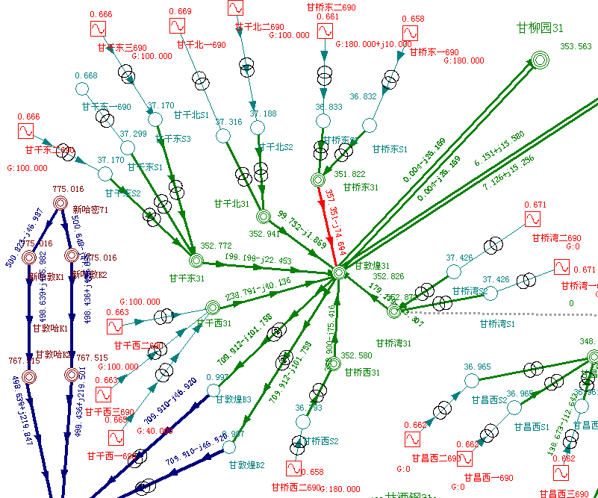
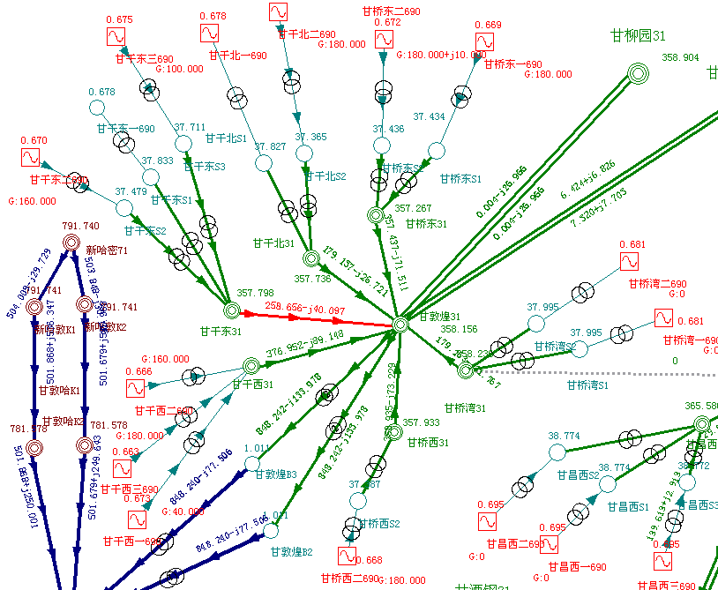
2. Challenges to Grid Operation by New Energy Integration
Proposing challenges to the integration capability of local grids
When wind farms and PV power plants are connected to the grid in a large-scale manner, the grid will be faced with enlarged transmission flow during large-scale power generation and more heavy-load operation lines, which makes thermal stability issue gradually prominent.
Due to limited capacity for PV power generation currently, such problem is not conspicuous; however, for wind power, it’s relatively prominent.
Notes:
13

Slide 14
2. Challenges to Grid Operation by New Energy Integration
New energy power generation suffers poor anti-disturbance ability which affect the safe operation of the grid.
Large-scale new energy grid connection increases risks for stable operation of the grid.
Variable system flow, and difficult control over intertie operation;
Reduced system inertia and decreased dynamic stability ;
Failure to re-establish terminal voltage for new energy power plants after faults, causing voltage instability;
As wind power units and PV power generation systems have no capability of LV ride through, in the event of instaneous voltage drop induced by system disturbance, self trip will produce impacts on the system.
Notes:
14

Slide 15
Contents
1
Introduction to New Energy Power Generation Development
2
Challenges to Grid Operation by New Energy Integration
3
Adaptive Requirement of the Grid to New Energy Integration
4
Key Operation & Control Technologies for New Energy Grid Integration
5
Summary and Outlook

Slide 16
3. Adaptive Requirement of the Grid to New Energy Integration
Technical Rule for Connecting Wind Farm to Power System GB/T 19963-2011
Active power control: all operating units in the wind farm should be capable of achieving continuous smooth regulation on active power and of participating in active power control of the systems. Additionally, they should be able to receive and execute the command to control active power and its changes assigned by dispatch agencies. The recommended values ​​for the change rate of the maximum power of the wind farm are given in the following table.
Installed capacity of wind farm（MW） | Maximum limit of changes to active power in 10min（MW） | Maximum limit of changes to active power in 1min（MW）
<30 | 10 | 3
30～150 | Installed capacity /3 | Installed capacity /10
>150 | 50 | 15
Reactive power control: wind turbine units in the wind farm should keep the power factor dynamically regulatable in the range of between 0.95 leading or lagging. Specific configuration principles are proposed for reactive capacity of the wind farm. The wind farm should be equipped with reactive voltage control systems and be capable of reactive power regulation and voltage control.
Notes:
16

Slide 17
3Adaptive Requirement of the Grid to New Energy Integration
Technical Requirements for Connecting Photovoltaic power plant to Power System GB/T 19964-2012
Active power control: Medium and large PV power plants should be equipped with active power control systems and be capable of active power regulation. Besides, they should be able to receive and execute automatically the command to control active power and its changes assigned by dispatch agencies of the power systems. The recommended values ​​for change rate of maximum power of the PV power plants are given in the table below.
Installed capacity of PV power plants（MW） | Maximum limit of changes to active power in 10min（MW） | Maximum limit of changes to active power in 1min（MW）
Small | Installed capacity | 0.2
Medium | Installed capacity | Installed capacity /5
Large | Installed capacity /3 | Installed capacity /10
Note: Reduced output power of PV power plants caused by solar irradiance is beyond limitations above.
Notes:
17

Slide 18
3. Adaptive Requirement of the Grid to New Energy Integration
Technical Requirements for Connecting Photovoltaic power plant to Power System GB/T 19964-2012
Medium and large PV power plants should be equipped with reactive voltage control systems and be capable of controlling reactive power and voltage. Specific configuration principles are proposed for reactive capacity of medium and large PV power plants connected to public grids via private lines and collections systems.
Small PV power plants can be of no capability of regulating reactive power and voltage. When their output active power is 50% higher than their rated power, their power factor should be no less than 0.98 (leading or lagging); while if their output active power is 20~50% higher than that of their rated power, their power factor should be no less than 0.95 (leading or lagging).
Notes:
18

Slide 19
Contents
1
Introduction to New Energy Power Generation Development
2
Challenges on Grid Operation Generated by New Energy Access
3
Adaptive Requirement of the Grid to New Energy Integration
4
Key Operation & Control Technologies for New Energy Grid Integration
5
Summary and Outlook

Slide 20
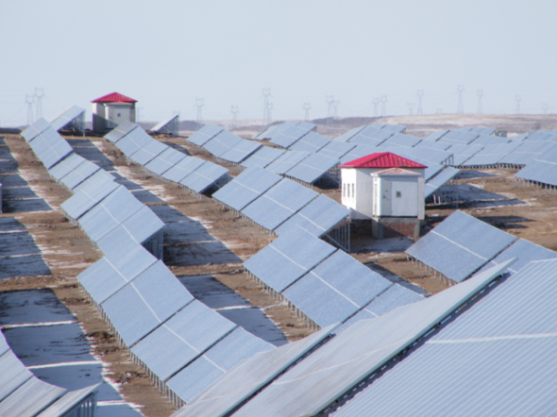
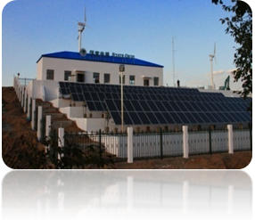
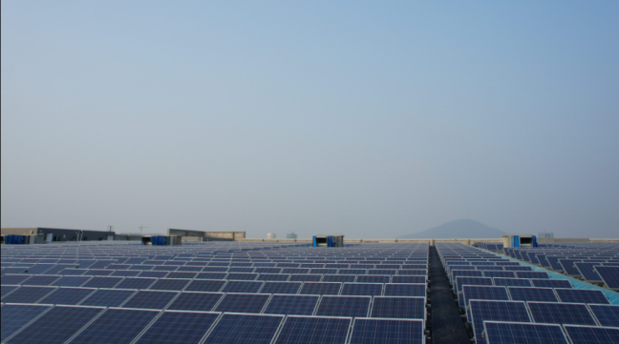
4. Key Operation & Control Technologies for New Energy Grid Integration
Objectives of new energy power generation control
Satisfy the requirements of relevant standards on adaptability of grid for new energy power station
Change the extensive control mode of active / reactive power of new energy power plants
Improve the control accuracy and rationality of active / reactive power of new energy power plants
Enhance power quality of new energy power plants and avoid possibly trip
Notes:
20

Slide 21
4. Key Operation & Control Technologies for New Energy Grid Integration
Active power control related to new energy power generation
Control architecture
New energy power plant group control
New energy power plant control
Active control of generation units
Scheduling division
Active commands
Master control station of new energy power plant group
Control substation of new energy power plant
Control substation of new energy power plant
Execution station of new energy power plant
Execution station of new energy power plant
Execution station of new energy power plant
Execution station of new energy power plant
Execution unit
Execution unit
Execution unit
Execution unit
Execution unit
Execution unit
Execution unit
Execution unit
Notes:
21

Slide 22
4. Key Operation & Control Technologies for New Energy Grid Integration
Reactive power control related to new energy power generation
Control architecture
Reactive voltage control of regional grids
Reactive control of new energy power plant group
Reactive control of new energy power plant
Reactive control of generation units and dynamic reactive compensation devices
Scheduling voltage
Plan curve
Master AVC station of regional power grid
Master AVC station of new energy power plant group
Master AVC station of new energy power plant group
Reactive control of new energy power plant
Reactive control of new energy power plant
Reactive control of new energy power plant
Reactive control of new energy power plant
Execution unit
Execution unit
Execution unit
Execution unit
Execution unit
Execution unit
Execution unit
Execution unit
Notes:
22

Slide 23
4. Key Operation & Control Technologies for New Energy Grid Integration
New energy power plant group control
Master control station
Communications: realize seamless integration of forecast data, dispatch commands and management commands through construction of standardized interfaces;
Configuration: practise integrated control of active frequency, reactive voltage, and safe and stable control;
Function: calculate optimal control capacity and control command with information received.
Wind-solar combined power forecast &prediction system
Master control station
Constraints
Power plant control system
Prediction information
Active and reactive control platforms
Stabilization and control system
Data
Data
control commands
Plan curve
Power dispatching system
Data
Operation optimization and electric quantity calculation
Online warning and assistant decision-making
Data
Data
Data
Data
Real-time monitoring on network and data support platform
Notes:
23

Slide 24
4. Key Operation & Control Technologies for New Energy Grid Integration
New energy power plant group control
Substation control
Communications: receive control capacity / control command and upload operating status information of the new energy power plants / generation units;
Configuration: The control objects are main transformer tap of the booster station, reactive compensation devices, wind farms, PV power plants; etc. ;
Function: the control commands of the master receiving stations regulate reactive compensation devices and the main transformer taps as well as emergency cutting; they also function to decompose the control capacity transmitted by the master station and send it to power plants.
Substation control system
Switch and regulate compensation devices
Transformer tap regulation
Forward control capacity or control commands
Switch control of grid-connected points in farms/stations in case of emergencies
Notes:
24

Slide 25
4. Key technologies on Grid-connected
Operation Control of New Energy
New energy power station group control
Execution station of new energy power plant
Communication: forward control command and upload operating status information of new energy power plants / generation units ;
Configuration: Control objects are mainly reactive compensation devices, PV power generation units, wind turbine units, etc.;
Function: receive operating information of the monitoring systems in farms/stations and upload it to the control sub-station; receive and execute control commands transmitted by control substations, and regulate PV power generation units as well as switch and regulatie local compensation devices.
Monitoring systems in farms/stations
Switch and regulate compensation devices
Forward control capacity
Distribute output of PV power generation units
Cut control on feeder lines in case of emergencies
Notes:
25

Slide 26
4. Key technologies on Grid-connected
Operation Control of New Energy
Active power control of new energy power plant
Control principles
Satisfy the requirements for active control performance indicators of new energy power plants by grid scheduling divisions
Based on the actual operation properties and power forecast information of new energy power plants
Coordinate generation units with various regulation performances
Control objectives
Track power generation plan commands issued grid scheduling divisions
power generation benefits of new energy power plants
Control objects
Wind turbine generator units
PV inverters
Scheduling system
Power plant information
Prediction system
Scheduling commands
Information on operating status
Information on power prediction
New energy generation active control
Control commands
Control feedback
Control commands
Control feedback
Generation unit 1
Generation unit n
Notes:
26

Slide 27
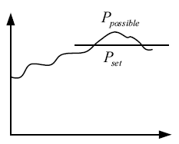
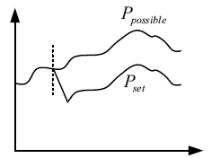
4. Key technologies on Grid-connected
Operation Control of New Energy
Active power control of new energy power plant
Control architecture
1. Limit mode: Active control system of new energy power plants shall control the output of power plants below preset limit or the limit issued by dispatching agencies; the limit values can be given in different time slots.
2. Difference mode: there’s power difference between the output of new energy power plants and the forecasted power of wind farms. Such power difference is pre-set value, or the value issued by the dispatching agencies, which is equivalent to reserving certain active power regulation margin for the stations.
Notes:
27

Slide 28
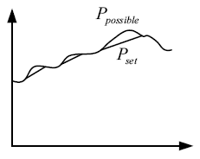
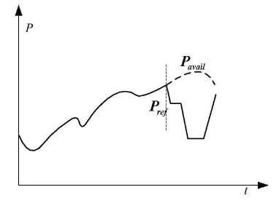
4. Key technologies on Grid-connected
Operation Control of New Energy
Active power control of new energy power plant
Control architecture
3. Slope mode: the changes of the output of new energy power plants must be within the given slope in each control cycle. The overall output power of the wind farms should follow the given power of the power plants on condition that the slope is satisfied.
4. Balance mode: under conditions of limited power change rate, the active power control system of new energy plant should immediately adjust its output to the power limit given by grid dispatching agencies (if the given value is greater than the maximum power, it can be adjusted to the maximum generatable power) .
Notes:
28

Slide 29

4. Key technologies on Grid-connected
Operation Control of New Energy
Reactive power control of new energy power plant
Control principles
Satisfy the requirements for reactive control performance indicators of new energy power plants raised by grid dispatching divisions
Based on actual operation properties and power forecast information of new energy power plants
Comprehensive utilization of inverters, dynamic reactive compensation and other reactive sources
Consider coordination between static and dynamic reactive controls
Control objectives
Track voltage curves or reactive commands issued by grid dispatching divisions
Improve energy quality of new energy power plants
Dispatching system
Booster station information
Power plant information
prediction system
Scheduling commands
Operating information
Operating information
Information on power prediction
New energy generation reactive control
Control commands
Control feedback
Control commands
Control feedback
Control commands
Control feedback
Current transformer 1…n
Dynamic reactive compensation devices
Switchable capacitance and reactance
Notes:
29

Slide 30
4. Key technologies on Grid-connected
Operation Control of New Energy
Reactive power control of new energy power plant
Control targets
Power generation unit AC devices
For new energy power generation units (such as double-fed wind turbine units, direct-drive wind turbine units, PV inverters) that are connected with the grid through current transformers , in theory, as long as the capacity of current transformers allows, the generation units themselves are capable of providing reactive power; however, early asynchronous wind power generation units have no such capability.
Reactive compensation devices
In accordance with national standards, to meet reactive demand of new energy power plants, all the power plants should be equipped with corresponding reactive compensation devices. The reactive compensation devices in use now are mainly two types, namely, SVCs (Static Var Compensators) and SVGs (static synchronous compensators) .
Notes:
30

Slide 31
4. Key technologies on Grid-connected
Operation Control of New Energy
Reactive power control of new energy power plant
Control pattern
Real-time voltage control pattern
Take voltage dispatching commands in real time from higher-level and control and maintain the voltage of grid-connection points of new energy power plants around the command value.
Reactive power control pattern
It controls the power output of wind farms or PV power plants no more than the specified limit. The limit value can be set.
Power factor control pattern
Fixed deviation (limit) are always kept between PV output power and the maximum adjustable output, which can be regarded as a means for PV power plants to participate in active reserve of the system.
Notes:
31

Slide 32
Contents
1
Introduction to New Energy Power Generation Development
2
Challenges on Grid Operation Generated by New Energy Access
3
Adaptive Requirement of the Grid to New Energy Integration
4
Key Operation & Control Technologies for New Energy Grid Integration
5
Conclusion and Outlook

Slide 33
5 Conclusion and Outlook
Conclusion
Active power control of new energy power plant
In a long-term viewpoint, controllable operation of new energy power plants and integrate it into the dispatching system of the grid is the development trend of safe grid-integrated development. Therefore, the generation management of new energy power plants will become an important research direction in the field of new energy grid-connection control. With improved technologies of active control related to new energy generation, it will lead to enhanced new energy grid-connection capacity, better grid damping characteristics, as well as continuously improved ability of new energy power plants to actively participate in grid regulation. To improve the dispatching ability of new energy power generation and promote the operating mode of new energy power plants to develop towards the way the conventional power plants does, will significantly improve operating mode, power generation plans as well as security and stability of the power system of the grids that accomodate large numbers of new energy power plants.
Notes:
33

Slide 34
5 Conclusion and Outlook
Outlook
Reactive power control of new energy power plant
Since new energy power plants are located at the end of the grid, substantial changes to the output is bound to cause larger fluctuations in the grid voltage and thus affect the stabilization of grid voltage; it will impose greater threats on secure and stable operation of the new energy power plants themselves. Therefore, it’s a must to require new energy power plants to carry out reactive voltage control which is also urgently needed for the development of new energy plants themselves. One of the major pattern to develop new energy power generation in China is to build up large new energy generation bases with centralized long- distance transmission. Adopting a master and coordinated reactive voltage control strategy for new energy power generation bases is a necessary way out for China’s new energy power generation.
Notes:
34

Slide 35

End
Thanks

