Slide 1
风力发电接入电网技术标准制定的经验
Chinese experience in development of grid code for wind power interconnection
中国电力科学研究院
Renewable Energy Department of CEPRI
迟永宁
Dr. CHI Yongning
1

Slide 2

1
我国风电的发展及并网挑战
Development & Challenges of Large Scale Wind Power
2
风力发电并网国家标准
Grid Code for Wind Power Grid Connection
3
风力发电并网的关键技术应用与实践
Application of Key Technologies and Practice in China

Slide 3
1.1 风力发电的发展现状及规划
Development of Large Scale Wind Power
  2012年，我国的风电累计装机达到7532千瓦，总量占世界首位。发电量100.8TWh, 占全国总发电量的2%。
  In 2012, the cumulative wind power capacity in China reached 75.32GW ( ranking 1st in the world). The electricity generated by wind in 2012 is 100.8TWh, accounting for 2.0% of the total electricity.
71.36% 平均年增长率
数据来源: CWEA

Slide 4

1.1 风力发电的发展现状及规划
Development of Large Scale Wind Power
  我国规划了八个大型千万千瓦风电基地
  8 large wind-power bases are in plan, each of them is with capacity larger than 10GW.
  根据发改委能源研究所做的2050中国风力发电发展路线图的研究，2050年我国风电装机将达到1000GW。
  According to the report “Wind Roadmap 2050, China” issued by Energy Research Institute (ERI) of NDRC, the planned total installed capacity of wind power will reach 1000 GW.
Jilin
Western Inner Mongolia
Hami
Eastern Inner Mongolia
Jiuquan
Hebei
Shandong
Jiangsu
4
4

Slide 5
1.2 大规模风电并网的技术挑战
Challenges of Large Scale Wind Power Grid Connection
系统调频调峰
Power balance
& frequency
control
无功电压
Reactive power & voltage control
风电并网
Wind power
潮流与短路
Load flow and short-circuit
系统稳定性
Transient stability
电源与输电规划
Generation and
transmission planning
电能质量
Power quality
5

Slide 6


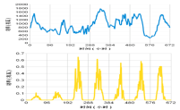
1.3 风电并网后系统调峰面临的挑战
Impacts on power balance & frequency control
50.0Hz
50.2
49.8
电源Power source
负荷Load
电力系统的有功需实时平衡
More difficulties to power balance
常规电源Conventional Power
电 网
Power Grid
用电负荷
Load
风力发电
Wind power
火电机组内按调度指令运行Thermal power follow with the load according to the dispatch command
日负荷规律性强
Regular daily load
风电出力随机变化，波动性较大Irregular wind power output with big variation
6

Slide 7
1.3 风电并网后系统调峰面临的挑战
Impacts on power balance & frequency control
  等效负荷概念：将风电场出力作为负的负荷叠加到负荷上，得到的等效负荷曲线。
  Net load = Load – Wind
  look the wind power output as a minus load
风电注入导致等效负荷更大的峰谷差
Big differences between peak and off-peak net load
7

Slide 8
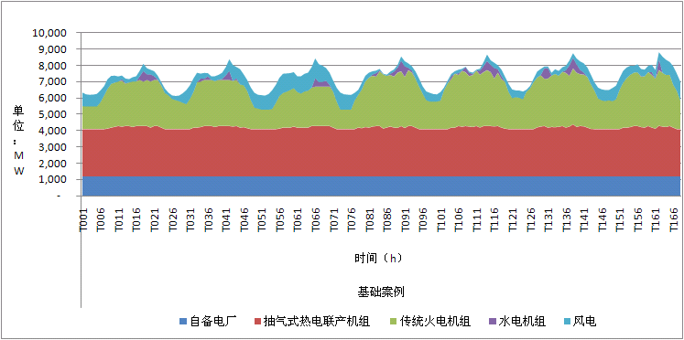
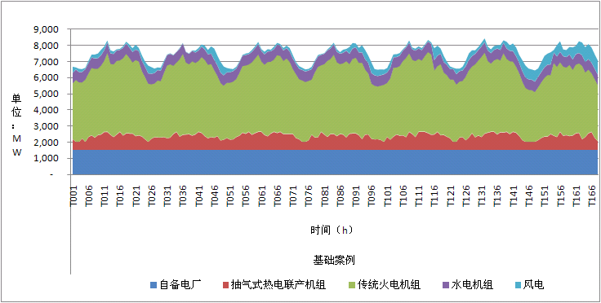
1.3 风电并网后系统调峰面临的挑战
Impacts on power balance & frequency control
冬季
夏季
  冬季－－有供热的需求，热电联产机组占据了出力的很大一部分。传统火电机组承担了大部分调峰任务。弃风百分比为1.6%；
  Winter season--with less flexibility because operating CHP unit used for heat supply, wind curtailment 1.6%.
  夏季－－没有供热的需求，传统机组有很大的空间进行调峰，没有发生弃风现象。
  Summer season—with many flexibility because operating CHP share very small, no wind power curtailment.
8

Slide 9
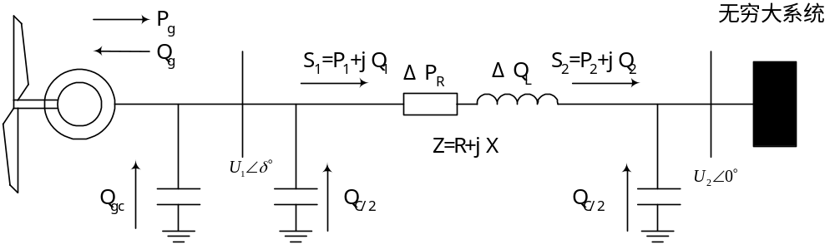
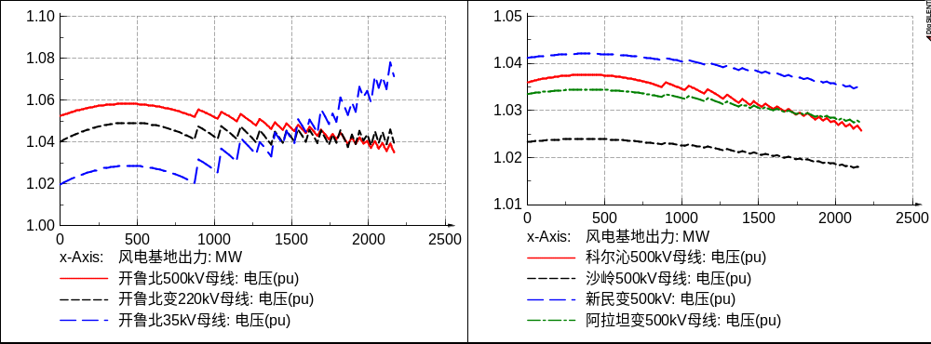
1.4 风电并网对系统无功电压的影响
Impacts on reactive power and voltage control
依靠风电场控制改变其注入电网无功功率，从而控制电网（风场）电压。
Control voltage by regulating the reactive power fed into grid
  风电并网电压稳定问题
  Voltage stability of wind power grid integration
9

Slide 10
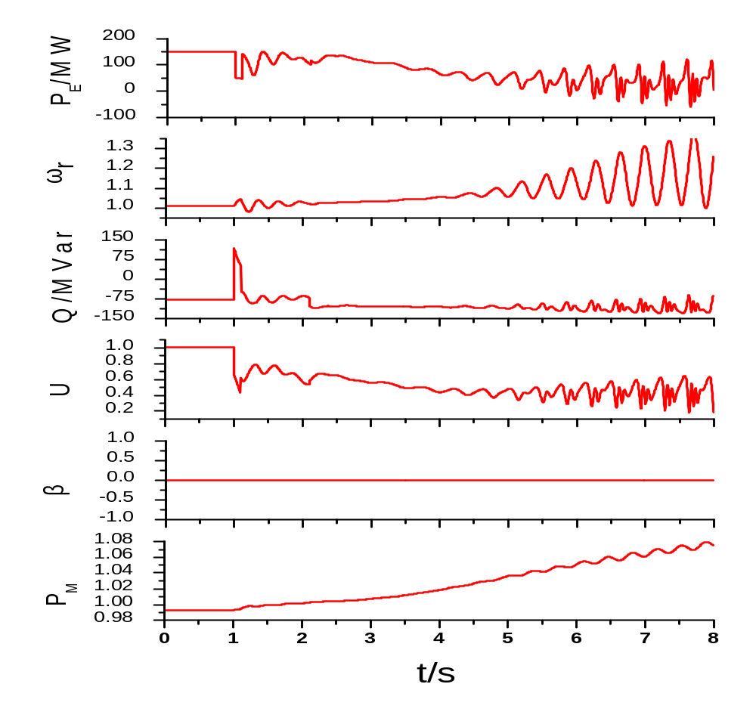
1.5 风电并网对系统稳定性的影响
Impacts on transient stability
系统发生故障后的动态电压崩溃
Dynamic voltage collapse after system fault
  150MW风电场，三 相短路故障，持续 0.1s。
Wind farm capacity: 150 MW，Three-phase short-circuit fault，Duration: 0.1s
10

Slide 11
1.5 风电并网对系统稳定性的影响
Impacts on transient stability
  大量风电机组和光伏逆变器未经检测并入电网，由于不具备低电压穿越能力、电网适应性差，发生了多起大面积脱网事故。
  Frequently large-scale wind power outage accidents
2008年以来风电主要事故
Wind power outage accidents since 2008
内蒙古地区
张家口地区
2010年，风电机组无法耐受自身产生的谐波，大范围跳闸。
2011年4月，佳鑫风电场内故障，造成张家口地区风电机组脱网644台。
吉林地区
内蒙古
2010年，500kV合松线故障导致大量风电机组切除，风电出力骤降70万千瓦。
山东地区
风电机组的电网适应性不足，电网正常运行时风电机组经常跳机。
酒泉风电基地
2011年发生3次大规模风电脱网事故；最严重一次造成风电机组脱网1278台。
河南地区
2009年，电铁引起电网三相电压不平衡度增加，导致风电机组脱网。

Slide 12
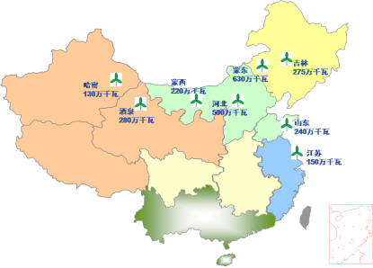

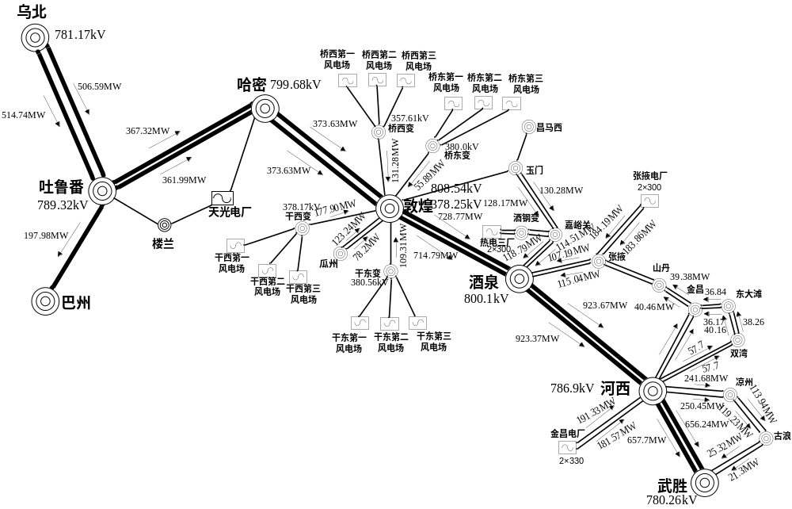
1.5 风电并网对系统稳定性的影响
Impacts on transient stability
  故障地点：甘肃酒泉风电
  Fault location: Gansu Jiuquan.
1226台
1545MW
598台
840MW
628台
705MW
50.034Hz 49.854Hz
12

Slide 13
1
我国风电的发展及并网挑战
Development & Challenges of Large Scale Wind Power
2
风力发电并网国家标准
Grid Code for Wind Power Grid Connection
3
风力发电并网的关键技术应用与实践
Application of Key Technologies and Practice in China

Slide 14
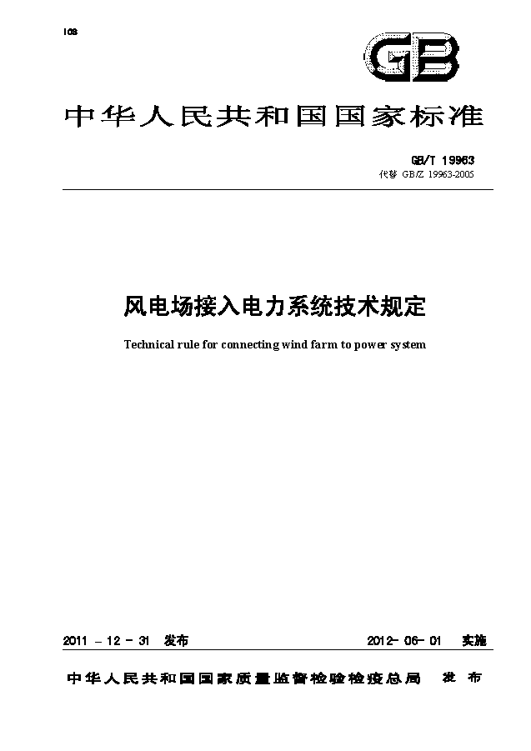
2.1 风电并网标准
Grid Code for Wind Power Connection
  根据中国风电发展的现状及并网运行的具体问题，在以下几个方面进行了修订
  Main aspects：
    风电功率预测 Wind power forecast
    有功功率及其控制 Active power control
    无功功率容量范围 Q capacity
    电压控制 Voltage control
    低电压穿越能力 LVRT
    风电场接入电网测试 Grid compliance test
14

Slide 15
2.2 风电场有功控制要求
Active power control of wind farm
  风电场应配置有功功率控制系统，具备有功功率调节能力。
  The wind farm should equipped with active power control system.
  场内所有运行机组应能够实现有功功率的连续平滑调节，并能够参与系统有功功率控制。
  The running wind turbines should be capable of a continuous smooth adjustment of the active power, and participating in active power control.
  风电场应能够接收并自动执行电力系统调度机构下达的有功功率及有功功率变化的控制指令，风电场有功功率及有功功率变化应与电力系统调度机构下达的给定值一致。
  Wind farms should be able to receive and automatically perform control instructions of active power set by the power system operator.
15

Slide 16
2.3 风电场功率预测要求
Power forecast requirement of wind farm
  风电场应配置风电功率预测系统，系统具有0～72h短期风电功率预测以及15min～4h超短期风电功率预测功能。
  The wind power forecast system should be installed in wind farm and the system should have the function of 0~72h short-term wind power forecast and 15min~4h ultra-short-term wind power forecast.
  风电场每天按照电力系统调度机构规定的时间上报次日0～24时风电场发电功率预测曲线，风电场每15min自动向电力系统调度机构滚动上报未来15min～4h的风电场发电功率预测曲线，预测值的时间分辨率为15min。
  Wind farms daily report the wind power forecast curve of the next day 0 ~ 24 hour, Wind farms automatically report wind power forecast curve of the next 15min ~ 4h to the power system operator each 15min , the time resolution should be 15min.
16

Slide 17




2.4 风电场无功容量
Reactive power capacity of wind farm
电网
Power grid
  普通风电场应补偿场内全部及送出线路的一半的无功损耗，风电基地的风电场应补偿场内及送出线路全部无功损耗。
  Wind farm should have required reactive power capacity to compensate the reactive power losses locally.
无功
补偿
VAR
无功
补偿
VAR
无功
补偿
VAR
集中无功补偿设备
必要时动态
风电场
Wind farm
并网点电压
V Control
of POI
-3%~+7%
风电场主变
有载调压
风电机组无功能力
超前0.95~滞后0.95
17

Slide 18
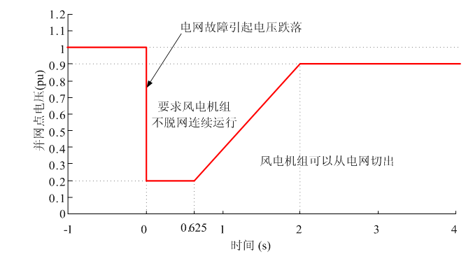
2.5 风电场低电压穿越要求
LVRT requirement of wind farm
  基本要求
  General requirements
  有功恢复
  Active power restore
    电力系统故障期间没有切出的风电场，以至少10％P_{N}/s的功率变化率恢复至故障前的值。
  动态无功支撑能力
  Dynamic reactive power capability
    百万千瓦级规模及以上的风电场群，三相短路故障，动态无功电流要求：
    响应时间≤ 75ms，持续时间应≥ 550ms。
    IT≥1.5×（0.9-UT）IN ，（0.2≤UT≤0.9）
18

Slide 19
1
我国风电的发展及并网挑战
Development & Challenges of Large Scale Wind Power
2
风力发电并网国家标准
Grid Code for Wind Power Grid Connection
3
风力发电并网的关键技术应用与实践
Application of Key Technologies and Practice in China

Slide 20
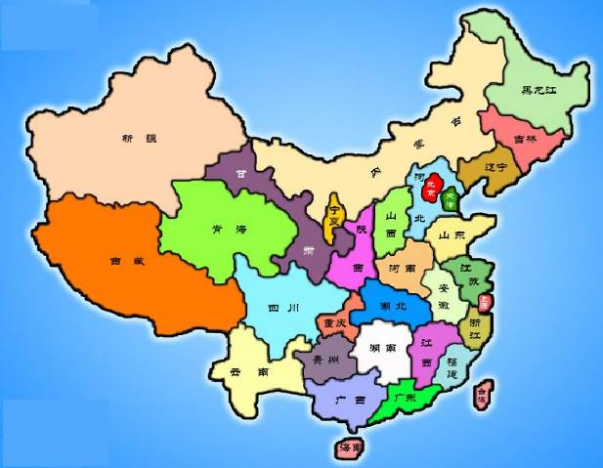
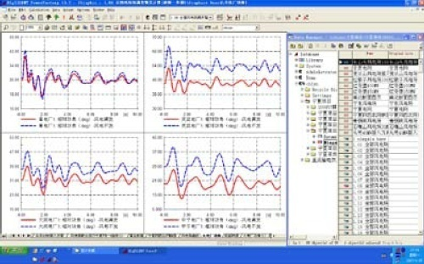






3.1 仿真分析
Simulation and Analysis
  完成12个省及地区风电、光伏发电接纳能力研究。
  More than 12 provinces and regions wind power, PV accommodation ability study.
  完成了黑龙江、吉林、辽宁、内蒙古、青海、甘肃、海南、云南、广东电网内共超过300个风电场及光伏电站的接入系统研究。
  More than 300 grid integration studies on wind farms and PV power stations.

Slide 21
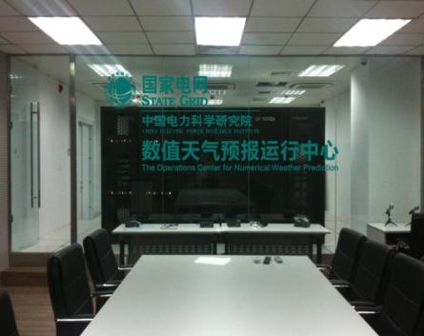
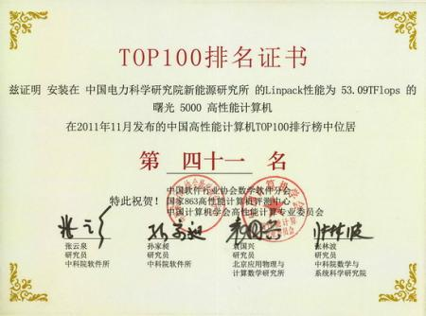
3.2 功率预测
Power Forecasting
  拥有计算核6560个、存储容量376TB，在2011年中国高性能计算机TOP100排名中以每秒53万亿次运算速度位列第41位(电力行业排名第一)。可在2.5小时内完成东北、西北、华北等主要风能开发区域网格分辨率为5×5千米的96小时数值天气预报。
  With 6560 CPU, storage capacity 376 TB, ranking at 41 in 2011 China‘s high-performance computer TOP100 with a speed of 53 trillion times per second. 96 hours 5 * 5 km grid resolution numerical weather prediction of northeast, northwest, north China and other major wind power development area can be finished within 2.5 hours.

Slide 22
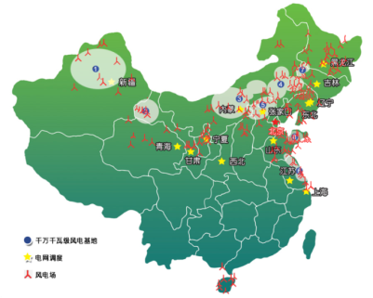
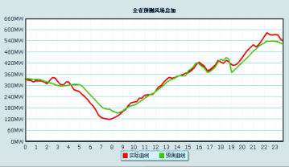

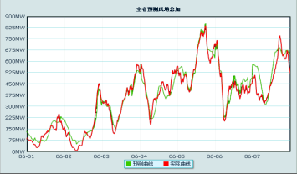
3.2 功率预测
Power Forecasting
  在辽宁、吉林、江苏、山东等网省调共建立16套风电/光伏功率预测系统；覆盖近400个风电场/光伏电站，总装机容量超过4000万千瓦，预测规模世界首位；平均绝对误差10%左右。
  16 wind power/PV prediction systems, covering nearly 400 wind/PV power stations, the total capacity more than 40 GW, the average absolute error is about 10%。

Slide 23
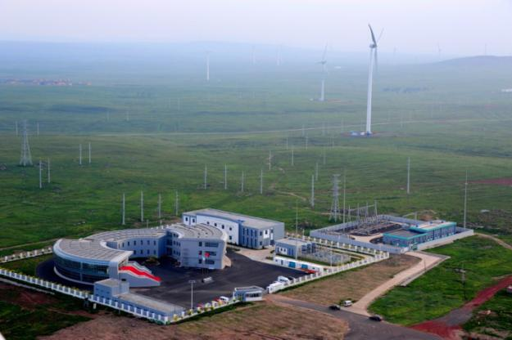
3.3 检测认证
Testing and Certification
  占地面积24.6平方公里，30台风电机组测试机位。
  National Wind Power Testing Center in Zhangbei County, Hebei Province. 24.6 km*km, 30 wind turbine generalized foundation.
  世界上规模最大、唯一具备检测风电机组全部整机性能（7类82个参数）的试验基地
  It is the largest test center having the capability of testing all the performances of wind turbines (7 classes and 82 parameters) in the world.

Slide 24
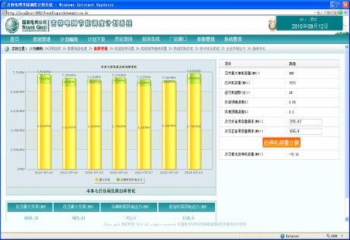
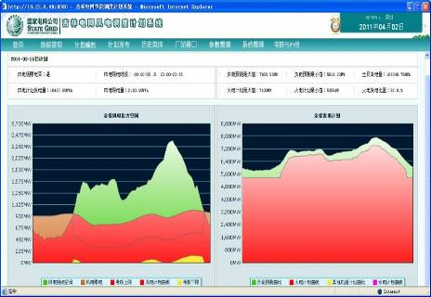
3.4 优化调度
Optimal dispatching technology
新能源优化调度系统 RE optimization scheduling system
  开发了具有自主知识产权的新能源优化调度系统，可实现七天滚动机组组合优化启停安排、新能源和常规电源协调调度、新能源优化控制。
  Developed RE optimization scheduling system with independent intellectual property rights, which can realize rolling unit commitment optimization for seven days, RE and conventional power coordination scheduling, RE optimization control.

Slide 25
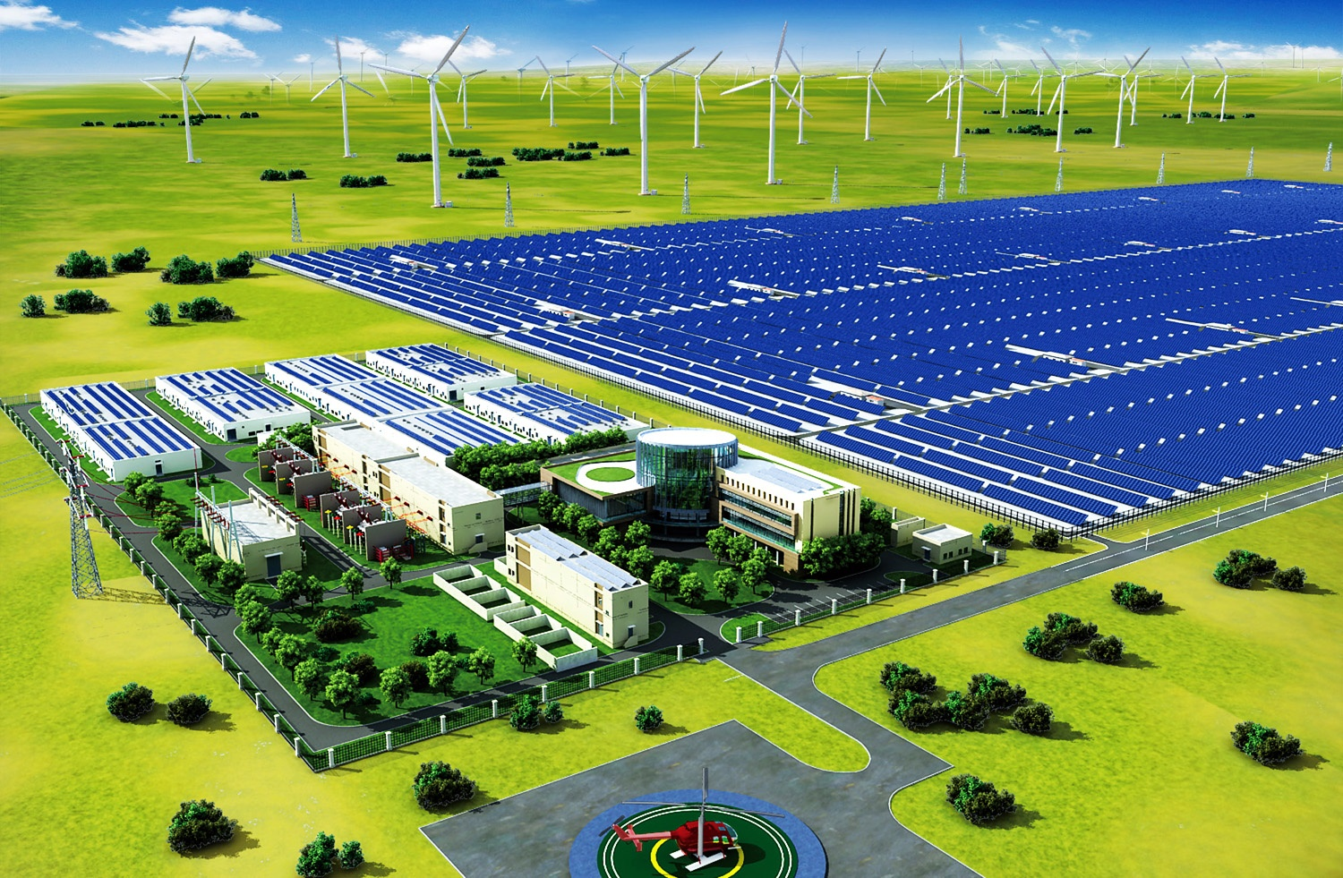
3.5 风光储输示范工程—中国张北
Demonstration Project of Wind, PV, Energy Storage and Transmission
  规划总容量为：风电500MW，光伏发电100MW，储能装置110MW。
  一期工程建设风电100MW、光伏发电40MW和储能装置20MW，于2011年12月31日建成投产。
  The planning capability: 500MW wind turbine, 100MW solar modules, 110MW energy storage equipment.
  The first phase of the project construct 100MW wind turbine, 40MW solar modules, 20MW energy storage equipment.

Slide 26
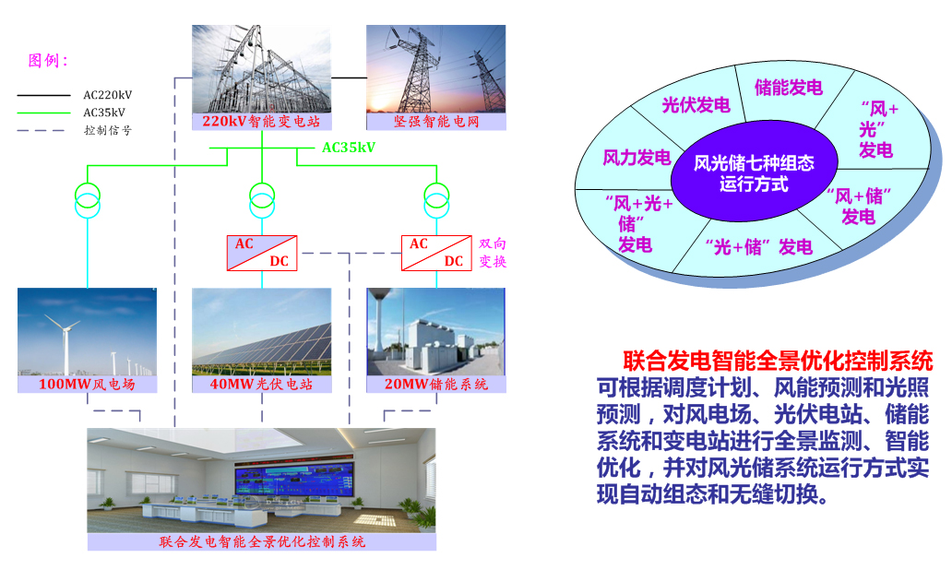
3.5 风光储输示范工程—中国张北
Demonstration Project of Wind, PV, Energy Storage and Transmission
Cogeneration Intelligent Optimization Control System
According to forecast for both light radiation and wind speed, the system can detect and intelligent optimize the wind farms, solar power plants, energy storage systems and substations. Furthermore, it can automatic configure and seamless switch from each operation modes.

Slide 27

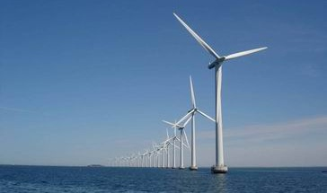
谢 谢
Thanks!
迟永宁
chiyn@epri.sgcc.com.cn

