Slide 1
China's Experiences and Challenges in Large-scale Wind Power
Integration
Bai Jianhua
State Grid Energy Research Institute
September 23, 2013
Notes:
1

Slide 2
Main Content
1. Status Quo of Wind Power Development
3. Wind Power Development Plan
4. Solutions to Wind Power Integration & Consumption
5. Conclusion
2. Main Situation of Wind Power Consumption
2

Slide 3
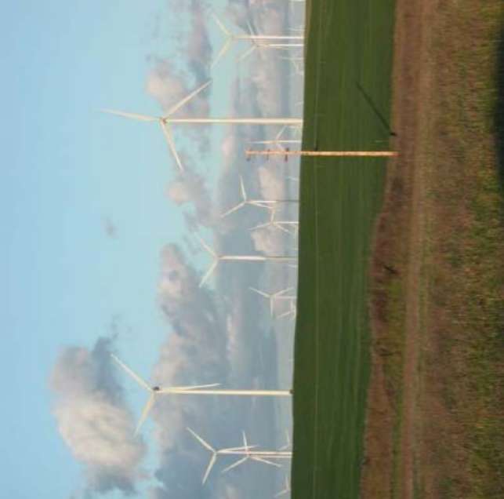
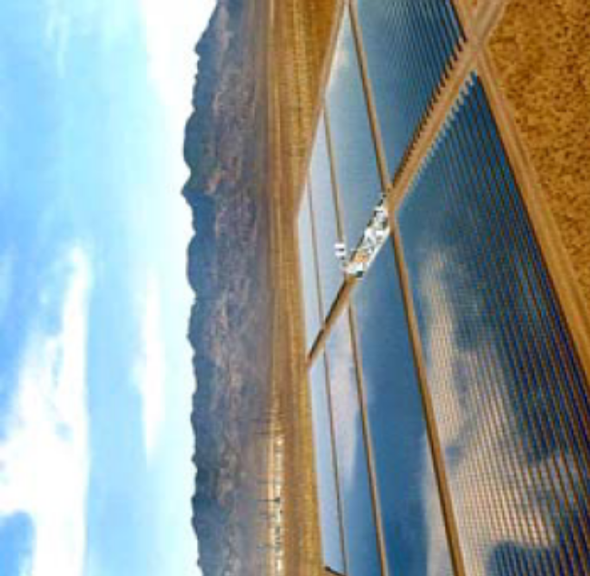
1. Status Quo of Wind Power Development
3
Notes:
3

Slide 4
(1) The situation of wind power integration
By the end of 2012, China's installed capacity of wind power integration topped the world, reaching 60.83 million KW.
Installed capacity of wind power
China US Germany Spain India France Italy UK Canada Portugal
Comparison of Top 10 Countries in Wind Power Installed Capacity
4
Notes:
8/8/2012

Slide 5
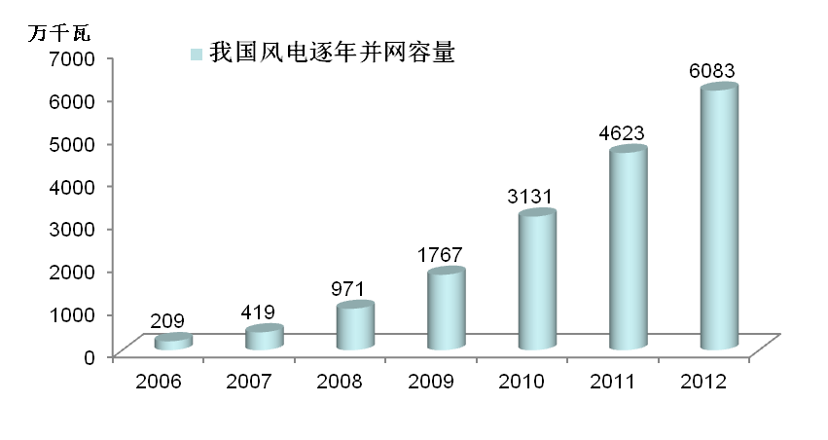
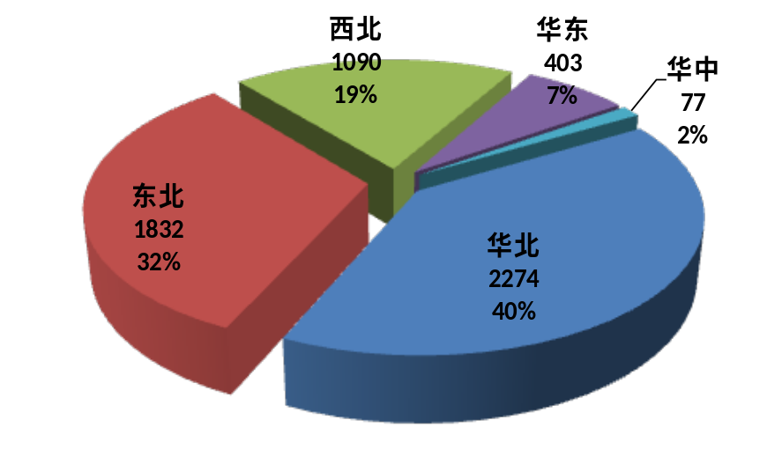

From 2006 to 2012, China‘s wind power has increased from 2 million KW to 60 million kW, with expanded scale and advanced technology.
10MW
NW
East of China
China's Wind Power Integration Capacity
Central China
NE
North China
China's Wind Power Integration Capacity from 2006 to 2012 (10MW)
Wind Power Integration Capacity by Region in 2012 (10MW)
5

Slide 6
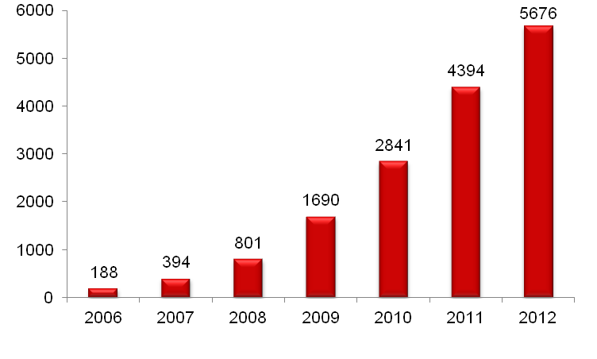
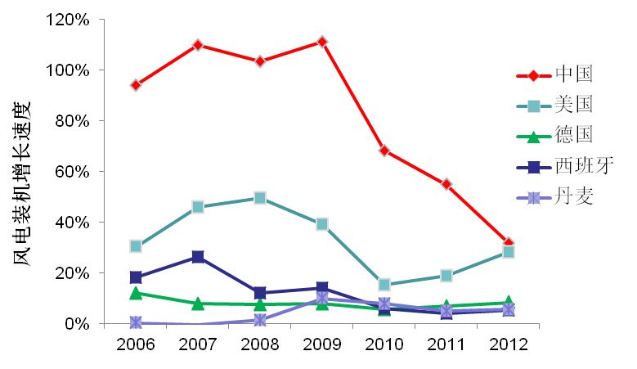
By the end of 2012, the installed capacity of wind power integration in SGCC's operating areas has increased to 56.76 million kW with an average annual growth rate of 76% since 2006.
Installed wind power capacity growth rate
China
US
Germany
Spain
Denmark
76%
Wind power integration capacity in SGCC's operating areas from 2006 to 2012
Comparison of Typical Countries in Installed Wind Power Capacity Growth Rate
The wind power integration capacity of the SGCC is the largest-scale in the world and increases at the fastest rate.
6

Slide 7
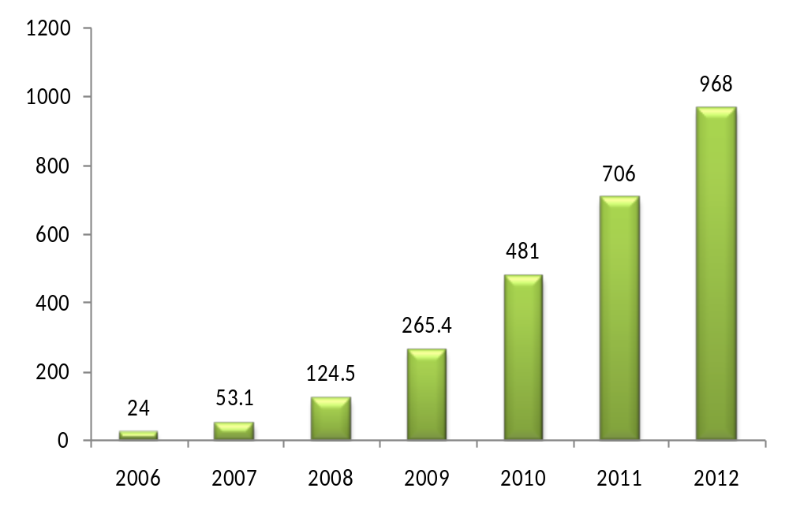
(2) Operational situation of wind power
Wind power generating capacity of SGCC's operating areas in 2012 increased to 96.8 billion kWh at the average annual growth rate of 85%, almost 41 times as much as that in 2006.
85%
Wind power generating capacity of SGCC's operating areas from 2006 to 2012
7

Slide 8
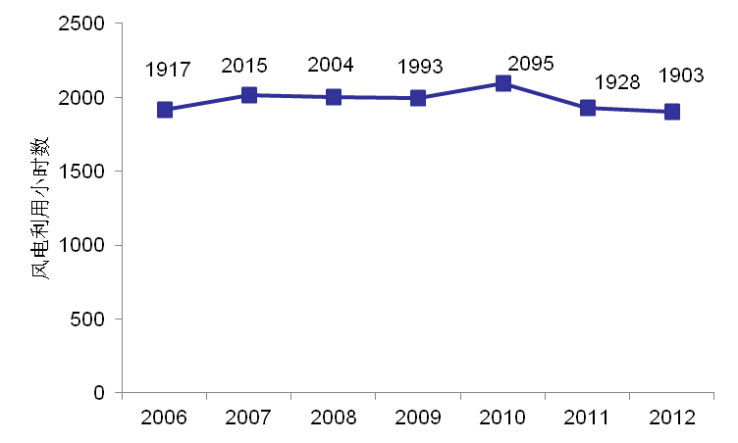
  Wind power utilization hours in SGCC‘s operating areas from 2006 to 2012 respectively reached 1917, 2015, 2004, 1993, 2095, 1928, and 1903 hours. There was “wind curtailment” in recent years.
Wind power utilization hours
Wind power utilization hours
SGCC's
operating
areas
Spain Germany Denmark
Comparison between domestic and international wind power utilization hours in 2012
Wind power utilization hours in SGCC's operating areas
8

Slide 9
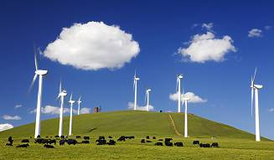
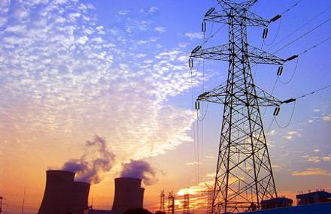
2. Main Situation in Wind Power Consumption
9

Slide 10
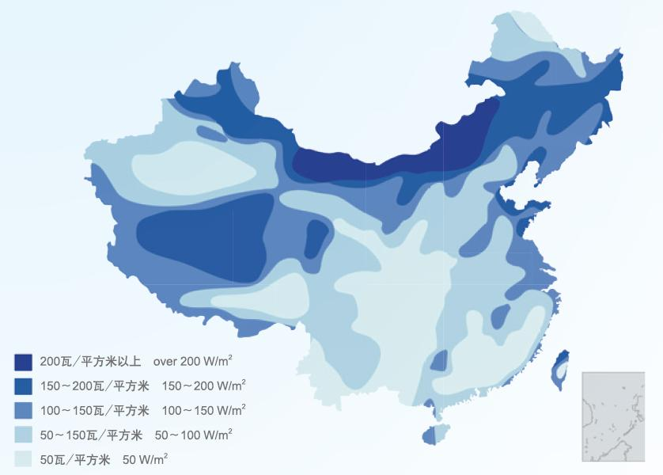
(1) Wind energy resource and power load distribution
  China‘s onshore wind energy resources are mainly in the “Three Norths” ( Northwest, Northeast & North China) , accounting for more than 90% of China's total wind energy resources. It is planned that the installed wind power capacity in “Three Norths” in 2015 and 2020 will reach 79 million kW and 164 million kW respectively, accounting for 80% of the planned total .
  Two thirds of the power load in China is concentrated in the eastern and central regions.
黑龙江
吉林
新疆
内蒙古
辽宁
青海
甘肃
宁夏
陕西
河南
西藏
湖北
安徽
四川
重庆
贵州
湖南
江西
云南
广西
台
湾
海南
China‘s wind energy resource distribution map
China's power load distribution map
10

Slide 11
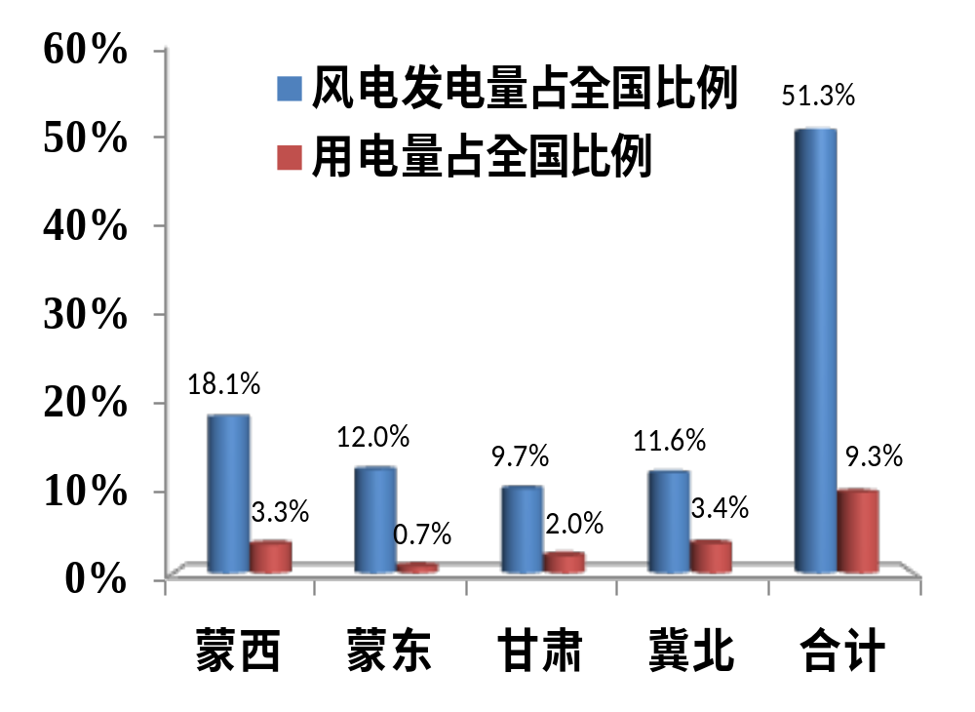
  Installed wind power capacity in western Inner Mongolia, eastern Inner Mongolia, Gansu, and northern Hebei, the four regions with the largest installed wind power capacity, accounts for about 50% of national total, but electricity consumption there only accounts for about 10%. Due to small electricity load, it is difficult for most of wind farms to consume locally.
% of wind power generation in national total
% of wind power consumption in national total
Western Inner Mongolia
Eastern Inner Mongolia
Gansu
Northern Hebei
Total
Wind power integration is not only about connection, but also about output and consumption.
11

Slide 12
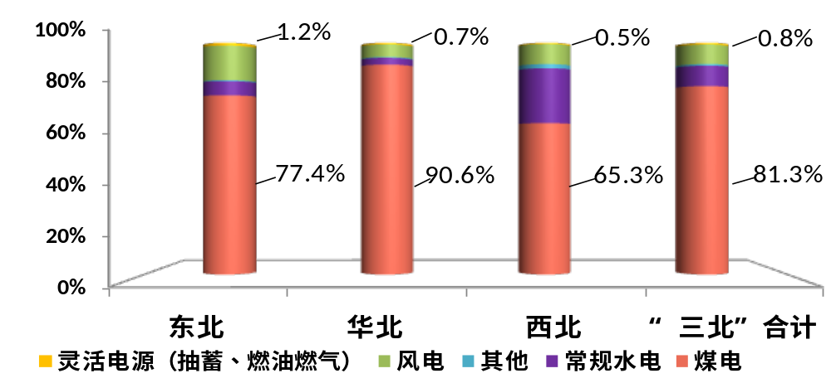
(2) Peak regulation in the system
  Wind power is characterized by intermittence, randomness, and volatility. Efficient use of wind power requires adequate support in peak regulation from conventional power source. Large-scale development and efficient consumption of wind power has become a global problem.
  As China's primary energy is coal-based, and the power mix in “Three Norths” where wind power is concentrated is single, in which thermal power accounts for 80%, heat-supply units take a large proportion, and power source for flexible adjustment such as fuel, gas and pumped storage power takes less than 1%, the ability of peaking regulation is limited, particularly in the heating period in winters.
 | Proportion of coal-fired thermal power | Proportion of coal-fired heat-supply units in all thermal units
Jinlin | 69% | 88%
Western Inner Mongolia | 78% | 57%
Heirongjiang | 80% | 68%
NE
North of China
NW
Total of “Three Norths”
Flexible power
(pumped storage, fuel and gas)
Wind power
Others
Hydro
Coal
Power mix in "Three Norths"
12

Slide 13
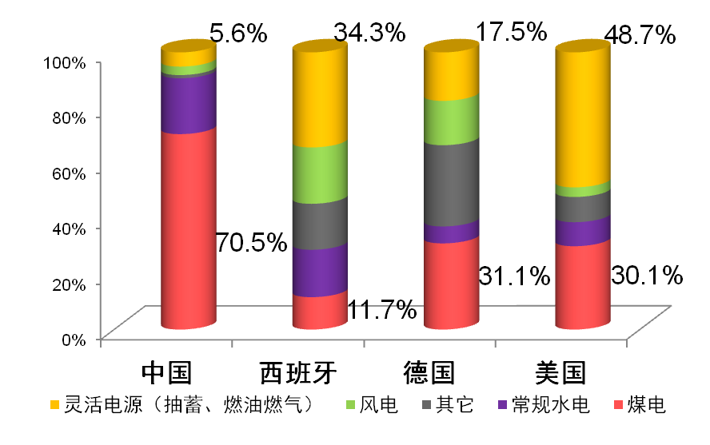
  The power resource with flexible regulation in Spain accounts for 34%, 1.7 times of wind power.
  That in U.S. accounts for 49%, 14 times of wind power.
  A higher proportion of flexible power resource is one of the main reasons why Spain and other countries are at a high level of wind power utilization.
  The power resource with flexible regulation in China only accounts for 5.6%, 1.1 times of wind power.
China Spain Germany US
Flexible power
(pumped storage, fuel and gas)
Wind power
Others
Hydro
Coal
Comparison Diagram of Power Mix
13

Slide 14
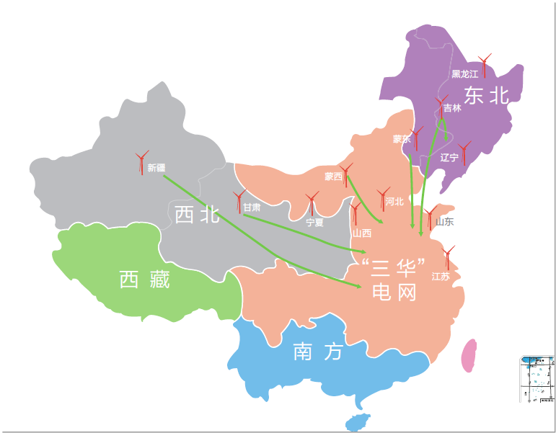
Locally: Installed wind power capacity in “Three Norths” has reached 20%. Subject to small-scale market, limited resources for peak regulation, and lack of a capacity of trans-regional transmission, there is no space for further wind power development.
Nationally: Installed wind power capacity accounts for only 5%. Resources for peak regulation are relatively abundant in the eastern and central regions; the consumption market has not been fully developed.
NE
NW
Tibet
“Three Chinas” Grid
South China
China‘s realities of reverse distribution between wind power and other new energy and load determine that China's new energy should focus on large-scale development and long-distance outbound delivery.
14

Slide 15
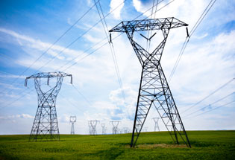
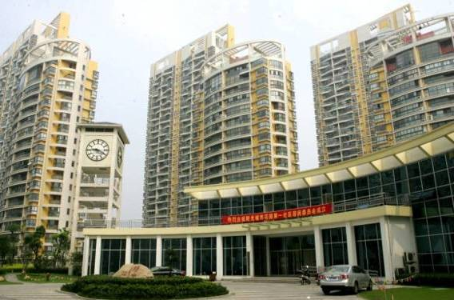
3. Wind Power Development Plan
15
Notes:
15

Slide 16
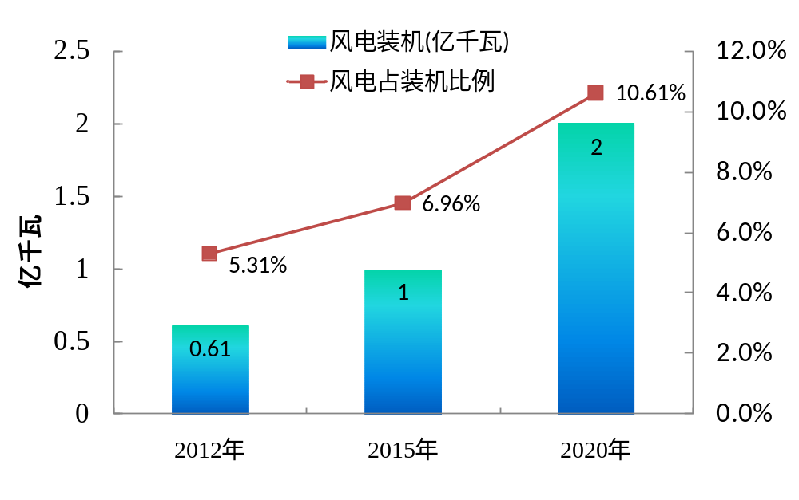
(1) Objectives of wind power development plan
According to the 12th Five-Year Plan for Wind Power Development issued by National Bureau of Energy of China in July 2012, there will be total of 100 million kW installed wind power capacity by the end of 2015, with annual wind power generating capacity reaching 190 billion Kwh; by 2020, there will be a total of 200 million kW installed wind power capacity,with annual generating capacity reaching 380 billion kWh.
Wind power installation (million kW)
% of wind power in installation
Million kW
Installed Wind Power Capacity in National Planning
16

Slide 17

Heilongjiang
(2) Large-scale wind power base
Eastern
Inner Mongolia
黑龙江
Jilin
Kumul
吉林
内蒙古
Hebei
辽宁
新疆
Jiuquan
Western Inner Mongolia
京
津
Shandong
河北
宁夏
山西
山东
青海
甘肃
Costal area of Jiangsu
陕西
河南
江苏
西藏
安徽
上海
湖北
China‘s wind power development is generally characterized by centralized development with the support of distributive development, relying mainly on onshore wind with the support of offshore wind power, and attaching equal importance to local consumption and trans-regional transmission.
According to the distribution characteristics of wind energy resource, China plans to construct a number of large wind power bases, including Kumul, Jiuquan, Western Inner Mongolia, Hebei, Eastern Inner Mongolia, Jilin, Shandong and coastal area of Jiangsu, Heilongjiang, etc.
四川
浙江
重庆
贵州
湖南
江西
福建
云南
广西
台
湾
广东
澳门
香港
海南
Schematic diagram of large-scale wind power bases distribution
17

Slide 18
Installed capacity planned of provinces
According to the 12th Five-Year Plan for Renewable Energy Development and provincial planning, a table of installed capacity in various regions is developed (see the table) .
China will maintain Three-Norths-based wind power development layout for a long time. The wind power development in 10 provinces in “Three Norths” region accounts for about 80%. The wind power decentralized development in the eastern and central regions is of limited-scale.
Categories | Bases/Provinces | Installed capacity planned
 |  | 2015 | 2020
Large-scale bases | Hebei | 1100 | 1600
 | Eastern Inner Mongolia | 800 | 2000
 | Western Inner Mongolia | 1300 | 3800
 | Jilin | 600 | 1500
 | Gansu | 1100 | 2000
 | Xinjiang | 1000 | 2000
 | Jiangsu | 600 | 1000
 | Shandong | 800 | 1500
 | Subtotal | 7300 | 15400
Key provinces | Shanxi | 500 | 800
 | Liaoning | 600 | 800
 | Heirongjiang | 600 | 1500
 | Ningxia | 300 | 400
 | Subtotal | 2000 | 3500
Subtotal of other provinces |  | 700 | 1100
National total |  | 10000 | 20000
18

Slide 19
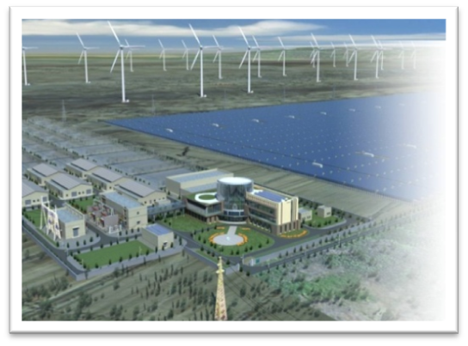
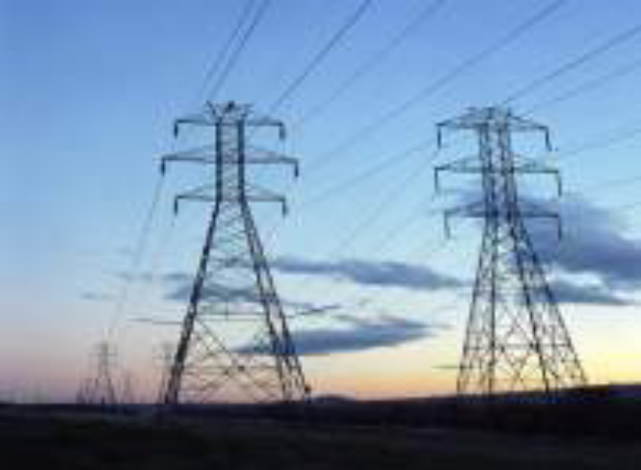
4. Solutions to Wind Power Integration & Consumption
19

Slide 20

(1) Coordinated solution to wind power integration & consumption
Good power supply structure, and increasing the flexible power supply for peak regulation in the system are the important foundation to raise the consumption capacity of wind power.
Incorporate the wind power large-scale development, transmission and consumption into the unified planning for power development, is the important guarantee to raise the consumption capacity of wind power.
Power structure
Coordinated planning
Grid layout
可再生能源发电
Construct strong interregional large power grid is objective need to raise the consumption capacity of new energy power generation market
Renewable energy power generation
Technical standards and norms
Electricity consumption structure
Formulate the strict integration technical standards and management norms is the basic to raise the consumption capacity of wind power.
Mobilize a wider range of demand side resources to participate in the system adjustment, is an effective way to improve the consumption capacity of wind power .
Improve overall capacity of electricity system receiving electricity from new energy
20

Slide 21
To fulfill the objective of national wind power's new energy planning development, the tasks are arduous and the management and technology are extremely complex. To make sure healthy and renewable development of new energy and wind power integration, it is needed to coordinate the whole power system comprehensively and optimize resources allocation while taking the larger picture into consideration.
21

Slide 22
(2) Overall system optimazation for wind power and other clean energy development
Principles of overall system planning for wind power
Safety:satisfying the system‘s max load (electricity balance) ; the min load (peak ragulation balance) ; hourly eolectricity balance (load tracing)
Cleaniliness:fulfilling the objective of the total amount of national wind power and other clean energy development and expanding the scale of wind power development
Economics:reasonablly planning other power and trans-province power grid, and minimizing
the total costs like system investment, operation and external cost, etc.
High efficiency:optimizing the system operation, improving the system's intelligent level, lowering the running cost and decreasing the consumption of fossil energy
22

Slide 23
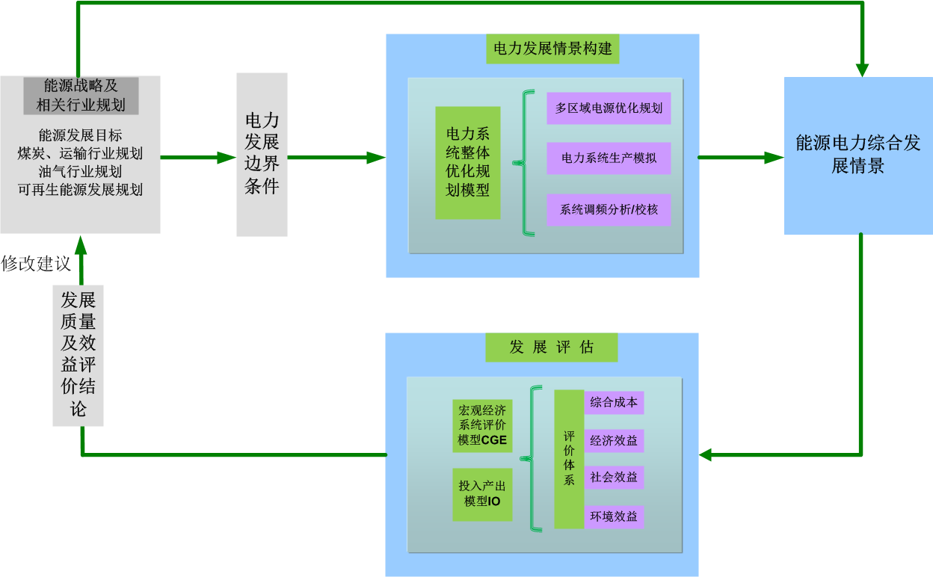
Overall design of clean energy development
Scenario construction: considering national energy strategy; coordinating supply and demand balance of coal, gas and electricity; forming electric power development scenario by combining power planning
Scenario analysis: analyze the electricity and layout ,running method and development and consumption situation of clean energy power under different development scenarios
Benefit evaluation: evaluate quality of all development scenario to provide the basis of the route of fulfilling the objective of clean energy and suggestion for formulating the energy strategy and related industry planning
Electric power development scenario construction
Energy strategy and relevant industry planning
Electric power development boundary conditions
Model for overall optimization and planning of power system
Optimization of multi-regional power
Overall development scenario of the energy power
Energy development goals
Coal and transportation industry planning
Oil & gas industry planning
Renewable energy development planning
Production stimulation of power system
Analysis/Verification of system frequency adjustment
Revision suggestions
Development quality and benefits evaluation conclusion
Development evaluation
CGE Model
Evaluation system
Overall cost
Economic benefits
IO Model
Social benefits
Environmental benefits
23
Overall design thinking of clean energy, conventional energy and power system
23

Slide 24
Build a coordinating development model for energy resource and power generation to adapt to the energy mix and adjust the target
I. Optimization of multi-regional power
Optimization of multi-regional energy resource: optimize the scale and layout of all kinds of power development as the input condition of renewable energy consumption plan computing
Power system output stimulation : optimize the operational model of the power system accommodating renewable power generation, the consumption method of wind power and other renewable energies and hydro and wind curtailment level.
Analysis/Verification of system frequency adjustment: identify the impact of the development and consumption plan for wind power and other intermittent power on the stability of system frequencyand adjust the consumption plan for wind power and wind curtailment level.
1. Identify the scale and layout for non-fossil energy power development
2. Optimize the scale and layout for power and power flow in various regions
3. Identify the total costs and composition of power system
4. Emission scale and layout of environmental pollutants and CO2
Adjusting wind power consumption plan and electricity level of wind and solar curtailment
II. Production stimulation of power system
1. Identify the operating curve of various power including wind power
2. Identify the operating curve of trans-provincial connection line
3. Identify wind and solar curtailment and fuel consumption CO2
No
Whether there exist acceptable limits in wind and solar curtailment levels in various regions
III. Analysis/Verification of system frequency adjustment
1. The overall situation of system frequency adjustment capacity and evaluation
2. Adjust wind power consumption plan and wind and solar curtailment level
Yes
Plan for output power planning scenario
24

Slide 25

(3) Wind power flow pattern
Heilongjiang
Northeast
Eestern Inner Mongolia
Jilin
Liaoning
Xinjiang
Western Inner Mongolia
Ningxia
Hebei
Northwest
Gansu
Shanxi
Shandong
Most grids in China's wind power bases are small in scale and insufficient in wind power consumption capacity, and the large-scale development and high-efficient use must rely on long-distance, large-volume and trans-regional delivery.
Northwest: in addition to consumption in the northwest grid, Xinjiang’s and Gansu’s wind power needs to transmit to “Three Chinas (East China, North China, Central China)" receiver-side grid at a large scale.
Northeast: based on taking full advantage of all regions' consumption and trans-provincial adjustment, it needs to deliver to " Three Chinas".
Western Inner Mongolia: apart from consumption within the region, wind power should be delivered to “Three Chinas" receiver-side grid .
Wind power fromHebei, Shandong and Jiangsu coordinately consumes within “Three Chinas" grid.
西
藏
Jiangsu
“San Hua“ region
receiver-side
grid
South
Notes:
25
Clean energy refers to primary energy which won’t emit pollutants and GHG which may damage the atmospheric environment in their conversion process. They include hydro power, nuclear power, wind power and hydro power, et.

Slide 26
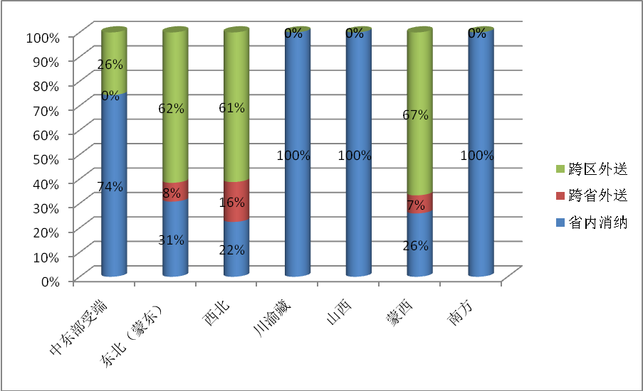
According to the plan , by 2020, the national wind power development scale will reach 200 million kW. Wind power consumption within the province will reach 96 million kW, trans-provincial consumption 14 million kW within regional grid and trans-regional grid consumption 90 million kw. Trans-provincial trans-regional consumption will amount o 50% by then, then the proportion of wind curtailment can be controlled below 5%.
Trans-regional delivery
Trans-provincial delivery
Intra-provincial consumption
NE (Eastern Inner Mongolia)
Sichuan, Chongqing and Tibet
Western Inner Mongolia
South
Central and eastern region receiver-side
NW
Shanxi
Proportion wind power consumption in main regions in 2020
26

Slide 27
To promote efficient use of clean energy like wind power, sending and receiver-side of the power grid have to satisfy the requirements of high-efficient integration and coordinated operation among various energies.
With increased scale of trans-regional power flow, the receiving propotion in receiver-side regions such as Beijing, Tianjin, Hebei and Shandong, four eastern provinces of Central China and East China will be increased and the running complexity of power system will be greater in the future.
There are higher requirements for resource allocation capabilities and coordinated operation platform functions of sending and receiver-side power grids, eg, require larger coverage and strong grid structure and further improved dynamic balancing ability and greater safety and stability level.
27

Slide 28
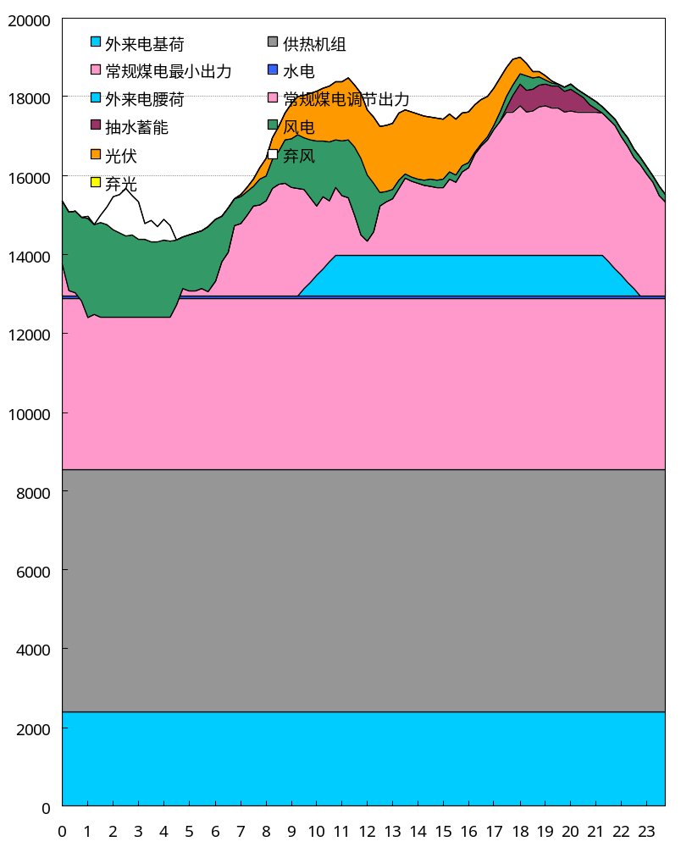
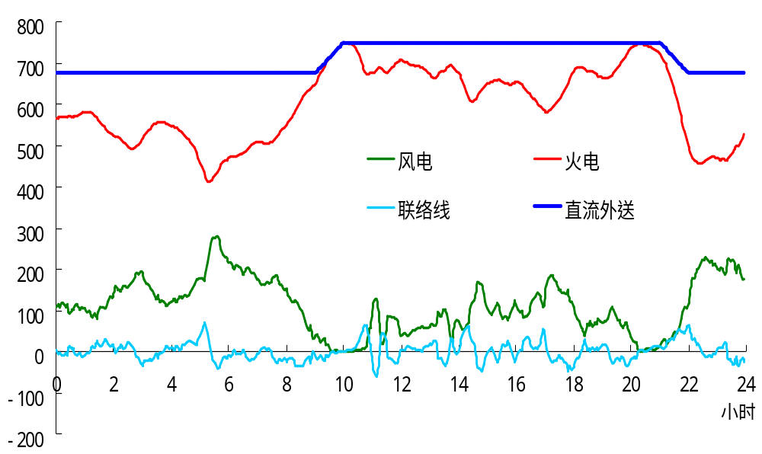
Base load of external power
Minimum output of conventional coal power
Medium load of external power
Pumped storage
PV
Solar curtailment
Heat supply units
Hydro
Regulating output of conventional coal power
Wind power
Wind curtailment
Wind power
Thermal power
Connection line
Direct current delivery
Hours
Sending side running curve
Receiver side grid running curve
28

Slide 29
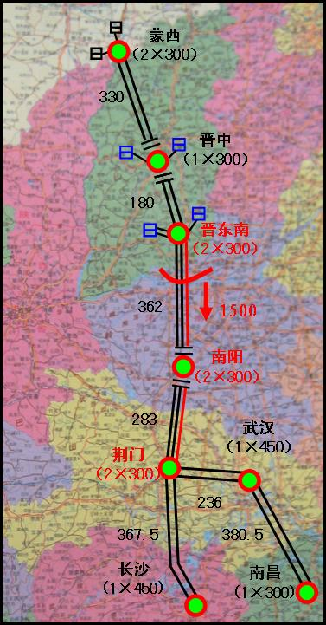
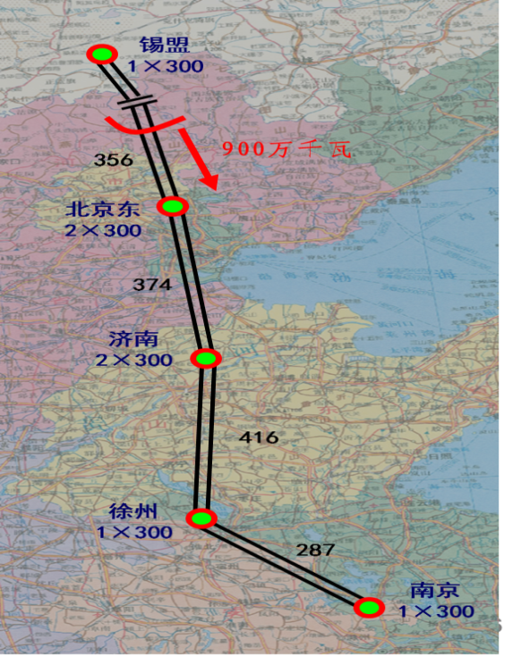
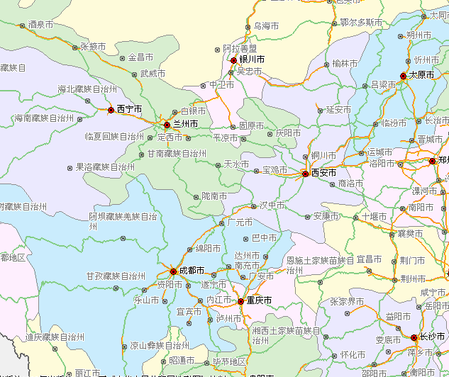
Currently, specialized plannings for national renewable energy sources, wind power and photovoltaic power have been issued, while transmission channels of new energy bases have not been implemented yet, including Xilingol League-Nanjing and Western Inner Mongolia- Changsha UHV AC power transmission projects targeted at Western Inner Mongolia wind power, and Jiuquan-Hunan, Hulun Buir-Shandong, Zhangbei-Nanchang UHV power transmission projects targeted at northwest, northeast and Zhangjiakou respectively.
Jiuquan
Hunan
Western Inner Mongolia -Changsha
Xilingol League-Nanjing
Jiuquan-Hunan
29

Slide 30
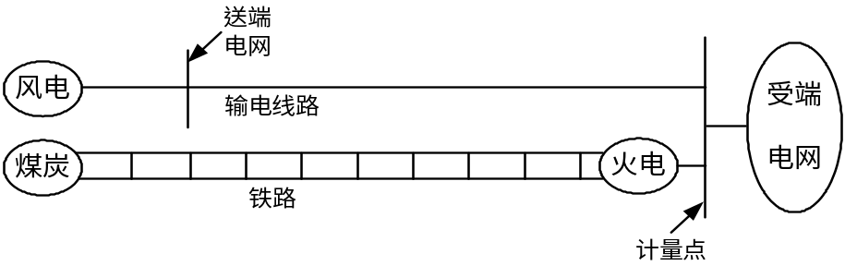
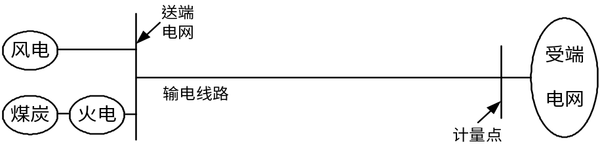
(4) The technical and economical problem of wind power delivery
Ways of wind power transmission
Way 1 Separate transmission of “coal or wind power"
Sending–side wind power is transmitted to the receiver side through long distance line. Sending–side coals supply to coal plants in the receiver side through long-distance railway transmission, and the average tariff in the receiver-side grid will be measured based on the ground tariff and feed-in tariff.
Way 2 "Coal and wind power" combined transmission
Sending–side combined wind power and coal power to be transmitted to the receiver side through long distance line, and the ground tariff of receiver-side grid will be calculated.
Sending-side grid
Sending-side grid
Wind power
Receiver-side grid
Receiver-side grid
Transmission line
Wind power
Coal
Thermal power
Transmission line
Railway
Coal
Thermal power
Measuring point
Measuring point
Way 1 Separate transmission of “coal or wind power”
Way 2 "Coal and wind power" combined transmission
30

Slide 31
Using coal power channel to transmit clean energy like wind power, improve the economics and safety of transmission and promote the large-scale development of clean energy.
Xinjiang, Erdos, Xilingol League areas are quite rich in wind energy and coal resources with close distribution, which has good conditions for combined transmission. The main way for transmission of clean energy is joint delivery of wind, solar and coal.
In Eastern Inner Mongolia and Northeast areas with poor overlapping distribution of wind power and coal resources and limited delivery capacity of conventional energy in some areas, wind power-centered delivery method can be explored and demonstrated as the possible way for large-volume clean energy transmission under the premise of technical feasibility.
31

Slide 32
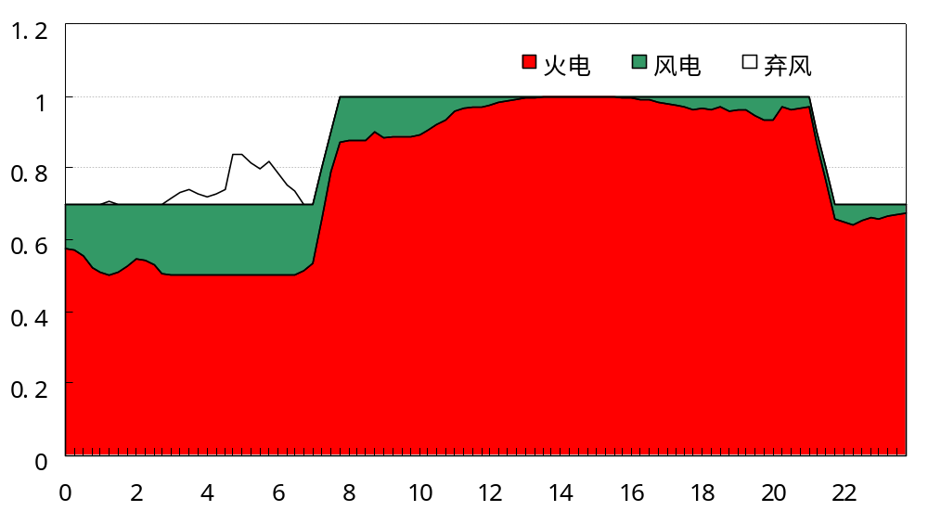
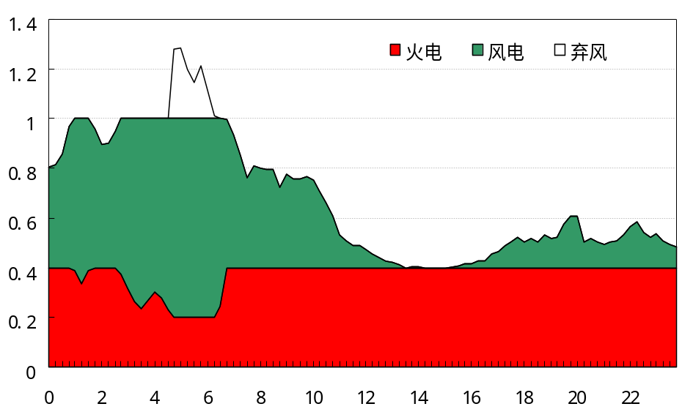
Combined delivery way
Wind power-centered delivery way
Thermal power
Wind power
Wind curtailment
Thermal power
Wind power
Wind curtailment
Small scale wind power transmission, dominated by coal power and complemented by wind power
Controllable transmission power curve, better matching with receiver-side load
More utilization hours, and low transmission cost
About 5% of wind curtailment
100% capacity replacing benefits
Large scale wind power transmission, dominated by coal power and complemented by wind power
Bigger fluctuation of transmission power
Less utilization hours, and high transmission cost
about 10% of wind curtailment
Less capacity replacing benefits
32

Slide 33
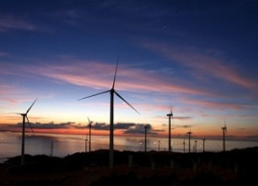
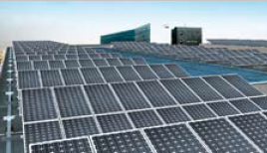
5. Conclusion
33

Slide 34
Adjusting energy structure and coping with climate change are the main direction for China's energy development. Vigorously developing clean energies, such as wind power and solar power is the significant measure to promote China's energy structure adjustment, ensure the safety of energy supply and coordinate the development of energy and environment.
The development of China's wind and solar power and electricity consumption center presents reverse distribution situation, which determines that it is a must for accelerating the construction of trans-provincial power transmission channel and promoting the large-scale power transmission from "Three Norths" while developing such peak regulating power as pumped storage power, gas filed power plant and so on; Meanwhile, it also requires to strengthen the interconnection of North China-East China and Central China-receiver-side grid so ad to provide a larger market platform for accepting external wind power. In addition, it also needs strengthening the construction of distribution system to support the development of distributed power.
34

Slide 35
Thank you!

