Slide 1
Overview of Wind Energy Grid Integration in USA
ADB Wind Energy Grid Integration Workshop
Sept 23, 2013
Pramod Jain, Ph.D.
President, Innovative Wind Energy, Inc.
International Consultant to ADB’s Quantum Leap in Wind
pramod@i-windenergy.com

Slide 2
Wind Energy Status
 | Onshore | Offshore
Wind Power Potential in the Country | 28,000 GW | 4,000GW
Wind Power Installations (MW) as of 2012 | 60,000 | 0
Wind Power Installations (MW) by 2015 | 14% annual
Wind Power Installations (MW) by 2025 | 6% annual
% Wind Power in Grid as of 2012 | ~4%
% Wind Power in Grid by 2015 | ~5%
% Wind Power in Grid by 2030 | ~14%
Tariff for wind energy (range) | $40/MWh in 2011/12
Incentives for wind energy | $23/MWh, 10 yrs
Maximum penetration of wind energy into grid (if this has been studied) | 20% by 2030

Slide 3
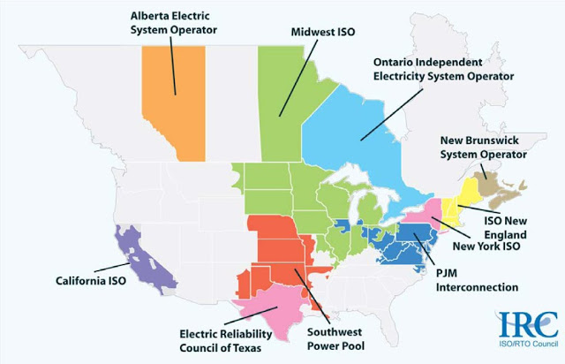
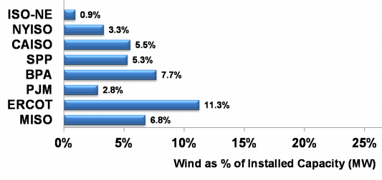
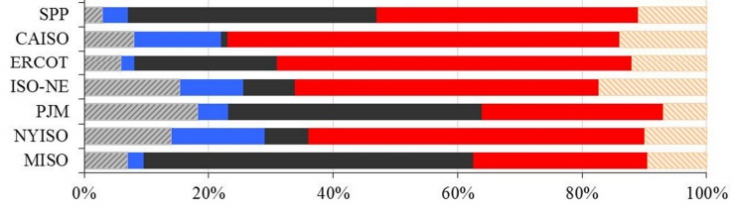
Wind Penetration & Generation Mix by Region
Total electricity demand in 2010: 3,749 TWh, annual growth rate of 0.8%
Source: Brattle Group

Slide 4
Grid Integration Issues
Issues | Comments
Lack of Transmission | Significant transmission has been and is being built. Fast track approvals have helped
Lack of spinning reserves | Sufficient gas-fired turbines are available as spinning reserves
Demand is low at off-peak hours | infrequent
Lack of flexibility in current generation | Gas and hydro provide flexibility
Lack of flexibility in demand | Demand response and smart grid rollouts are picking up steam
Texas/ERCOT wind curtailment has dropped from 17.1% in 2009 to 2.5% in 2012
Next highest curtailment was 2% in 2009 in MISO
You may choose to talk about different regions of country.

Slide 5
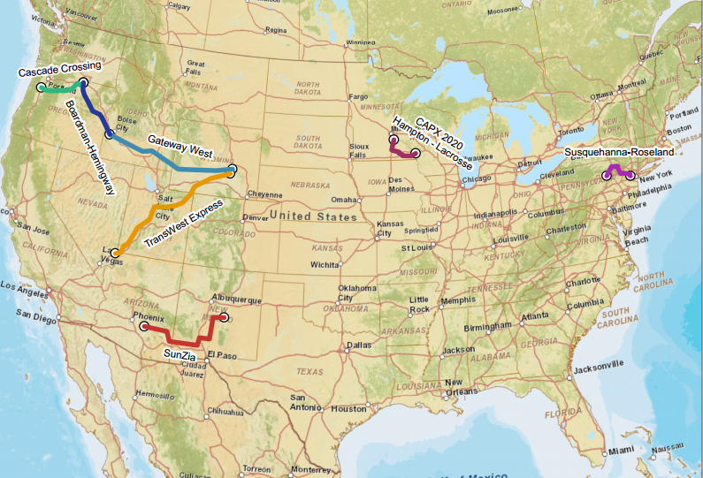
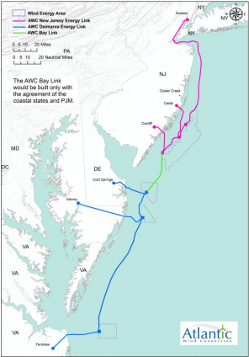
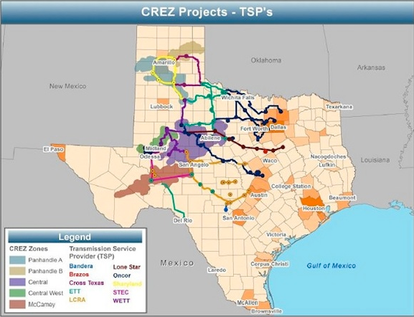
Transmission Lines to Support Wind Projects
New transmission lines, part of RRTT, total of about 50GW
Texas: 345kV lines to deliver 6GW of wind energy from West Texas to South and East Texas
6GW of grid backbone for offshore wind
http://trackingsystem.nisc-llc.com/etrans/defaultmap.pdf
http://www.atlanticwindconnection.com/ferc/Jan2013/TCG-Atlantic%20Wind%20Connection%20Report%20JAN%209.pdf

Slide 6
Grid Code for Wind Energy Integration
Issues
Active Power Control
Fault Ride Through | *
Voltage, Reactive Power control | *
Power quality
Protection
Communication and data requirements | *
Forecasting
Federal Energy Regulatory Commission (FERC) issued grid code in 2005. It forms basis for minimum requirements. Each RTO has additional requirements.

Slide 7
Grid Operations/Wind Power Dispatching
Scheduling timeframe | Depends on region. Hourly scheduling in West
Curtailment of wind power | Depends on region. 2 to 2.5%
At peak supply of wind energy, which source of generation is reduced | Gas-based generators, Hydro
Is Wind Energy Forecast required? | Yes, in most RTOs
How is rapid ramping up/down of wind energy managed? | Gas-based generators
What are integration costs? | For 40% of peak load penetration, various studies predict cost of $5/MWh or less
Present logic for dispatching wind: Is wind considered source with low marginal cost?

Slide 8
Solutions to Increased Wind Energy Penetration in US
Revising rules in both the operations and planning horizons, by changing the way to procure and price services/products
Increasing balancing area coordination
Improving interconnection and transmission planning processes
Source: Judy Chang, Brattle Group

