Slide 1
Overview of Wind Energy Grid Integration in Australia
ADB Wind Energy Grid Integration Workshop
Sept 23, 2013
Dr Geoff James
Specialist, Renewable Energy Integration and Energy Storage
geoffcjames@gmail.com

Slide 2
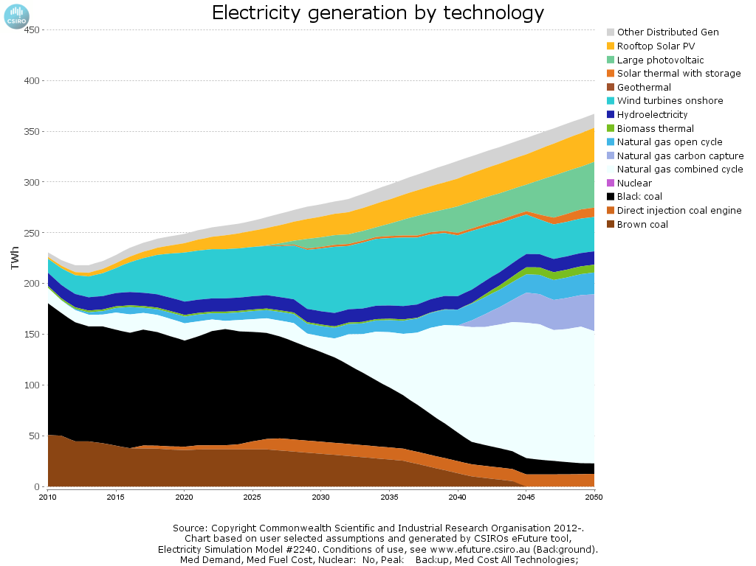
Projected energy mix to 2050
CSIRO, http://efuture.csiro.au
Rooftop solar PV
Onshore wind
Demand reduction

Slide 3
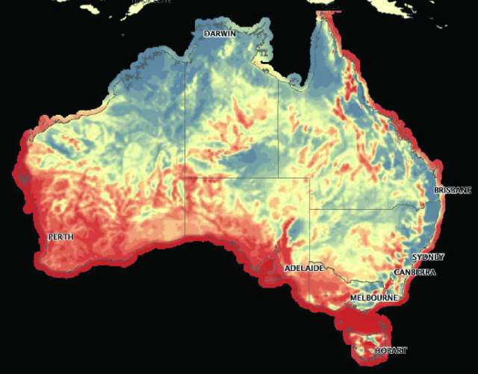
Wind Energy Resources
Dept of Environment (2008) Renewable Energy Atlas

Slide 4
Wind Energy Status
BREE (2013) Energy in Australia, AEMO (2012) 100% renewable energy study, on-line commentary
 | Onshore | Offshore
Wind Power Potential in the Country | 880 GW (eastern states with CF > 35%) | 660 GW (eastern states with CF > 50%)
Wind Power Installations (MW) as of 2012 | 2,127 MW | 0
% Wind Power in Grid as of 2012 | 2.4% of energy 4.1% of capacity | 0
Tariff for wind energy (range) | Wholesale: 40-70 $/MWh in 2012/13 Bilateral contracts: 90-100 $/MWh
Incentives for wind energy | Renewable Energy Certificate 40 $/MWh
Maximum penetration of wind energy into grid (if this has been studied) | 47% of power observed in South Australia 26% of energy from wind in 2011-12

Slide 5
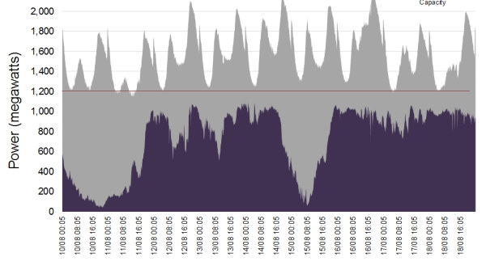
Demand and wind in South Australia
AEMO MMS database for 10-16 August 2013

Slide 6
Wind Penetration by Region
BREE (2013) Energy in Australia
State | Capacity in 2012 (MW)
NSW & ACT | 188
Victoria | 428
Queensland | 12.5
South Australia | 1,152
Western Australia | 205
Tasmania | 143
Northern Territory | 0.1

Slide 7
Wind Penetration by Region
Jackson (2012) Wind in the NEM
 | Installed capacity |  |  | Proposed capacity
 | Scheduled & Semi Scheduled | Non- Scheduled | Total | Committed | Publically Announced (Approx.)
NSW | 95 | 186 | 281 | 0 | 4,635
SA | 388 | 815 | 1203 | 0 | 2,215
Tas | 0 | 140 | 140 | 168 | 330
Vic | 432 | 67 | 499 | 440 | 3,518
Qld | 0 | 12 | 12 | 0 | 1,129

Slide 8
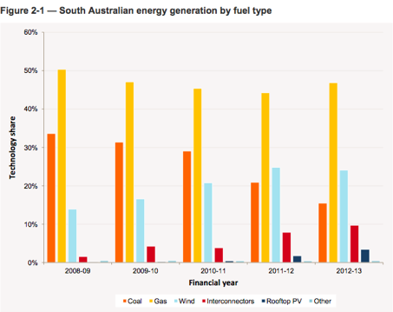
Generation mix in South Australia
Parkinson (2013) South Australia’s changing energy mix

Slide 9
Grid Integration Issues
Issues | Comments
Lack of Transmission | Integrated national planning allows for changing generation mix. However policy uncertainty inhibits investment in wind and associated transmission.
Lack of spinning reserves | There is no present lack of spinning reserves due to investments in gas generation. Energy storage is advancing as an alternative flexibility resource. Considering markets for inertia or very fast FCAS.
Demand is low at off-peak hours | Interconnectors and other network elements can constrain wind at times of high wind and low demand, and this has caused price collapse in South Australia.
Lack of flexibility in current generation | Gas and hydro provide flexibility.
Lack of flexibility in demand | Demand response programs are not yet widespread but are steadily advancing.

Slide 10
Grid Operations/Wind Power Dispatching
Scheduling timeframe | 5-minute dispatch operates across the eastern states of Australia – an attractive market for wind integration.
Curtailment of wind power | Network-constrained curtailment has occurred.
At peak supply of wind energy, which source of generation is reduced | Short term: gas-based generators and hydro (where available) are balancing resources. Long term: coal generators are proving uneconomic and being decommissioned or reduced to seasonal operation.
Is Wind Energy Forecast required? | Yes, using the European ANEMOS system adapted for 5-minute dispatch, which has proved highly successful.
How is rapid ramping up/down of wind energy managed? | Gas and hydro generators are the traditional means, while energy storage is increasingly used by system integrators and some generators.
What are integration costs? | Not quantified yet.

