Slide 1

Wind Power Forecasting
Cao Xiao
September, 2013
Notes:
Good afternoon , Now， Allow me to introduce Smart Grid & Wind Power Forecasting.

Slide 2
Content
Current situation of forecast technology
Forecast principle of wind power
Key technology of forecast
Development of forecast technology
Cooperation with ADB
Notes:
The introduction of the technology of wind forecasting inculde:
Current situation of forecast technology
Forecast principle of wind power
Key technology of forecast
Development of forecast technology
Cooperation with ADB

Slide 3

Current situation of forecast technology
1.The technology has a long history and higher level at abroad.
2.The forecast technology has not been studied in China until 2007 .
3.The major method :statistic & physical.
4.The monthly RMSE criterion : (short-term) less than 20%，(ultra-short term) less than 15%.
Notes:
The study in wind power forecast in the world has a long history of almost 20 years. The earliest study group is Risoe national lab in Denmark.Denmark, German, Spain has a higher level of forecast technology. The forecast technology has not been studied in China until 2007 and has been largely improved after recent years of research and development. NARI has already built wind power forecast system in areas with abundant wind energy like North China, Northeast China, East China and so on, which to be cover nearly 60 wind power stations, and with a installed capacity of more than 7 million Kilowatt.
The adopted . forecast technology at home and abroad are mainly statistic method , physical method, and the combination of statistic and physical methods. The forecast method of value set has been studied internationally to increase the accuracy of wind speed forecast. The multi-value forecast mode is used to increase the forecast accuracy.
Combining the layout features of Chinese wind power station and the current status of domestic forecast technology, the indicator of technical requirement implemented domestically now are: the monthly root-mean-square error（RMSE） of short-term forecast should be less than 20%，the monthly RMSE of ultra-short term should be less than 15%. The forecast system developed by NARI could meet all the above requirement of technical indicator, the RMSE of the systems put into operation is between 9%－20%.

Slide 4
Forecast principle of wind power
Numerical Weather Prediction(NWP)
Mast
Real-time Data
AWS
Real-time Data
Wind Forecasting Model
AWS
Historical Data
Mast
Historical Data
Statistical & Physical method
Wind Farm
Real-time Data
Mast
Historical Data
Power Forecasting Model
Wind Turbine
Historical Data
Human-computer Interface
Notes:
The basic principle of wind power forecasting is based on historical weather data, historical power data , wind turbine data and geographical information of wind power station, building weather forecast model and power forecast model by the combination of statistic method and physical method.
We regard real-time weather data and NWP data as the input of weather forecast model to acquire the forecast value of wind speed and wind direction.
If we input the forecast value of weather element, real-time power data of wind power station into the power forecast model.,We would acquire power forecast value.

Slide 5
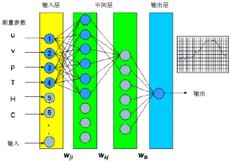
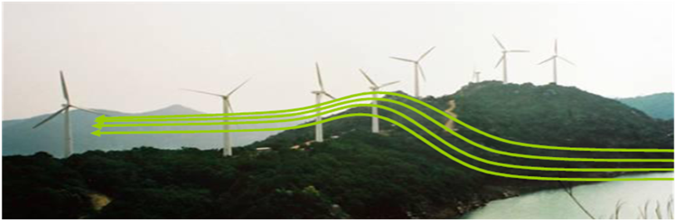
Forecast principle of wind power
Statistic Method:
building the relativity between weather element and power output.
1 .The different mathematical models could be adopted.
2. The large amount of historical data is needed to conduct training.
3. The regular retraining for the model is needed.
Physical Method:
calculate wind speed and direction at the hub height.
1.NWP, WT/WasP and so on could be adopted to calculate the wind speed and direction in the surface layer.
2.Boundary conditions are needed.
Notes:
Forecast Principle of Statistic Method: building the relativity between weather element and power output.
The different mathematical models like Time Series Analysis, Artificial Neural Network, and so on could be adopted.
The large amount of historical data is needed to conduct training.
The regular retraining for the model is needed.
Forecast Principle of Physical Method: calculate wind speed and direction at the hub height.
NWP, WT/WasP and so on could be adopted to calculate the wind speed and direction in the surface layer.
Boundary conditions like wind turbine position, the hub height, the geographical character, the roughness of the surface, the power curve of wind turbine and so on are needed.

Slide 6
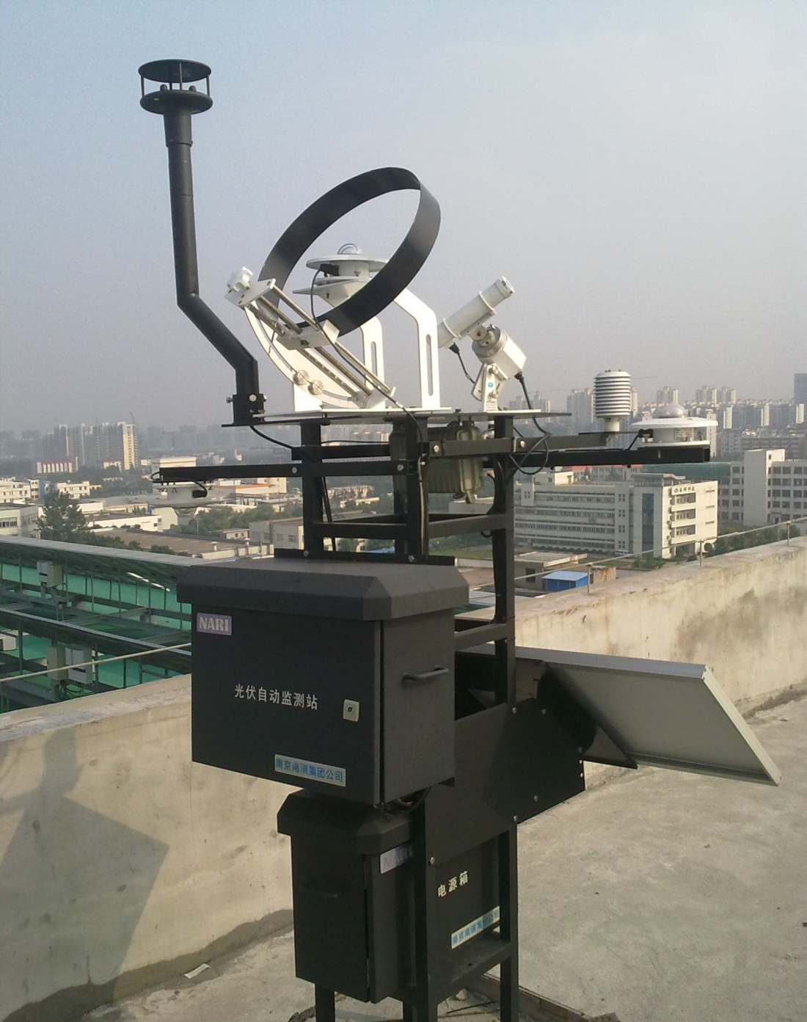

Key technology of forecast
Technology of Real-time Weather Date Acquisition
Weather element : wind speed/direction, temperature, humidity, air pressure, radiation
Height :10/30/70meters and hub height.
Notes:
Realize real-time acquisition of the weather element data like wind speed, wind direction, temperature, humidity, air pressure, radiation and so on at 10、30、70meters and hub height （ the different high level ）in wind power station area. These data are the key data source of realizing ultra-short term forecast and model check of NWP.

Slide 7


Key technology of forecast
Numerical Weather Prediction:
Regard GFS (global forecasting system) as the background field.
Based on ADAS (ARPS Data Analysis System).
Combine large amount of locally actual measurement data.
Debug Mesoscale model WRF.
Adopt application technology
output 0-72 hours’ forecast value of wind speed and direction.
measurement data
data processing
server
GFS
ADAS
detailed forecast value
WRF
Forecast value
Application
Technology
Notes:
Based on ADAS (ARPS Data Analysis System), regard GFS (global forecasting system) as the background field, combine large amount of locally actual measurement data, debug Mesoscale model WRF( Weather Research and Forecasting), adopt application technology, then we could obtain 0-72 hours’ forecast value of wind speed and direction at the hub height.

Slide 8
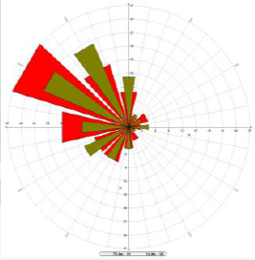
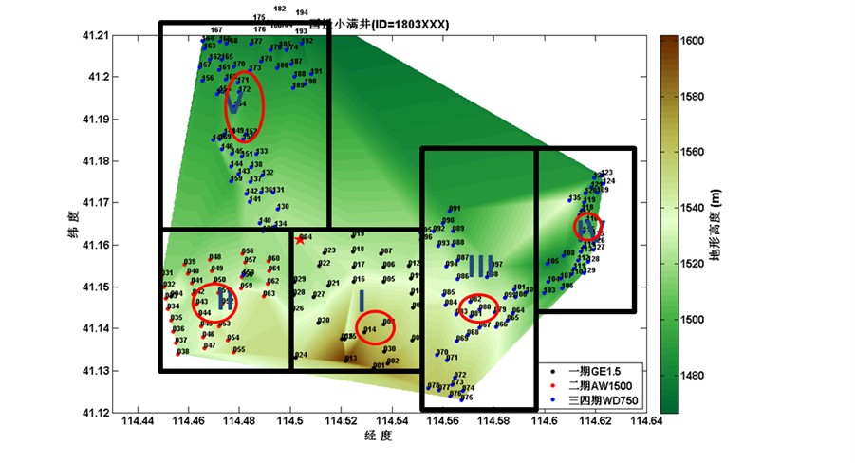
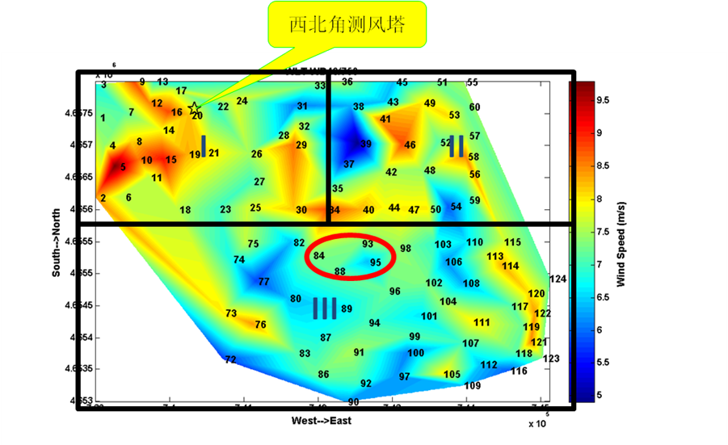
Key technology of forecast
Technology of Forecast Modeling :
1.Establish weather forecast model by the combination of statistic and physical methods.
2.Establish power forecast models in accordance with the conditions ( geography and climate features , type and distribution of wind turbine and so on).
Notes:
Technology of Forecast Modeling:
Establish forecast model of weather element by the combination of statistic and physical methods, to realize the forecast of wind speed, radiation and so on.
Establish applicative power forecast models like single turbine model, region model, whole wind farm model and so on to realize the forecast of wind power, in accordance with the detailed conditions like geography and climate features in the station, type and distribution of wind turbine and so on.

Slide 9
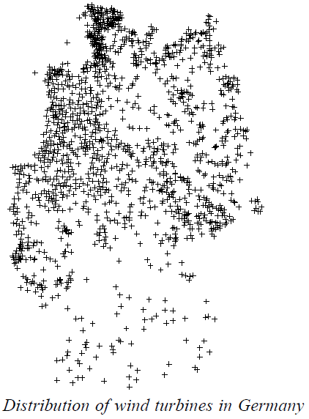
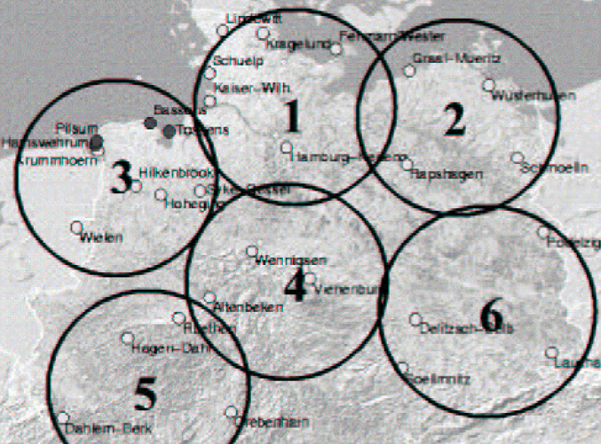
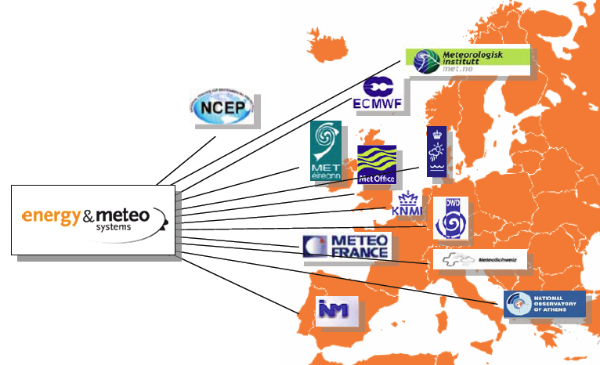
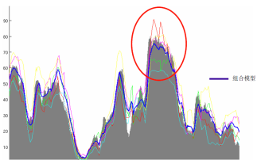
Development of forecast technology
1、The Diversity of Wind Power Forecast Result at Home and Abroad:
(1) Distribution of wind power stations
Large scale of collective distribution in China.
More expansive and equal in Europe
(2)NWP level
The weather stations are dense distribution in the Europe .
The geographic location Europe lies are beneficial to NWP.
Many commercialized weather service companies in Europe.
Notes:
The Diversity of Wind Power Forecast Result at Home and Abroad:
1、Distribution of wind power stations
Compared with the large scale of collective distribution in Chinese, the wind power stations in Europe are more expansive and equal, so the smooth effect of the forecast in this area is much better, which is beneficial to the accurate forecast of wind power .
The right picture is about distribution of wind turbines in Germany.
（2）NWP level
The European weather station has a highly distribution density and the geographic location it lies has determined the fact that it has much less sudden-change weather like strong convection than China, all of which are beneficial to the NWP.
There are many commercialized weather service companies in Europe, most of the forecast system adopt more than 3 NWP service, and at the same time, it has the application of collective forecast product that are based on all the NWP, which could reduce system deviation of single NWP.
The left picture is about a forecasting system adopts many NWP service .

Slide 10

Cooperation with ADB
Demand of China
Mission of ADB
Smart Grid
&
Reduce CO₂ emission
Eliminating Poverty
&
Environment Sustaining
TA7721-PRC: Developing Smart Grid for Efficient
Utilization of Renewable Energy
Notes:
ADB has carried out many projects to help china develop the economy and reduce CO2 emission. In the last year, SGCC collaborating with ADB start a new project to develop the smart grid and utilize the renewable energy in north china. So, the project TA7721 was born. In this project, North China Grid Corporation (NCGC) is the Executive Agency.

Slide 11

Smart Grid Demonstration Project
Wind Power Forecast
Acceptable
Capacity
Scheduling
GCA
Wind power
Control
Integration Scheduling System of Smart Grid (D5000)
Information
Of Wind Farm
Notes:
This the is smart grid demonstration project of integration scheduling system as one of the subtopics of the TA project. Thanks to IT and communication tech., the real-time information collection of wind farm is achieved, and Wind power forecast is optimized for improving the acceptable capability of wind power.

Slide 12
Wind Power Forecast Result
Date: 2011.04-2011.05
Date: 2011.11-2011.12
Forecast the
Weather Trend
RMSE=12.72% MAE=9.77%
Corr=74.71% Rate=87.44%
RMSE=8.1% MAE=5.82%
Corr=86.86% Rate=96.88%
Significant improve !
WPF Result of NCGC
Error
Notes:
This is the forecast result of optimized by this TA project. We can cleanly see that the forecasted red line and the measured black line match with each other very well, even in the rapid changing period. And the accuracy is significant improved, compared with old forecast model. Error reduced, correlation increase.

Slide 13
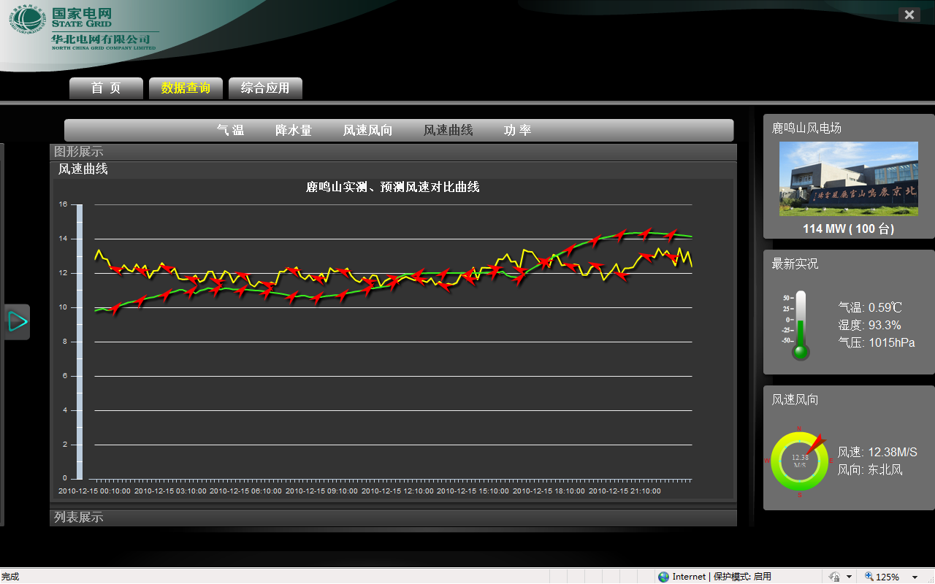
Case : Wind Forecasting

Slide 14
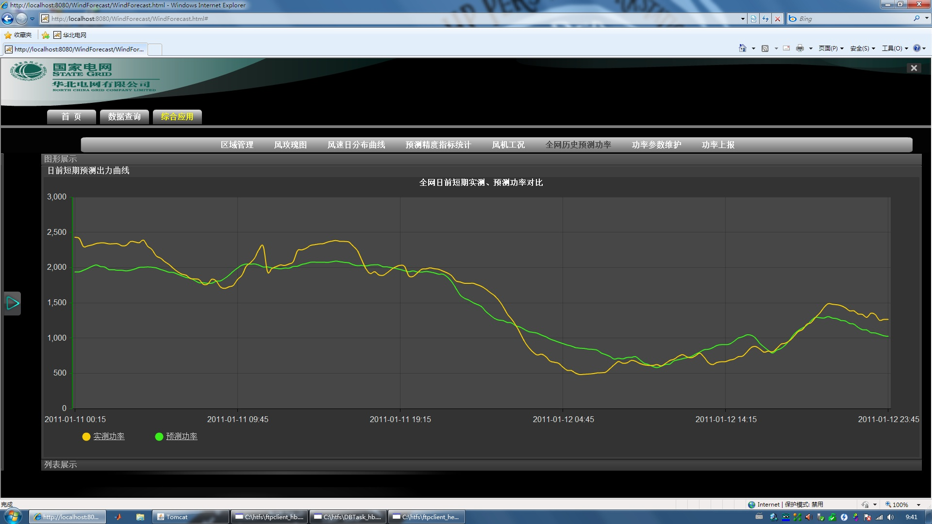
Case : Wind Power Forecasting

Slide 15
Cao Xiao
Address:No.8 Nanrui Road , Nanjing PRC 210003
TEL:+86 25 83092802 FAX:+86 25 83092877
Mobile:+86 13813889826
Email:caoxiao@sgepri.sgcc.com.cn
Thank you!
Notes:
Excuse me, In order to describe it accurately, I speak it in chinese. Somebody help me to translate it . thank you very muh.

