Slide 1
Beijing | Brussels | London
Global Wind Power Update
Steve Sawyer, Secretary General
June 21, 2011
Quantum Leap In Wind – ADB
Manila

Slide 2
Beijing | Brussels | London
C0 Members
C2 Members
Associations
GWEC – Uniting the global wind industry and its representative associations

Slide 3
Beijing | Brussels | London
2010 growth: 24.1%
14 yr avg growth: 28.3%
3
Notes:
1997: 24.6%; 1998: 34.2%; 1999: 33.3%; 2000: 27.9%; 2001: 37.4%; 2002: 30.1%; 2003: 26.8%; 2004: 20.8%; 2005:24.1%; 2006: 25.3%; 2007: 26.7%; 2008: 28.7%; 2009: 31.9%; 2010: 24.1%: tot 395.9 = 28.28% for14 years… 2000-2010 average %

Slide 4
Beijing | Brussels | London
2010 growth: -0.5%
14 yr avg growth: 29.2%
Notes:
1997: 19.5%; 1998: 64.7%; 1999: 36.5%; 2000: 9.3%; 2001: 72.9%; 2002: 11.8%; 2003: 11.9%; 2004: 0.9%; 2005: 40.5%; 2006: 32.2%; 2007: 30.3%; 2008: 36.2%; 2009: 41.7%; 2010: -0.5% = 408.9/14 =29.2 – 2000-2009 avg 28.77%

Slide 5
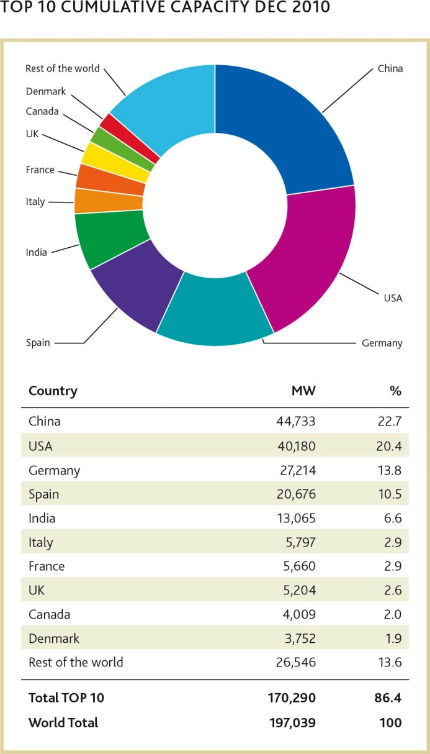
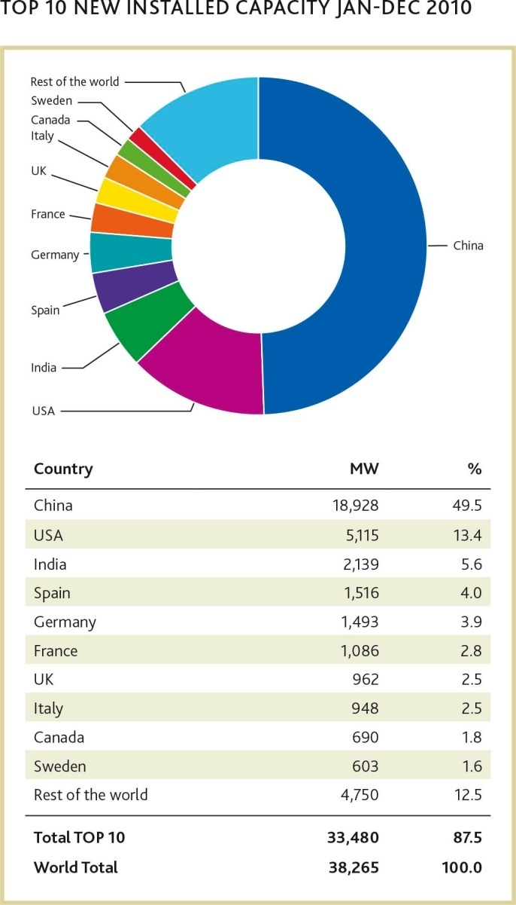
Beijing | Brussels | London

Slide 6
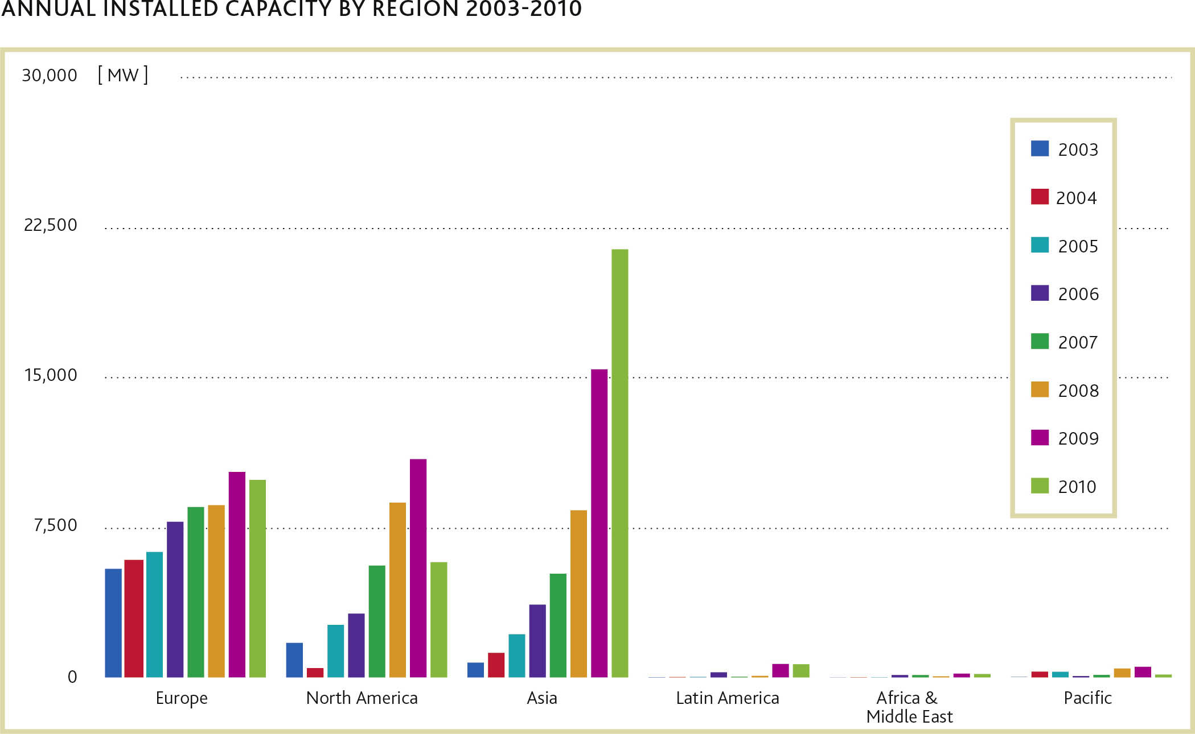
Beijing | Brussels | London

Slide 7
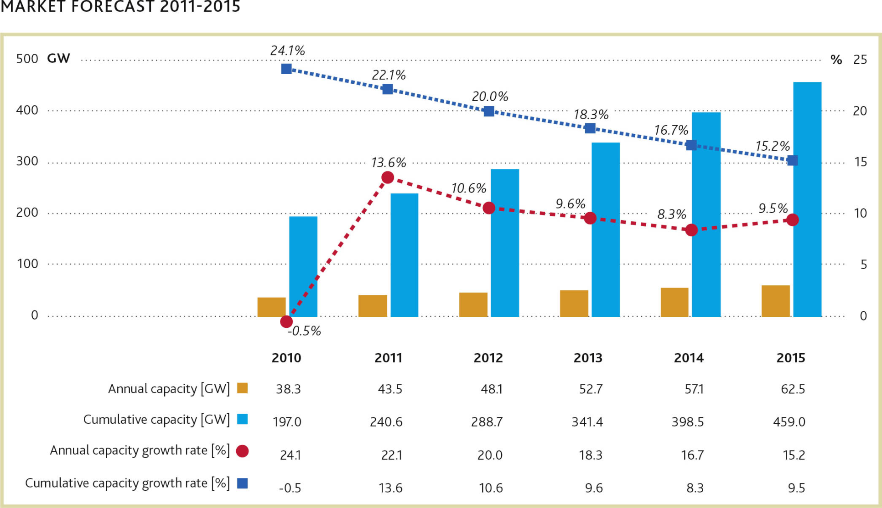
Beijing | Brussels | London

Slide 8
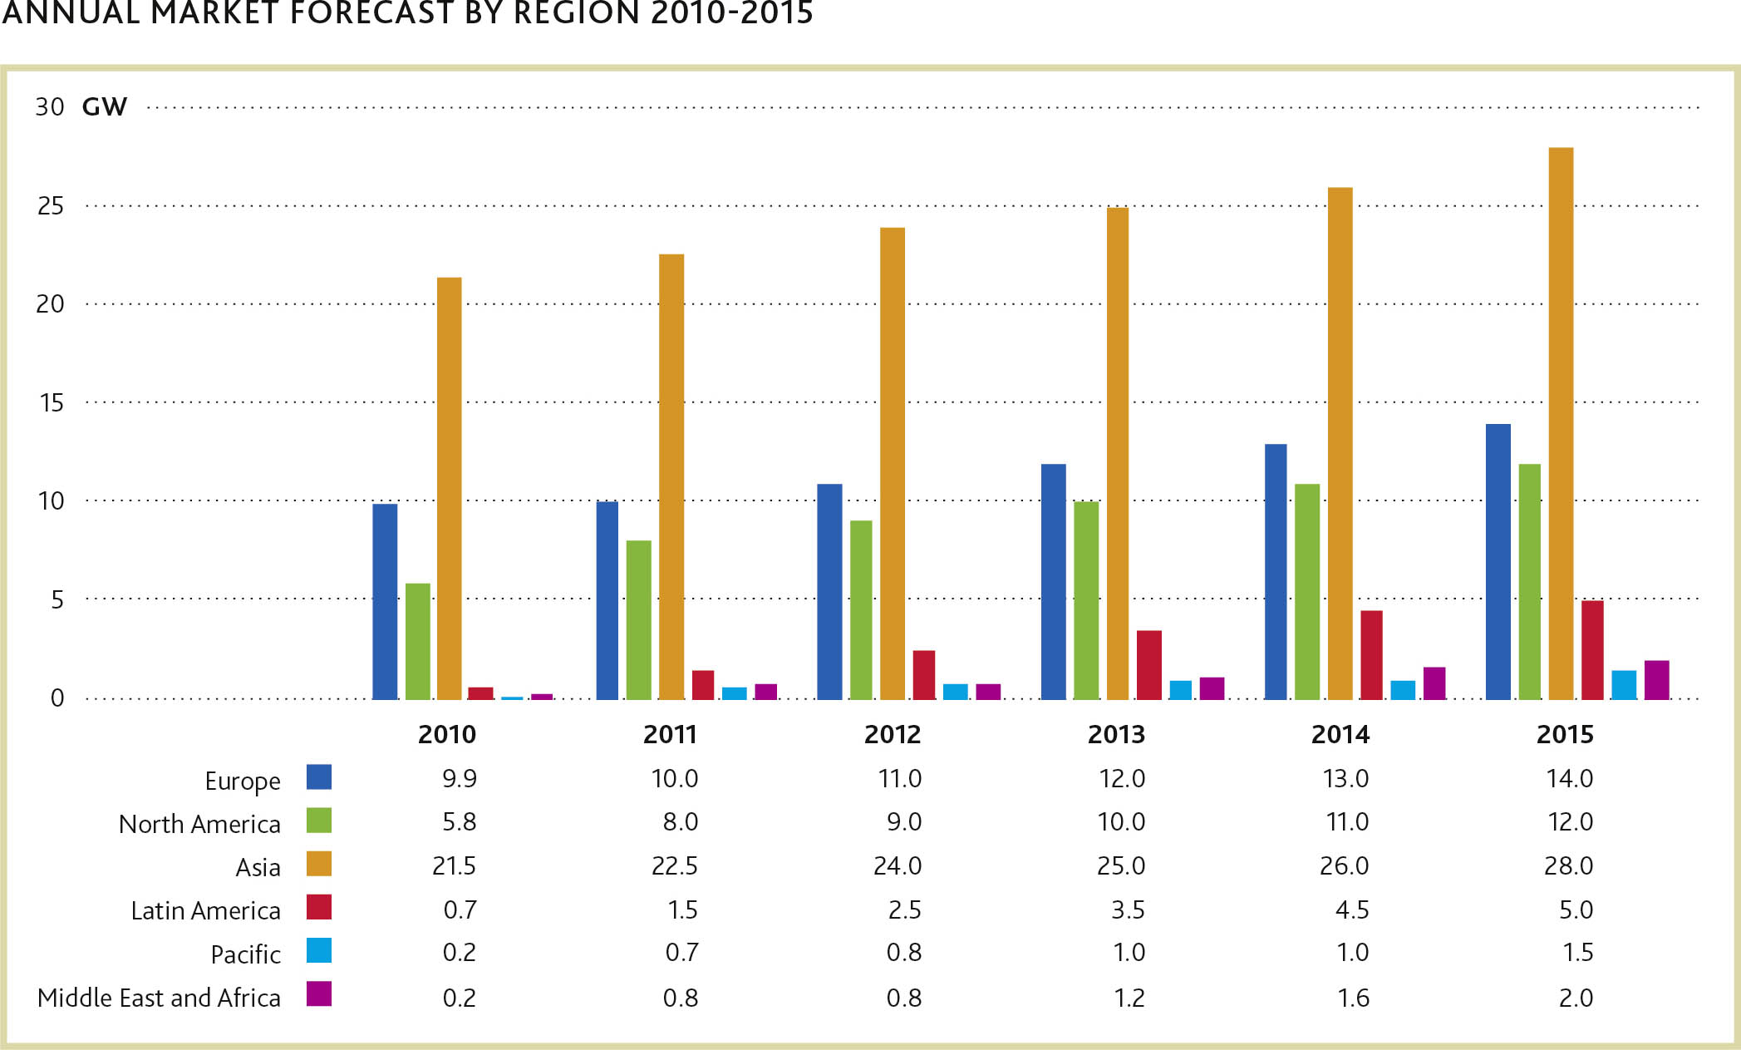
Beijing | Brussels | London

Slide 9
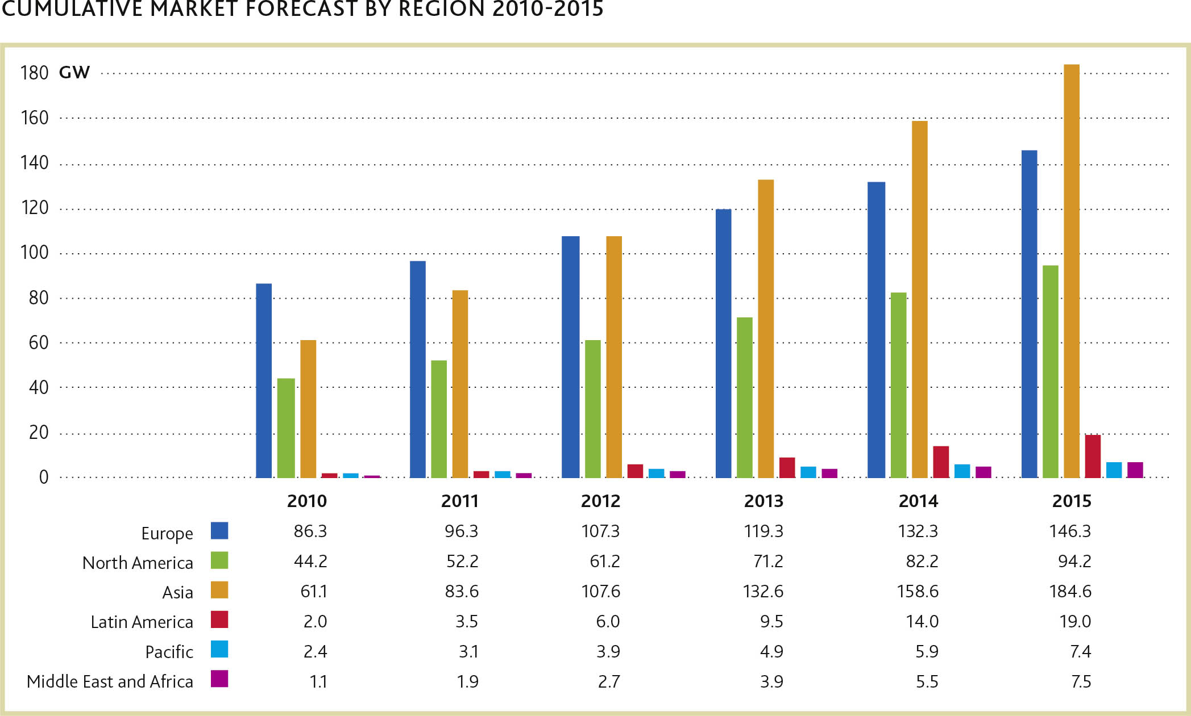
Beijing | Brussels | London

Slide 10
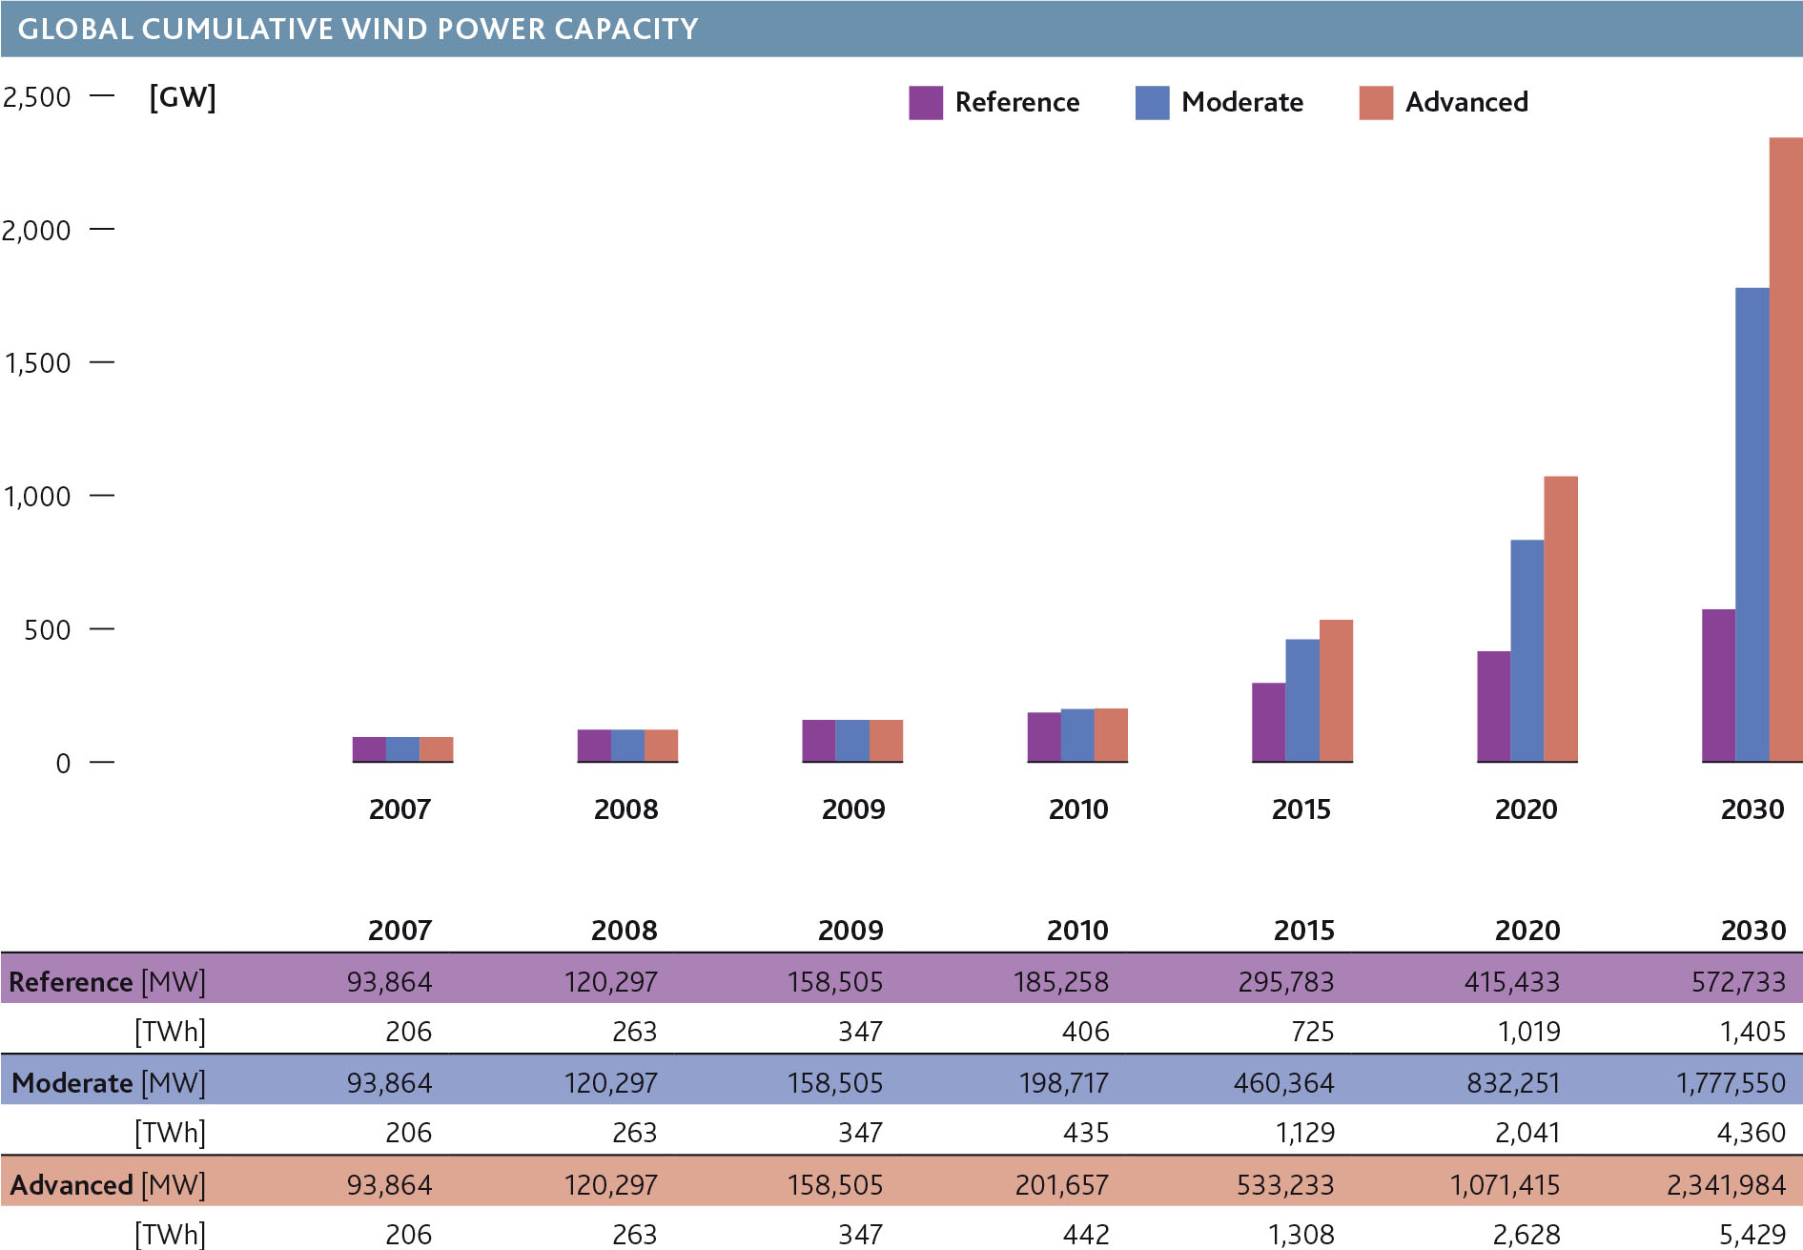
Beijing | Brussels | London

Slide 11
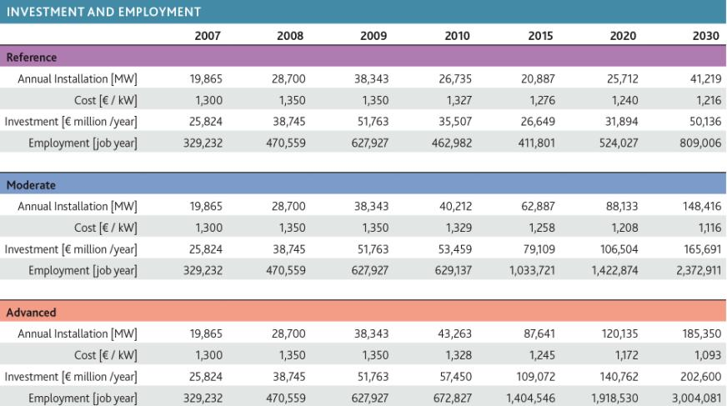
Beijing | Brussels | London
Source: http://www.gwec.net/index.php?id=181

Slide 12
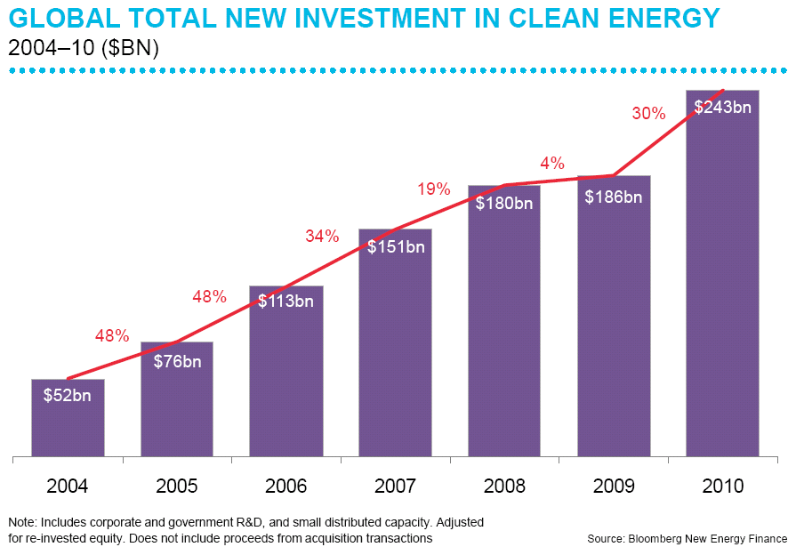
Beijing | Brussels | London
$96bn in wind power
(up by 31%)
$96bn in wind power
(up by 31%)

Slide 13
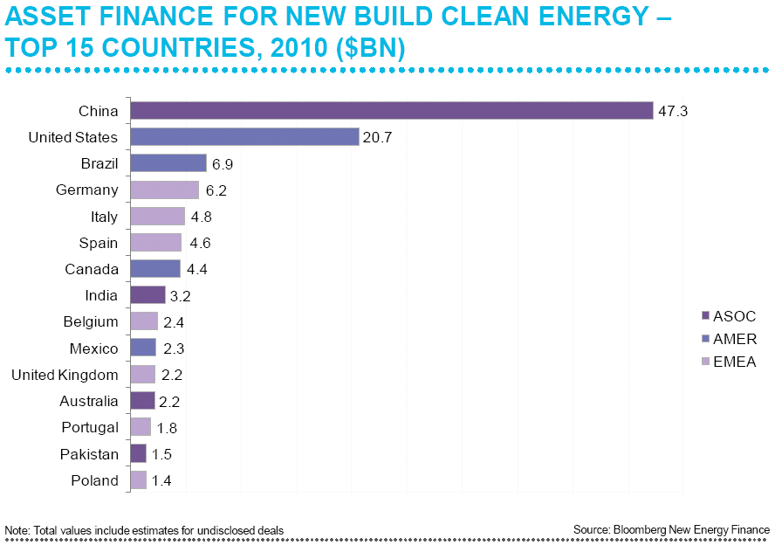
Beijing | Brussels | London

Slide 14
Beijing | Brussels | London

Slide 15
Beijing | Brussels | London
Conclusions
Market conditions:
- Asian market driving global growth
- European market solid and steady
- North America uncertain and weak at the moment
- Hopeful signs in Latin America, Africa
- Downward price pressure continues
- Trade barriers/new protectionism?
- International commodity price volatility returns with economic recovery

Slide 16
Beijing | Brussels | London
Conclusions - 2
A global climate agreement will be fundamental for wind power to achieve its maximum potential, but for the short term:
Uncertainty:
- in international political landscape
- in the future of the carbon markets
- in ‘new’ climate-related funds
Focus on national/regional legislation and markets
Market drivers all still in place, and increasingly prominent:
energy security; cost stability; macroeconomic security; local economic development and job creation; local environment and climate

Slide 17
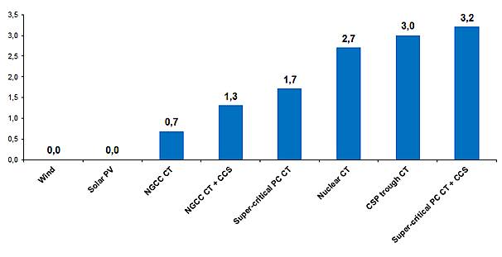
Beijing | Brussels | London
Global Water Crisis
Water Intensities of Power Generation (m3/MWh)
Source: http://www.vestas.com/en/about-vestas/strategy/political-affairs/water-energy-climate-nexus.aspx

Slide 18
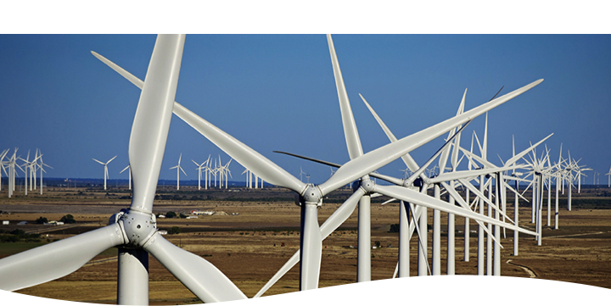
Beijing | Brussels | London
For more information:
Steve Sawyer
steve.sawyer@gwec.net
Thank you!

