Slide 1
Money Money Everywhere….. ……..Why can’t I get my project financed?
Quantum Leap in Wind Jesse Ang, June 2011

Slide 2
IFC RE & Wind Track Record
Asia Wind Market Drivers
Financing Challenges ~ Discussion

Slide 3
IFC was established in 1956 to promote private sector development and is a member of the World Bank Group
IFC
Power Sector
Wind Power
Provides equity, quasi-equity, debt, risk management and advice in 179 member countries
FY10: Committed US$12.6bn, Mobilized US$5.4bn, Portfolio US$38.9bn, 1,656 Clients, 103 Countries
Committed US$6.8bn in 205 transactions in 53 countries
Invest in generation, transmission and distribution
Many firsts: largest wind farms in LAC and SE Europe, largest solar farm in SE Asia, first merchant wind farm etc
Huge growth in all RE: wind, solar, geothermal, hydro, biomass
Committed nearly 1GW in China, Brazil, Bulgaria, Chile, Turkey, & Mexico & manufacturing capacity in China & India
Strong pipeline in India, Pakistan, Philippines, Thailand,
Technical expertise and sector knowledge/network
No. Power Transactions
% Renewable

Slide 4
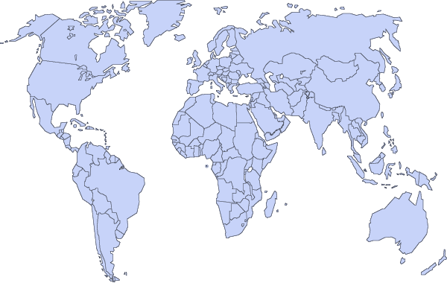
Selected recent IFC Wind Investments
Wind
Mexico
Wind
Bulgaria
Wind
China
Eurus
AES Kavarna
$75,000,000
Subordinated Debt
and Debt
Goldwind
Lead Lender of
US$375m financing
May 2010
US$52,000,000
Loan Project Financing
US$75,000,000
Equity
Lender
December 2008
October 2010
Wind
India
Gamesa
US$11,000,000
Loan Financing for
800MW manufacturing
plant
Wind
Chile
Norvind
Lender 2011
$30,750,000
Loan Project Financing
Lead Lender of
US$60.75m financing
February 2009

Slide 5
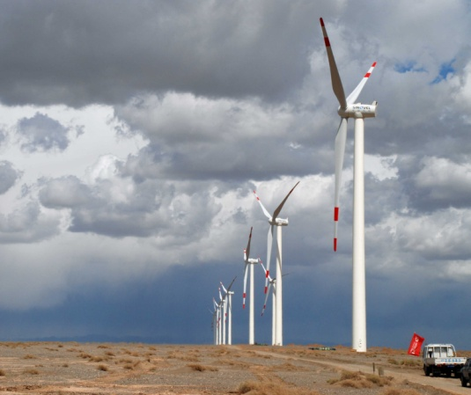
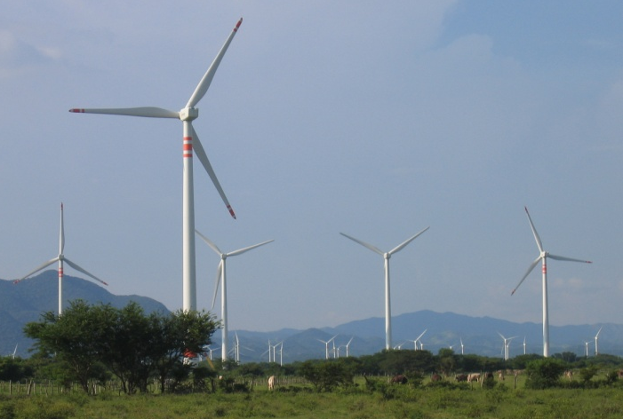
Two Case Studies of IFC’s Wind Transactions
 | Gansu Guazhou Xiehe | Eurus
Country | China | Mexico
Size | 201MW | 250MW
Sponsor | China Wind Power | Acciona (Spain)
Turbines | Sinovel 1.5MW | Acciona AW70 1.5MW
Wind | Class II | Class S
Off-Take | 5yr PPA to Sate Grid-owned Gansu Electric Power, NDRC approved tariff for 30,000 operating hours (10-15 years) | 20yr PPA to Cemex
Project Cost | US$240m | US$560m
IFC Role | Lead Lender | Lead Lender
IFC Investment | US$45m Senior Loan (12yr), $95m syndicated loan (10yr) | US$71m Senior and Mezzanine (15yr)
IFC Value Add | First project financing with int’l commercial debt syndication | Cumulative bird study, regional development

Slide 6
IFC Support to the Wind Sector
Direct investment
Manufacturing
Generation assets
Wholesale support via Financial Intermediaries
Concessionary finance (Clean Technology Fund, Canadian Funds, Global Environment Facility)
Advisory services
PPP Concession structuring

Slide 7
IFC RE Track Record
Asia Wind Market Drivers
Financing Challenges ~ Discussion

Slide 8
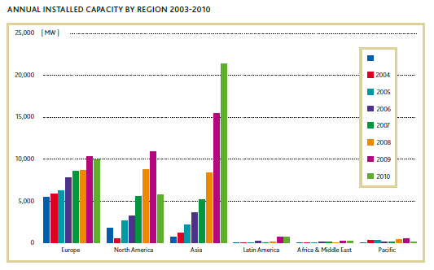
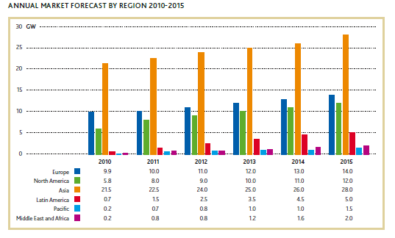
Asia has seen the most dramatic ramp up in installed wind capacity in the last decade…and its market dominance is expected to continue
Source: GWEC, Global Wind Report 2010

Slide 9
Drivers of the Wind Sector
Competitive natural resource
eg Inner Mongolia
Competitively priced equipment
Asia strength
Sufficiently high power prices and/or suitable regulations: (“TLC”)
Fundamental & defines market in region
Availability of long, cheap financing
A function of country risk, regulatory environment with TLC & creditworthy off-takers

Slide 10
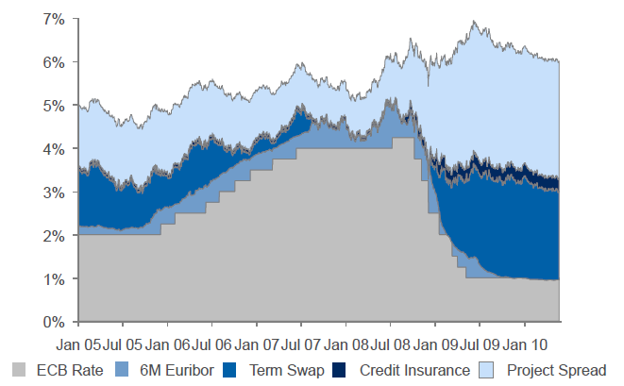
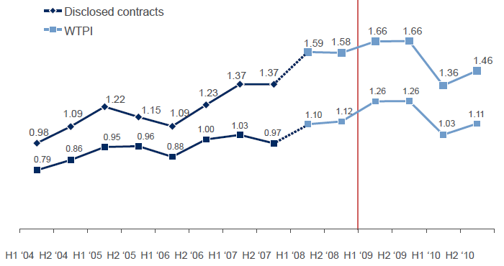
But resource is site specific and equipment and capital markets are dynamic
Cost of debt for typical EU wind farm
Turbine prices by delivery date (€ and $/MW)
Source: Bloomberg New Energy Finance

Slide 11
IFC RE Track Record
Asia Wind Market Drivers
Financing Challenges ~ Discussion

Slide 12
Key drivers of available, low cost financing
Regulatory and contractual certainty?
Wind resource certainty?
Project development certainty?
Construction certainty?
Equipment certainty?

Slide 13
Annex – support slides for discussion

Slide 14
Pros and Cons of regulatory support systems used for wind in different regions of the world
 | Feed In Tariff (“FiT”) | Portfolio Standards | Auctions | Tax Incentives
Strengths | TLC [Transparency, Longevity, Certainty] “Pull” incentive on the market. Separate FITs can allow multiple technologies to be supported and deliver diversification. | Can drive competition between RE technologies, delivering the government target at the lowest cost Can achieve an exact volume target if measured against metered output Cost efficient (depends on floor price of certificate) | Combination of market efficiency with the auction and the TLC of a guaranteed price Greatest regulatory control on expansion of RE in the system Separate auctions can allow multiple technologies to be supported and deliver diversification | Can accelerate pay down of capital cost Regulatory reliance is not long-term Public “subsidy” is delivered upfront so regulatory reliance and public liability are not long-term
Weaknesses | Getting the price right is hard! Equipment and financing prices are dynamic. A FIT that is too low will result in no investment and a FIT that is too high will give away excess returns and add to public costs. A FiTalone is not enough to spur the market – also need access to grid, bankable PPAs etc FITs create a long-term liability – suitable caps on the amounts of RE supported are needed. Sustainability depends on who is paying– are the tariffs passed through to consumers or subsidized by government funds - and how much is committed to. | Low TLC Price volatility Disadvantages some RE techs so likely to only support the single lowest cost technology for that country Complexity Bureaucracy in administering and managing the RE credit scheme Setting right % can be challenge in understanding the cost implications on the sector(this can be mitigated by setting a suitable safety valve or penalty price above which the credits cannot go) | Can be high transaction costs and long lead times associated with running the auctions Risk of non-delivery if auction entry requirements and bid scrutiny are inadequate Setting suitable bid deposit/guarantees are essential to successful outcomes Harder to achieve success in context of volatility in capital costs and/or costs of capital particularly related to currency markets (bids may become quickly unviable) | Burden is directly on govt. finances with reduced tax income Can lead to stop/start markets if support is only approved on an annual basis (such as in the US) or with economic cycles affecting the availability of profits to shelter from taxes Less operating incentive can lead to less well run generation assets May disadvantage some RE technologies
Application in wind sector | Europe China | UK USA Chile | Brazil Uruguay Argentina | USA Central America

Slide 15
If we accept reliance on national regulatory support, we need to know it is politically & financially sustainable?
Is the regulation distorting or correcting?
Implied cost of CO2?
Achieving intended consequences?
Who will bear the cost?
What is the cost?
Absolute
System wide/per kWh/per person
Can they bear the cost?
Is there a safety valve?
Is there a track record of consistent regulation

Slide 16
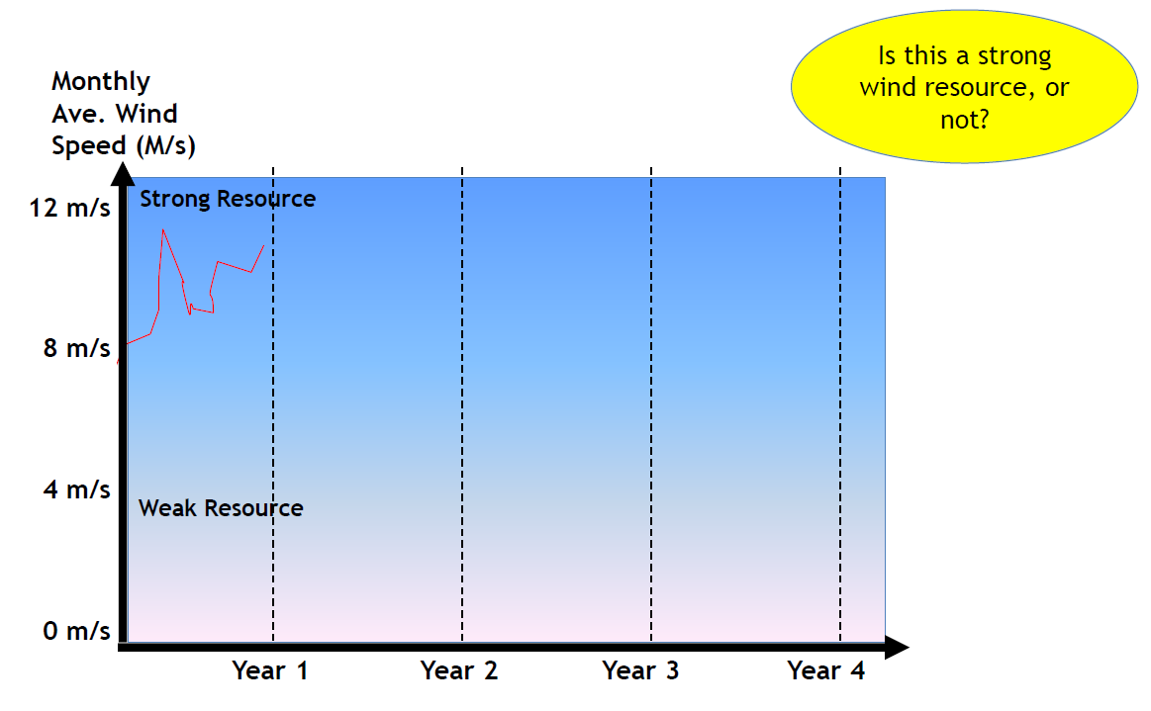
Wind resource risk?

Slide 17
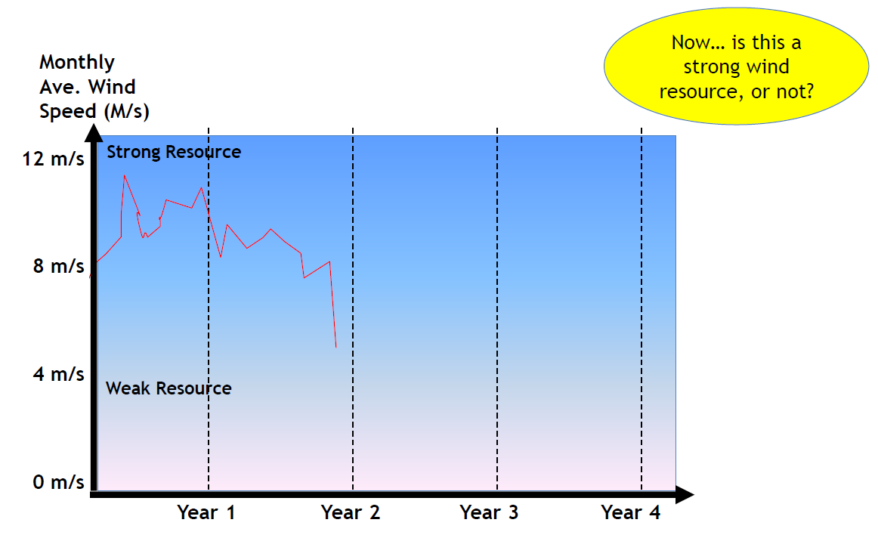
Wind resource risk?

Slide 18
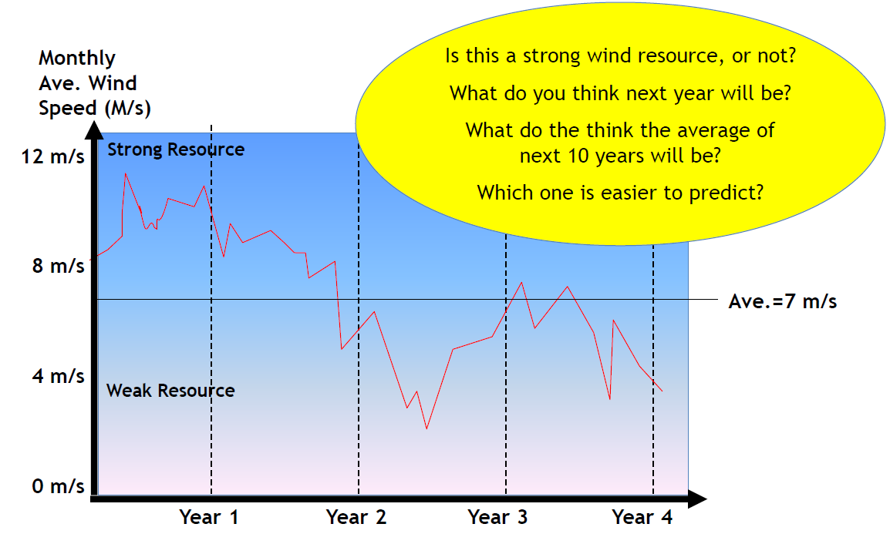
Wind resource risk?

